Slide 1
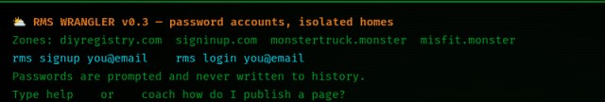
HD
Wrangler
CLIENT GUIDE
RegisterMySite client guide
REGISTERMYSITE · CLIENT TRAINING
Wrangler
WELCOME, FROM THE WALKTHROUGH
Deploy a static HTML page from HTML Studio.
The session bar above this crop is not shown. It is not needed for the welcome text.
Walkthrough on 3 October 2026, after HTML Studio gained a Send to Wrangler button.
Send
Import
Check
Deploy
RMS WRANGLER v0.3 · mode LIVE · default zone DIYREGISTRY.COM
1
This guide lives at https://registermysite.com/guides/wrangler-guide/
Notes:
Hi, and welcome. This is a guide to Wrangler, and how to deploy a static HTML page from HTML Studio. HTML Studio gained a Send to Wrangler button, and we walked through it on the third of October, 2026. Wrangler is at wrangler dot registermysite dot com. The screen says RMS Wrangler, version 0.3, mode Live, and the default zone is diyregistry dot com. The welcome line says password accounts, isolated homes, and it names four zones. This guide lives at registermysite dot com slash guides slash wrangler-guide. I'll only point at what that walkthrough actually showed.

Slide 2
HD
Wrangler
CLIENT GUIDE
RegisterMySite client guide
SEVEN STEPS
The path, in order
Send the page, import it, check it, see the zones, deploy, then open the URL.
1
Send to Wrangler
Slug bistro-lumi-re in the dialog.
Tip
Passwords are prompted and never written to history.
2
import --studio
Imports Bistro Lumière. Not rms import.
3
ls
public/ and wrangler.jsonc.
Wrangler is RMS WRANGLER v0.3, mode LIVE. The welcome also says “password accounts, isolated homes.”
4
wc public/index.html
Second line: 3100 words.
5
rms zones
Four zones. Default diyregistry.com.
6
rms deploy
Project bistro-lumi-re, zone diyregistry.com.
7
Open the URL
https://diyregistry.com/s/bistro-lumi-re/
2
Welcome text you can quote: “password accounts, isolated homes” and “Passwords are prompted and never written to history.”
Notes:
Here's the whole path before we look at a screen. In HTML Studio, press Send to Wrangler. Then, in Wrangler, run import --studio. List the folder with ls. Count the page with wc. See the zones with rms zones. Deploy with rms deploy. Then open the URL it prints. A tip from the welcome text, and it's worth keeping: passwords are prompted and never written to history. That same welcome names the four zones. diyregistry dot com, signinup dot com, monstertruck dot monster, and misfit dot monster. We'll take those steps one at a time.

Slide 3
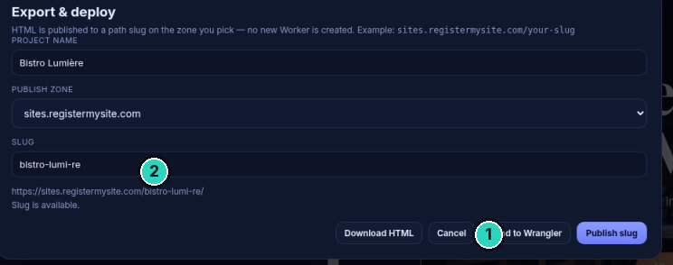
HD
Wrangler
CLIENT GUIDE
STEP 1 OF 7 · SEND
SLIDE 3 OF 12
Send to Wrangler
The slug in this dialog is what gets sent. The project name was still Bistro Lumière.
!
Warning
The header still said Ready and No project id. This dialog’s slug is what gets sent.
3
Walkthrough reply, not visible on this modal: “Sent bistro-lumi-re. Run import --studio at wrangler.registermysite.com”.
Notes:
This is the Export and deploy dialog in HTML Studio. The body says HTML is published to a path slug on the zone you pick, and no new Worker is created. The project name was still Bistro Lumière. The zone was sites dot registermysite dot com, and the slug was bistro-lumi-re. It said the slug is available. We've marked Send to Wrangler, and that slug. Warning: the header behind the modal still said Ready, and No project id. Send to Wrangler used the slug in this dialog, not a saved project id. The walkthrough reply was, Sent bistro-lumi-re, run import --studio at wrangler dot registermysite dot com. That sentence is not on the captured modal, so we haven't drawn it.

Slide 4

HD
Wrangler
CLIENT GUIDE
STEP 2 OF 7 · IMPORT
SLIDE 4 OF 12
import --studio
It imported Bistro Lumière, then printed the deploy command to run next.
!
Warning
The command is import --studio, not rms import. If you have not sent yet, there is no pending export.
4
rms import returns “Unknown rms subcommand: import”. Before Send to Wrangler: “No pending HTML Studio export. POST /api/import first.”
Notes:
In Wrangler, the command is import --studio. Not rms import. On this screen the prompt was still in the sites folder. It printed Imported, Bistro Lumière. The files line was public slash index dot html. The next line said to run rms deploy, with the project name bistro-lumi-re, and the zone diyregistry dot com. We've marked the Imported line and that next step. Warning: typing rms import returns Unknown rms subcommand, import. And if you haven't pressed Send to Wrangler yet, import --studio says there is no pending HTML Studio export. It tells you to POST slash api slash import first. We didn't fake a picture of that error. After this, the prompt is in sites slash bistro-lumi-re.

Slide 5

HD
Wrangler
CLIENT GUIDE
STEP 3 OF 7 · LIST
SLIDE 5 OF 12
ls
Two names in ~/sites/bistro-lumi-re: public/ and wrangler.jsonc.
5
Working folder after import: ~/sites/bistro-lumi-re. ls printed public/ and wrangler.jsonc.
Notes:
Next we ran ls. The prompt is now in sites slash bistro-lumi-re, which is the project folder. ls printed two names, and we've marked both. public, with a slash, is the folder that holds the page. wrangler dot jsonc is the config file sitting beside it. That's the whole listing. Nothing else was in the folder. ls does not deploy anything, and it does not change the page. It only shows what import just put there. This crop starts at the ls line, so you see the listing and not the earlier session text. The next command counts the words in public slash index dot html.

Slide 6
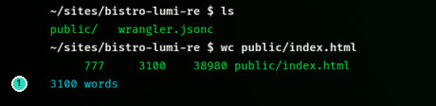
HD
Wrangler
CLIENT GUIDE
STEP 4 OF 7 · COUNT
SLIDE 6 OF 12
wc public/index.html
The line printed 777, 3100, and 38980. A second line said 3100 words.
Tip
On this product, wc prints lines, words, and bytes, in that order.
6
Printed line: 777 3100 38980 public/index.html. Second line: 3100 words. This product’s wc is lines, words, then bytes.
Notes:
Then we ran wc, on public slash index dot html, still in that same folder. The first line printed 777, then 3100, then 38980, and the file name. A second line said 3100 words. We've marked that words line. This product's wc prints lines, words, and bytes, in that order. So that is 777 lines, 3100 words, and 38980 bytes. The help text is not in this picture. The footnote has the full printed line.

Slide 7
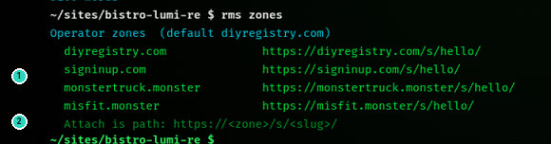
HD
Wrangler
CLIENT GUIDE
STEP 5 OF 7 · ZONES
SLIDE 7 OF 12
rms zones
Four operator zones. Attach is a path: https://<zone>/s/<slug>/.
7
Default zone diyregistry.com. Each hello URL is https://<zone>/s/hello/. Attach is path: https://<zone>/s/<slug>/.
Notes:
rms zones lists the operator zones. The heading says the default is diyregistry dot com. There are four, and we've marked the list. diyregistry dot com, signinup dot com, monstertruck dot monster, and misfit dot monster. Each one shows a hello address, with slash s slash hello on the end. The last line says attach is a path. https, then the zone, slash s slash, then the slug. We've marked that pattern too. That's how a page is attached. It is a path on the zone. It is not a new hostname under the zone.

Slide 8
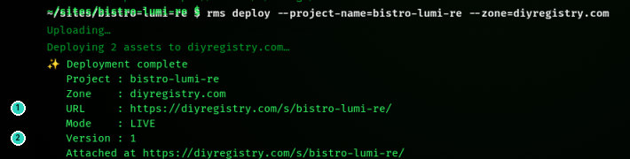
HD
Wrangler
CLIENT GUIDE
STEP 6 OF 7 · DEPLOY
SLIDE 8 OF 12
Deploy
Deployment complete. The URL is a path on diyregistry.com. Version 1.
Tip
Two assets, mode LIVE. The URL is a path, not a subdomain.
8
URL: https://diyregistry.com/s/bistro-lumi-re/ · Mode LIVE · Version 1 · Deploying 2 assets.
Notes:
The deploy command was rms deploy, project name bistro-lumi-re, zone diyregistry dot com. It said Uploading. Then, deploying 2 assets to diyregistry dot com. Then, deployment complete. The project is bistro-lumi-re. The zone is diyregistry dot com. We've marked the URL. It is https, diyregistry dot com, slash s slash, bistro-lumi-re. Mode is Live. We've also marked version 1. The last line says attached at that same URL. Tip: that's two assets, and the mode is Live. Don't publish this as a subdomain, like bistro-lumi-re dot diyregistry dot com. This deploy's URL is the path.

Slide 9
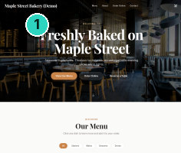
HD
Wrangler
CLIENT GUIDE
STEP 7 OF 7 · OPEN
SLIDE 9 OF 12
The live page
Maple Street Bakery (Demo). The headline is Freshly Baked on Maple Street.
9
https://diyregistry.com/s/bistro-lumi-re/ — brand Maple Street Bakery (Demo). The visitor counter is lower in the same screenshot.
Notes:
Open the URL from the deploy. It's https, diyregistry dot com, slash s slash, bistro-lumi-re, with the slash at the end. This crop is the top of that live page, so you can read it. We've marked the brand in the nav. It says Maple Street Bakery, Demo. The headline says Freshly Baked on Maple Street. Further down the same screenshot is the visitor counter. It isn't in this crop, because the capture is a tall phone-width page, and the counter sits lower. If the brand and the headline match, you're on the page this deploy just attached.

Slide 10
HD
Wrangler
CLIENT GUIDE
RegisterMySite client guide
WARNINGS
What not to mix up
Three warnings from this walkthrough. Two of them we hit before the button existed.
!
Warning
rms import is not a command. It returns “Unknown rms subcommand: import”. The command is import --studio.
!
Warning
import --studio before Send to Wrangler returns “No pending HTML Studio export. POST /api/import first.”
!
Warning
The live URL is a path on the zone, not sites.registermysite.com. That zone belongs to HTML Studio’s own publish.
10
Do not publish to a subdomain like bistro-lumi-re.diyregistry.com. This URL is https://diyregistry.com/s/bistro-lumi-re/.
Notes:
Three things are easy to mix up. We hit the first two before the Send to Wrangler button existed. First, rms import is not a command. It returns Unknown rms subcommand, import. The command is import --studio. Second, if you run import --studio before you've pressed Send to Wrangler, it finds nothing. The message is: No pending HTML Studio export. POST slash api slash import first. Third, the live URL is a path on the zone you deployed to. It is not sites dot registermysite dot com. That zone belongs to HTML Studio's own publish. Our page is on diyregistry dot com, under slash s slash bistro-lumi-re. And it is not a subdomain of that zone.

Slide 11
HD
Wrangler
CLIENT GUIDE
RegisterMySite client guide
RECAP
The commands, in order
One line each, in the order the walkthrough ran them.
1
Send to Wrangler · slug bistro-lumi-re
2
import --studio
3
ls
4
wc public/index.html
5
rms zones
6
rms deploy --project-name=bistro-lumi-re --zone=diyregistry.com
7
Open https://diyregistry.com/s/bistro-lumi-re/
11
Walkthrough on 3 October 2026, after HTML Studio gained a Send to Wrangler button.
Notes:
Here's the recap, one line at a time. In HTML Studio, Send to Wrangler, slug bistro-lumi-re. Then import --studio, which imported Bistro Lumière. Then ls, public and wrangler dot jsonc. Then wc on public slash index dot html, 3100 words. Then rms zones, four zones, default diyregistry dot com. Then rms deploy, project name bistro-lumi-re, zone diyregistry dot com. Version 1, mode Live, two assets. Then open the path on diyregistry dot com, slash s slash, bistro-lumi-re. If the header still says no project id, that's expected. The slug in the dialog is what gets sent.

Slide 12
HD
Wrangler
CLIENT GUIDE
RegisterMySite client guide
REGISTERMYSITE
Contact
If you want a hand with Send to Wrangler, or with the deploy, start here.
WEB
WRANGLER
registermysite.com
wrangler.registermysite.com
PHONE
(562) 751-4597
EMAIL
info@registermysite.com
RMS WRANGLER v0.3. Mode LIVE. Default zone DIYREGISTRY.COM.
IN PERSON
Los Angeles and Orange County
12
registermysite.com · (562) 751-4597 · info@registermysite.com · in person in Los Angeles and Orange County.
Notes:
If you'd like a hand with this, you can reach us on the web at registermysite dot com. Call 562, 751, 4597. Or email info at registermysite dot com. We also meet in person in Los Angeles and Orange County. Those are the same details on the slide. Wrangler itself stays at wrangler dot registermysite dot com, if you want to try the steps yourself. This guide stays at registermysite dot com slash guides slash wrangler-guide. You can download the PowerPoint or the PDF from the More menu. Thanks for following the walkthrough.

