Slide 1
HD
SVG Studio
CLIENT GUIDE
RegisterMySite client guide
REGISTERMYSITE · CLIENT TRAINING
SVG Studio
WHAT THE HEADER SAYS
Workers AI · live preview · production markup.
Workers AI, a live preview, and markup you can download. The preview is the check.
The preview is the check. A caption can describe a loaf while the picture is still three bars.
Walkthrough on 3 October 2026. The empty preview says the SVG streams in. The bakery page is the one this guide follows.
Preview
Loaf
Publish
Live tab
svg-studio.registermysite.com
1
This guide lives at https://registermysite.com/guides/svg-studio-guide/ . Open the product at https://svg-studio.registermysite.com .
Notes:
Hi, and welcome. This is SVG Studio, at svg studio dot registermysite dot com. The header reads SVG Studio. The line under it says Workers AI, live preview, production markup. We walked through it on the third of October, 2026, to make a bakery favicon for a page built in HTML Studio. When the studio opens, the preview pane is empty, and it says the preview appears here as the SVG streams in. This guide lives at registermysite dot com slash guides slash svg studio guide. A short recording of that walk is on the recording page. I will only describe what the pictures showed.

Slide 2
HD
SVG Studio
CLIENT GUIDE
RegisterMySite client guide
FIVE STEPS
The path, in order
Send a prompt, read the preview, download only a loaf, publish, then check the live tab.
1
Open SVG Studio
Send a prompt. The Favicon chip is not the control.
2
Read the preview
The caption can say loaf while the picture is three bars.
3
Download the loaf
Download SVG or Copy SVG, only when the preview is a loaf.
4
Publish the page
HTML Studio. Zone sites.registermysite.com. Slug bistro-lumi-re.
5
Check the live tab
The header stays words. The mark is the favicon, not a logo.
Tip
The Favicon chip still says “S monogram at 32px”. It was not the control used on this walk.
2
No still shows a favicon link in Advanced Code. Generate until the preview is a loaf, download or copy, publish, then check the live tab.
Notes:
Here is the path, before the pictures. One, open SVG Studio and send a prompt. The buttons are Download SVG, Copy SVG, Copy data URI, Light canvas, Reset, and Send. Two, read the preview, not only the caption. The Favicon chip still says S monogram at 32 pixels, and that chip was not the control we used. Three, when the preview is a loaf, use Download SVG or Copy SVG. Four, publish the HTML Studio project. Five, check the live tab. There is no still of a favicon link inside Advanced Code, so that step stays a footnote, not a picture.

Slide 3
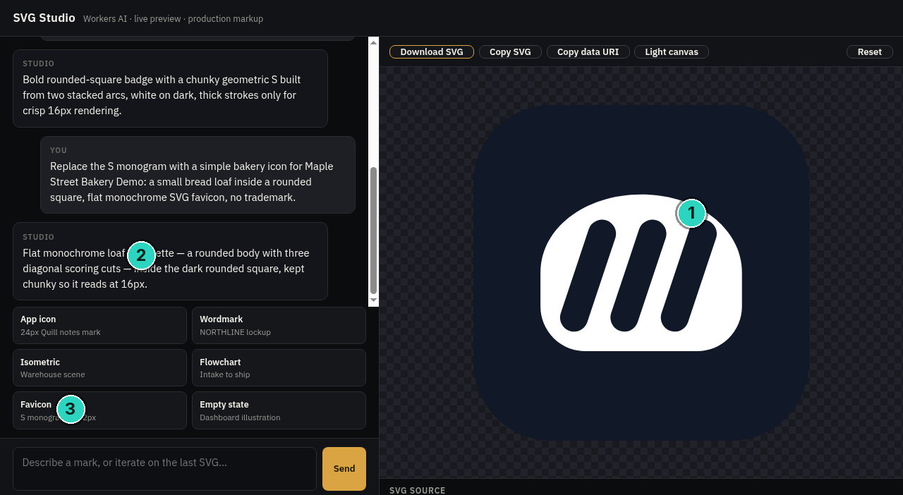
HD
SVG Studio
CLIENT GUIDE
STEP 2 OF 5 · READ PREVIEW
SLIDE 3 OF 8
The first preview is not a loaf
The caption describes a loaf. The preview is three thick diagonal bars in a dark rounded square.
!
Warning
Read the preview, not only the caption. Three bars are not a loaf, even when the studio text says they are.
3
Prompt asked for a loaf. Studio text describes a loaf. Preview: three thick diagonal bars in a dark rounded square. favicon.svg on disk is not this preview.
Notes:
This is the first send. The prompt asks to replace the S monogram with a small bread loaf, in a rounded square, flat and monochrome, with no trademark. The studio caption then describes a loaf. It says a rounded body with three diagonal scoring cuts, inside the dark rounded square. Look at the preview. It is a dark rounded square, and the mark is three thick diagonal bars in a white rounded shape. That is not a bread loaf. A warning: read the preview, not only the caption. A loaf file named favicon.svg that was already on disk is not this preview. Do not treat it as the studio output.

Slide 4
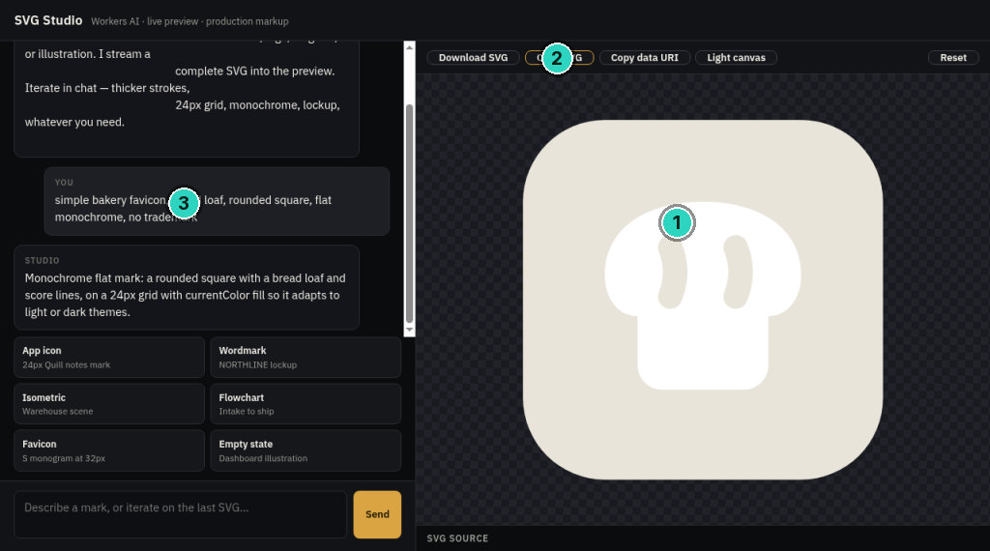
HD
SVG Studio
CLIENT GUIDE
STEP 3 OF 5 · DOWNLOAD
SLIDE 4 OF 8
The loaf mark
A later send. Pale rounded square, a white loaf, two score marks. Copy SVG is the highlighted button.
Tip
Copy SVG is highlighted. The download is 24 by 24, currentColor square, white loaf, two score strokes. Not favicon.svg.
4
Studio: “Monochrome flat mark: a rounded square with a bread loaf and score lines, on a 24px grid with currentColor fill so it adapts to light or dark themes.” Download: favicon-from-studio.svg matches this loaf.
Notes:
A later send got a loaf. The prompt on screen says, simple bakery favicon, bread loaf, rounded square, flat monochrome, no trademark. The studio reply says a rounded square with a bread loaf and score lines, on a 24 pixel grid, using current color so it adapts. The preview is a pale rounded square, a white bread loaf, and two score marks. Copy SVG is the highlighted button. The downloaded file is 24 by 24. Its title is Bakery favicon, bread loaf in a rounded square. Current color for the square, white for the loaf, and two score strokes. That file matches this preview. It is not the first picture.

Slide 5
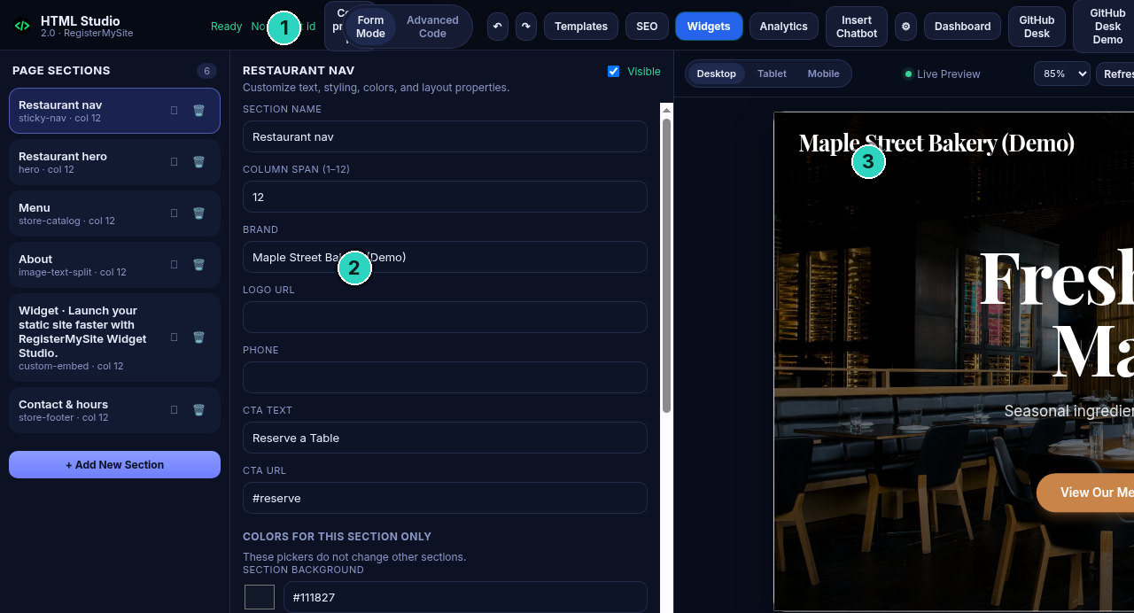
HD
SVG Studio
CLIENT GUIDE
STEP 4 OF 5 · PUBLISH
SLIDE 5 OF 8
HTML Studio, no project id
This is not a login wall. The header says Ready, and No project id. The brand is Maple Street Bakery (Demo).
!
Warning
Not a login wall. No project id is still on screen. The Advanced Code crop does not show the favicon link.
5
Shot 03: Ready, No project id, brand Maple Street Bakery (Demo). The Advanced Code crop (menu handlers, renderMenu, updateCartUI) has no link rel icon. That crop is not shown here.
Notes:
This is HTML Studio, at html studio dot registermysite dot com. It is not a login wall. The header says Ready, and No project id. The brand field says Maple Street Bakery, Demo, and the preview header is those same words. A separate crop of Advanced Code sits at the end of the HTML skeleton. You can read the menu handlers, render menu, and update cart UI. There is no link rel icon in that crop. Do not treat that crop as the favicon embed. The stills never show the icon link being added. The picture here is the form, not that code.

Slide 6
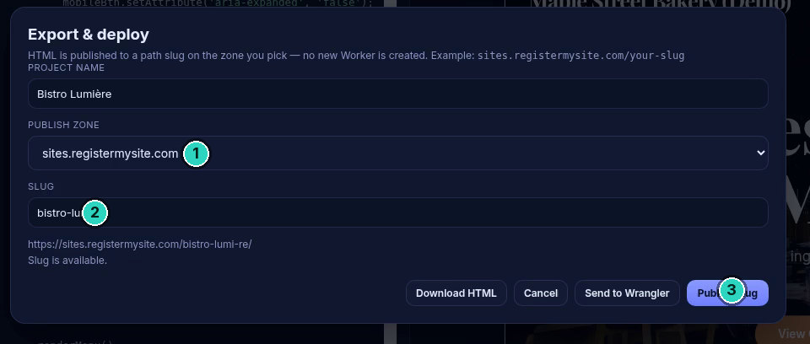
HD
SVG Studio
CLIENT GUIDE
STEP 4 OF 5 · PUBLISH
SLIDE 6 OF 8
Publish to bistro-lumi-re
Export and deploy, from the recording. Zone, slug, and four buttons. No toast was captured.
!
Warning
No toast was captured. Do not assume the dialog itself is the confirmation.
6
Buttons on this dialog: Download HTML, Cancel, Send to Wrangler, Publish slug. Zone sites.registermysite.com. Slug bistro-lumi-re. No toast in the recording.
Notes:
Publish is the Export and deploy dialog. This frame is from the recording. The project name is Bistro Lumière. The publish zone is sites dot registermysite dot com. The slug is bistro hyphen lumi hyphen re. Under it, the address is sites dot registermysite dot com slash bistro hyphen lumi hyphen re, and the line says the slug is available. The buttons are Download HTML, Cancel, Send to Wrangler, and Publish slug. No toast was captured after this dialog. We are not inventing one. The recording then shows a blank tab, and no confirmation message.

Slide 7
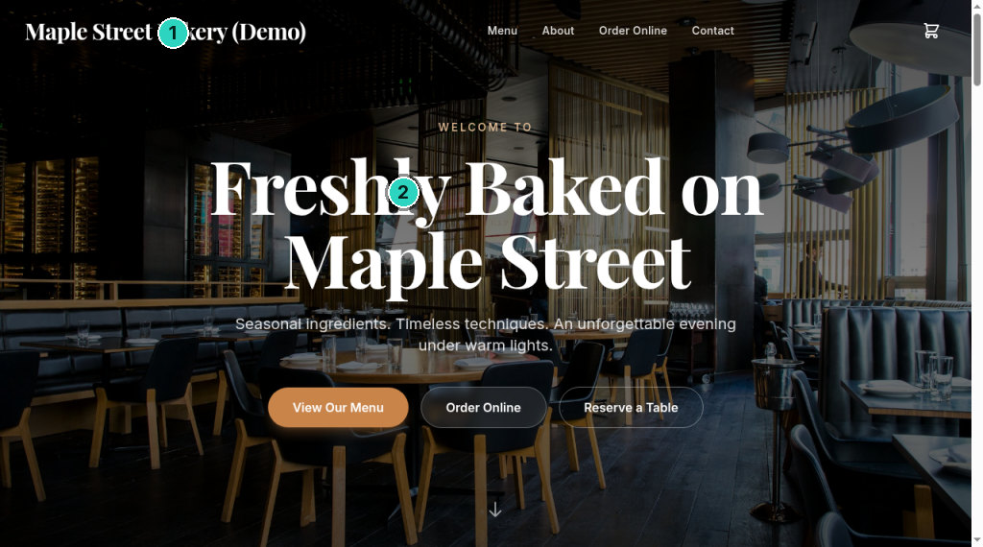
HD
SVG Studio
CLIENT GUIDE
STEP 5 OF 5 · LIVE TAB
SLIDE 7 OF 8
The live page, and the tab
The header is the words Maple Street Bakery (Demo). The hero is Freshly Baked on Maple Street. The loaf is not in the header.
!
Warning
Do not draw a loaf into the tab. Shot 05’s tab icon is three bars. Shot 08 does not show a readable loaf.
7
https://sites.registermysite.com/bistro-lumi-re/ . Header text did not change. Stills do not show a readable loaf in the tab. Ryan confirmed the bread mark on that URL.
Notes:
Ryan opened the live page at sites dot registermysite dot com slash bistro hyphen lumi hyphen re. The page header is the words Maple Street Bakery, Demo. It is not an image of the loaf. The hero reads Freshly Baked on Maple Street. The bread mark belongs in the tab, as the favicon, not in that header. In the still of this URL, the tab icon is a small dark rounded square with three light bars, like the first preview. A later tab shot does not show a readable loaf. Ryan confirmed the bread mark on that URL. The page header itself did not change. We are not drawing a fake icon.

Slide 8
HD
SVG Studio
CLIENT GUIDE
RegisterMySite client guide
REGISTERMYSITE
Contact
The same desk that publishes this guide. Web, phone, email, and in person in Los Angeles and Orange County.
WEB
SVG STUDIO
registermysite.com
svg-studio.registermysite.com
PHONE
(562) 751-4597
EMAIL
info@registermysite.com
Live page from this walk: sites.registermysite.com/bistro-lumi-re/
IN PERSON
Los Angeles and Orange County
8
registermysite.com · (562) 751-4597 · info@registermysite.com · in person in Los Angeles and Orange County.
Notes:
If you want a hand with a mark, or with publishing the page, start here. The web is registermysite dot com. The phone is 562, 751, 4597. Email info at registermysite dot com. We also meet in person in Los Angeles and Orange County. SVG Studio stays at svg studio dot registermysite dot com. The live page from this walk is sites dot registermysite dot com slash bistro hyphen lumi hyphen re. This guide stays at registermysite dot com slash guides slash svg studio guide. You can download the PowerPoint or the PDF from the More menu. Thanks for following the walkthrough.

