Slide 1
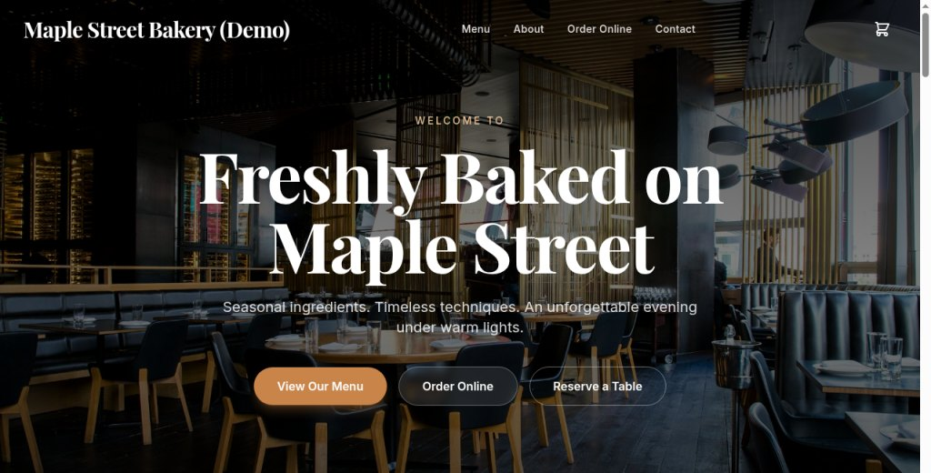
HD
HTML Studio
CLIENT GUIDE
RegisterMySite client guide
REGISTERMYSITE · CLIENT TRAINING
sites.registermysite.com/maple-street-bakery-studio-guide/
HTML Studio
A step-by-step guide to pick a template, edit it, add a visitor counter, save a project, and publish it on a zone.
Template
Edit
Counter
Save
Publish
Walkthrough recorded 3 October 2026. Free plan. Nothing on these slides was purchased.
1
This guide lives at https://registermysite.com/guides/html-studio-guide
Notes:
Hi, and welcome. This is a step-by-step guide to HTML Studio. We'll pick a template, edit it, add a visitor counter, save a project, and publish it on a zone. The studio is at html-studio dot registermysite dot com, and the header says HTML Studio 2.0 RegisterMySite. We recorded this walkthrough on the third of October, 2026. This guide lives at registermysite dot com slash guides slash html-studio-guide. I'll point only at what that walkthrough actually showed, and we'll stay on the Free plan the whole way.

Slide 2
HD
HTML Studio
CLIENT GUIDE
RegisterMySite client guide
SIX STEPS
The path, in order
Six steps. Do them in this order, and you end on a page you can open.
1
Account
2
Template
3
Edit
Create an account and verify the email.
Choose Bistro Lumière. Use in Studio.
Set the brand and the hero heading.
4
Counter
5
Save
6
Publish
Add the visitor counter. Type: counter.
Create the project from the canvas.
Publish the slug, then open the page.
Tip
Stay on the Free plan. This walkthrough did not buy anything.
2
HTML Studio is https://html-studio.registermysite.com. The header says HTML Studio 2.0 RegisterMySite.
Notes:
Here's the whole path before we touch a screen. One, create an account. Two, choose a template. Three, edit the brand and the hero heading. Four, add a visitor counter. Five, save the canvas as a project. Six, publish it and visit the page. A tip, and it's worth keeping: stay on the Free plan. This walkthrough did not buy anything. You can follow all six steps without a paid plan. HTML Studio itself is at html-studio dot registermysite dot com, and the header there says HTML Studio 2.0 RegisterMySite.

Slide 3
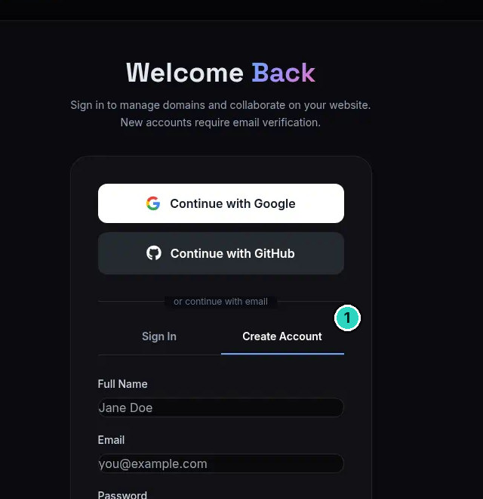
HD
HTML Studio
CLIENT GUIDE
STEP 1 OF 6 · ACCOUNT
SLIDE 3 OF 13
Create the account
Sign-up is the Create Account tab at registermysite.com/login.
!
Warning
New accounts must click the verification link within 1 hour, and the link arrives by email.
3
The name and email in the picture are the form's sample placeholders, not an account from this walkthrough.
Notes:
Step one is the account. Go to registermysite dot com slash login, and open the Create Account tab. That's the tab we've marked. The login page says, new accounts require email verification. After signup, the page said: Account created. We've sent a verification link to the email. Please check your inbox and your spam, and click the link within one hour. So here's the warning. New accounts must click that verification link within one hour, and the link arrives by email. The name Jane Doe, and the address you at example dot com, are the form's own sample placeholders. They are not our account.

Slide 4
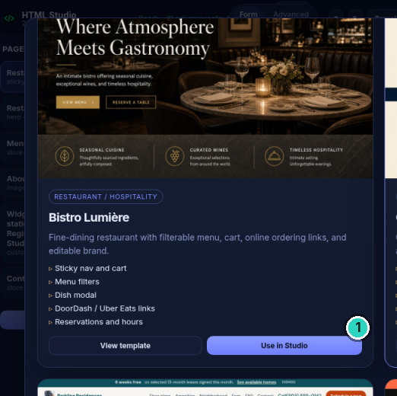
HD
HTML Studio
CLIENT GUIDE
STEP 2 OF 6 · TEMPLATE
SLIDE 4 OF 13
Choose Bistro Lumière
Category Restaurant / Hospitality. Use in Studio loads it on the canvas.
Tip
View template only previews it. Use in Studio loads it on the canvas.
4
Card text: “Fine-dining restaurant with filterable menu, cart, online ordering links, and editable brand.” Original hero line: “Where Atmosphere Meets Gastronomy”.
Notes:
Step two, choose the template. The card we used is Bistro Lumière, in the category Restaurant, Hospitality. The card says: fine-dining restaurant with filterable menu, cart, online ordering links, and editable brand. On the card preview, the original hero line is Where Atmosphere Meets Gastronomy. There are two buttons under that list. View template only previews the page. Use in Studio, the button we've marked, loads that template onto the canvas. That's the one to click. Once it loads, you're on the canvas and ready to edit the brand.

Slide 5
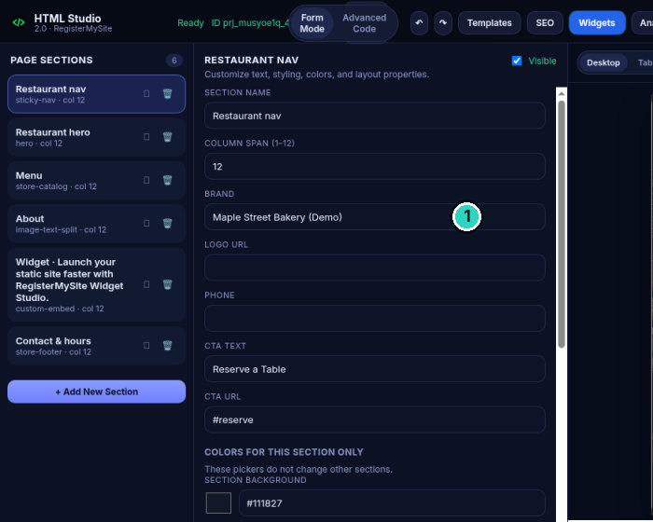
HD
HTML Studio
CLIENT GUIDE
STEP 3 OF 6 · EDIT
SLIDE 5 OF 13
Set the brand
The preview sticky nav updates to Maple Street Bakery (Demo).
5
Other fields were left as the template: CTA TEXT “Reserve a Table”, CTA URL #reserve. The header shows Ready and a project id. The crop truncates it.
Notes:
Now we edit. Open the Restaurant nav section, and set the BRAND field to exactly Maple Street Bakery, Demo, with that capitalisation and the word Demo in parentheses. We've marked the field. The sticky nav in the preview updates to the same name. We left the other fields as the template wrote them. CTA text stayed Reserve a Table, and the CTA URL stayed hash reserve. On this screen the header says Ready, plus a project id. The crop cuts that id short. The full id is written when we save the project. Don't try to read the rest of it off this picture.

Slide 6
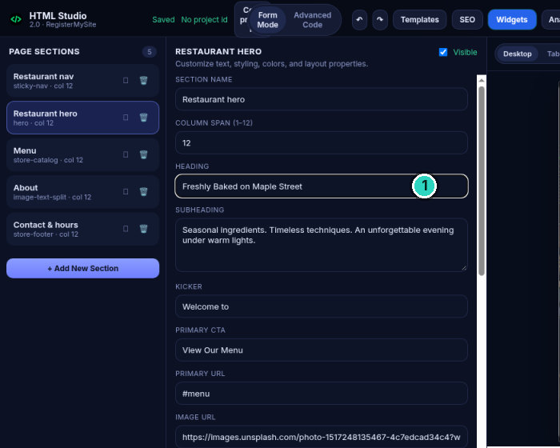
HD
HTML Studio
CLIENT GUIDE
STEP 3 OF 6 · EDIT
SLIDE 6 OF 13
Change the hero heading
HEADING is exactly Freshly Baked on Maple Street.
Tip
The subheading and kicker were left as the template wrote them.
6
Subheading left as “Seasonal ingredients. Timeless techniques. An unforgettable evening under warm lights.” Kicker left as “Welcome to”. This crop’s header says No project id.
Notes:
Stay in the editor and open Restaurant hero. Set the HEADING field to exactly Freshly Baked on Maple Street. That's the field we've marked. A tip from this step: we left the subheading and the kicker as the template wrote them. The subheading is still Seasonal ingredients. Timeless techniques. An unforgettable evening under warm lights. The kicker is still Welcome to. Look at the header on this crop. It says Saved, and it says No project id. A template sitting on the canvas is not a saved project until you create one. We'll do that two steps from now.

Slide 7
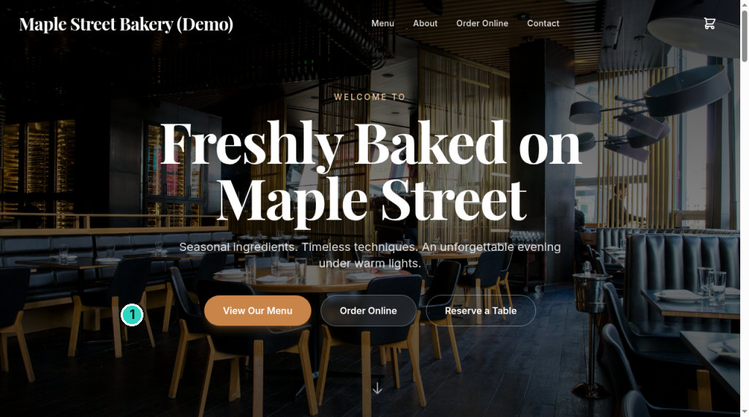
HD
HTML Studio
CLIENT GUIDE
STEP 3 OF 6 · EDIT
SLIDE 7 OF 13
The rest is still the template
The brand and one heading changed. The sample page underneath did not.
!
Warning
Menu, phone, address, and photos are still Bistro Lumière sample content until you edit those sections.
7
This crop is the hero. Menu, phone, and address sit further down the page and are still sample content. The phone is (555) 123-4567, shown on the counter slide.
Notes:
Before we add anything else, look at what we did not change. This is the top of the live page, and we've marked the photograph. That photo is still the Bistro Lumière sample. Here's the warning. The menu, the phone, the address, and the photos stay as Bistro Lumière sample content until you edit those sections. Changing the brand and one heading does not replace the rest of the template. The footer still has sample data, including a phone number and a Bistro-style address. We'll point at that phone when we reach the counter.

Slide 8
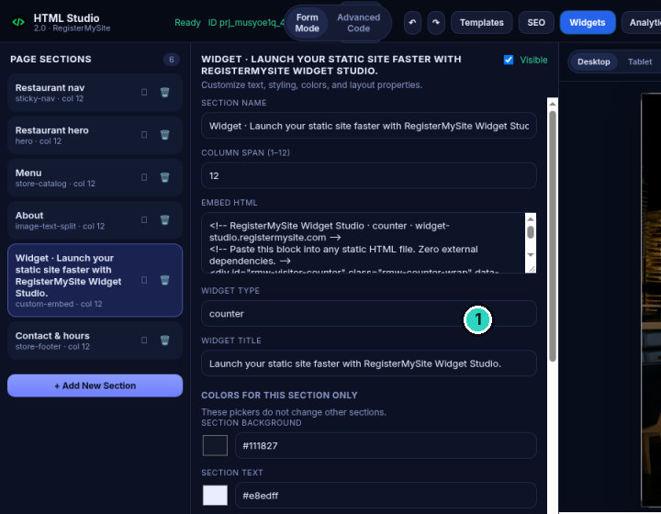
HD
HTML Studio
CLIENT GUIDE
STEP 4 OF 6 · COUNTER
SLIDE 8 OF 13
Add the visitor counter
WIDGET TYPE reads counter. That is the widget we exported.
Tip
If the type does not say counter, you exported a different widget.
8
The embedded HTML comment includes “RegisterMySite Widget Studio - counter”. Exported with “Export to HTML Studio” and “Send embed back to HTML Studio”. No Widget Studio screenshot was captured.
Notes:
Next, the visitor counter. We built it in Widget Studio, at widget-studio dot registermysite dot com. We don't have a picture of Widget Studio, so this slide shows the result inside HTML Studio, not a drawing of that other screen. Over there, the buttons we used were Export to HTML Studio, and Send embed back to HTML Studio. Back here, the section title starts Widget, Launch your static site faster with RegisterMySite Widget Studio. The embedded HTML comment includes RegisterMySite Widget Studio, counter. We've marked WIDGET TYPE. It reads counter. Tip: if the type does not say counter, you exported a different widget.

Slide 9
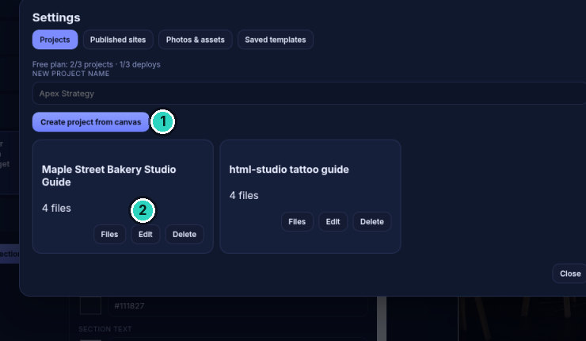
HD
HTML Studio
CLIENT GUIDE
STEP 5 OF 6 · SAVE
SLIDE 9 OF 13
Save the project
Free plan on this screen: 2/3 projects and 1/3 deploys.
!
Warning
Until you do this, the header can say “No project id”.
9
Other card “html-studio tattoo guide” was already on the account, not part of this walkthrough. Full project id recorded: prj_musyoe1q_4g4822g3j4. Header crops show “ID prj_musyoe1q_4…” only.
Notes:
Save the project, or the canvas never gets an id. Open Settings from the studio, and stay on the Projects tab. It says Free plan, two of three projects, and one of three deploys. Leave that line in view. Click Create project from canvas. That's mark one. A card appears: Maple Street Bakery Studio Guide, with four files, and Files, Edit, and Delete. That's mark two. Warning: until you do this, the header can say No project id. The other card, html-studio tattoo guide, was already on the account. It isn't part of this walkthrough. The full project id is in the footnote. The header crops only show the start of it.

Slide 10
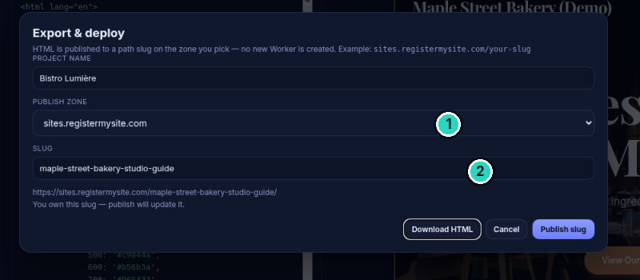
HD
HTML Studio
CLIENT GUIDE
STEP 6 OF 6 · PUBLISH
SLIDE 10 OF 13
Name the zone and the slug
No new Worker is created. The public URL uses the slug.
Tip
“You own this slug — publish will update it.”
10
Project name in this dialog still said Bistro Lumière. The public URL uses the slug. “HTML is published to a path slug on the zone you pick — no new Worker is created.”
Notes:
Open the dialog from the Export and Deploy button. The title is Export and deploy. The body says HTML is published to a path slug on the zone you pick, and no new Worker is created. We've marked the zone and the slug. The zone is sites dot registermysite dot com. The slug is maple-street-bakery-studio-guide. Under the URL, the dialog says you own this slug, publish will update it. Download HTML saves a file. Publish slug is the button that publishes. Cancel does not publish. The project name in this dialog still said Bistro Lumière. The public URL uses the slug, not that name.

Slide 11
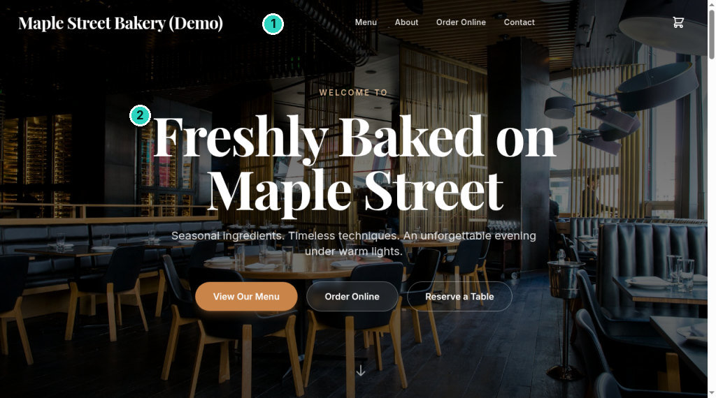
HD
HTML Studio
CLIENT GUIDE
STEP 6 OF 6 · PUBLISH
SLIDE 11 OF 13
Open the published page
https://sites.registermysite.com/maple-street-bakery-studio-guide/
11
Confirmed on the live page: nav brand “Maple Street Bakery (Demo)” and headline “Freshly Baked on Maple Street”.
Notes:
After Publish slug, open the page. The address is https://sites.registermysite.com/maple-street-bakery-studio-guide/ with the slash at the end. We've marked the two edits you should see straight away. In the nav, the brand reads Maple Street Bakery, Demo. The headline reads Freshly Baked on Maple Street. If those two match, the slug published the project you saved. Don't stop at the headline. The rest of the page can still be the template, The next slide is the counter, still on that same live page.

Slide 12
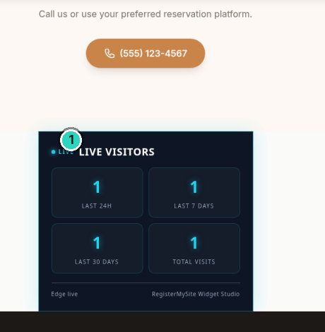
HD
HTML Studio
CLIENT GUIDE
STEP 6 OF 6 · PUBLISH
SLIDE 12 OF 13
Find the visitor counter
LIVE VISITORS, four boxes. In this screenshot each box shows 1.
!
Warning
The phone number above it is still the template’s (555) 123-4567.
12
Each box shows 1 in this screenshot only. Do not read that as a typical count. Labels on screen: LAST 24H, LAST 7 DAYS, LAST 30 DAYS, TOTAL VISITS.
Notes:
Scroll the live page until you find the visitor counter. It's labeled Live Visitors, and we've marked it. There are four boxes: last 24 hours, last 7 days, last 30 days, and total visits. In this screenshot, each box shows 1. That is only what was on the screen when we captured it. It is not a typical count, and there is nothing else on the screen to explain the number. Warning: the phone number above the widget is still the template's, 555, 123, 4567. The footer still has other Bistro-style sample data too, including the address. Changing the brand and one heading did not replace the rest of the template.

Slide 13
HD
HTML Studio
CLIENT GUIDE
RegisterMySite client guide
RECAP
The six steps, again
1
Create the account and click the verification link within one hour.
CONTACT
Want a hand with this?
2
Choose Bistro Lumière and click Use in Studio.
3
Set the brand and the hero heading. The rest is still the template.
WEB
registermysite.com
Add the visitor counter and check the type says counter.
PHONE
4
(562) 751-4597
EMAIL
5
Save the project from the canvas so the header has a project id.
info@registermysite.com
IN PERSON
6
Publish the slug and open the live page.
Los Angeles and Orange County
13
Walkthrough recorded 3 October 2026. Contact is registermysite.com, (562) 751-4597, info@registermysite.com, in person in Los Angeles and Orange County.
Notes:
That's the whole path, one line at a time. Create the account, and click the verification link within one hour. Choose Bistro Lumière, and click Use in Studio. Set the brand and the hero heading, and remember the rest is still the template. Add the visitor counter, and check the type says counter. Save the project from the canvas, so the header has a project id. Publish the slug, and open the live page. If you'd like a hand with any of that, you can reach us at registermysite dot com, call 562, 751, 4597, or email info at registermysite dot com. We also meet in person in Los Angeles and Orange County. Thanks for following the walkthrough.

