Slide 1
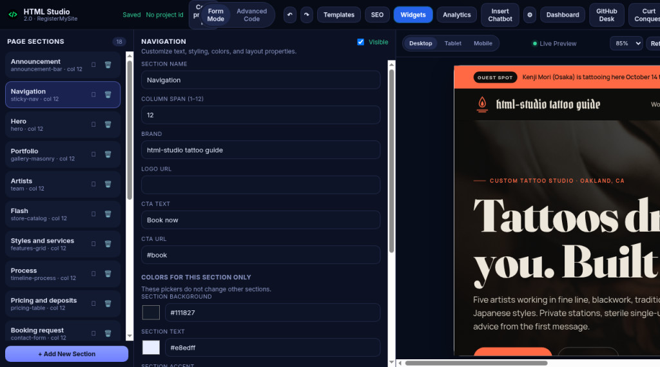
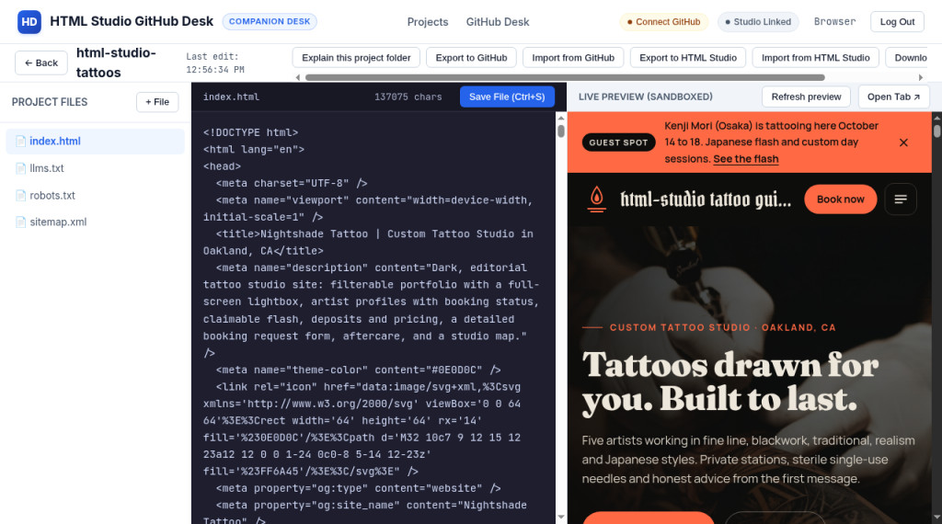
HD
HTML Studio GitHub Desk
RegisterMySite client guide
COMPANION DESK
html-studio.registermysite.com
REGISTERMYSITE CLIENT GUIDE
Put your HTML Studio site into GitHub Desk
Import from HTML Studio ↓
github.registermysite.com
Move a page you designed into a project folder you can open, edit, preview and export back.
HTML Studio
→
Widget Studio
→
GitHub Desk
Demo business: the Nightshade Tattoo template, renamed “html-studio tattoo guide”. Every screen is from our real run.
Notes:
Hi, and welcome. In this guide I'll show you how to take a page you designed in HTML Studio and move it into GitHub Desk, as a project folder you can open, edit and preview. Everything you'll see comes from a real run with our demo business. We started from the Nightshade Tattoo template and renamed the brand to html-studio tattoo guide. Behind is the page in HTML Studio, and in front is the same page after we imported it into GitHub Desk.

Slide 2
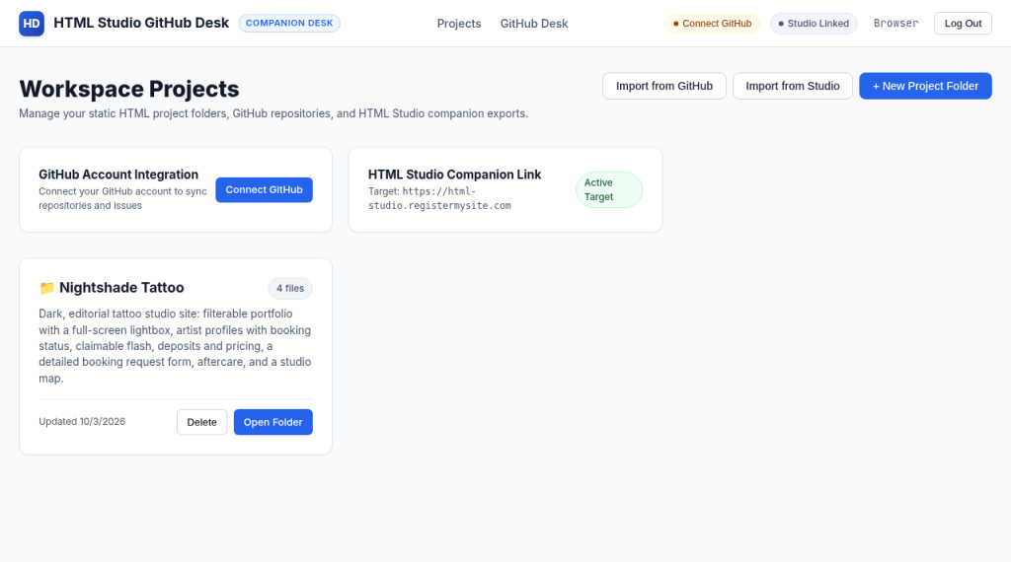
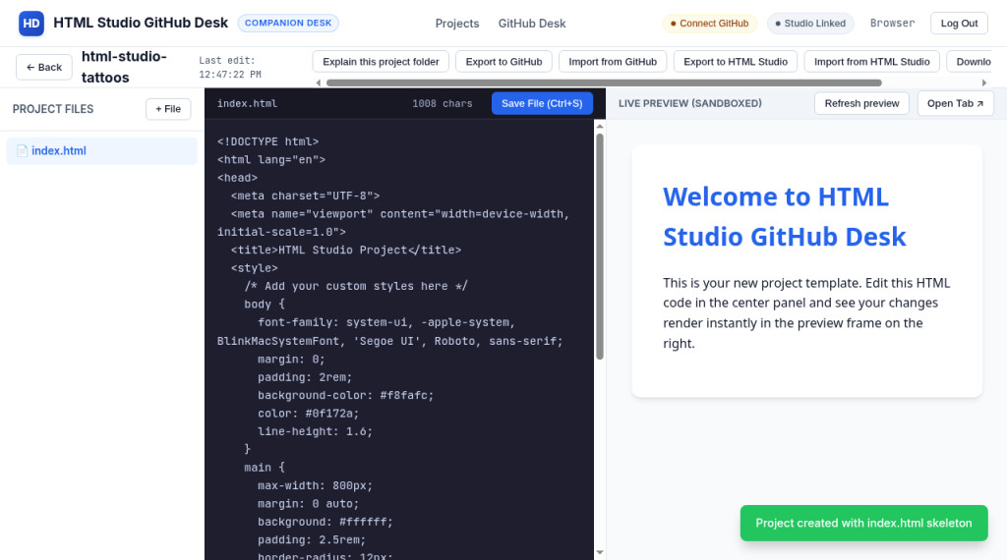
HD
HTML Studio GitHub Desk
RegisterMySite client guide
COMPANION DESK
WHAT IT IS
A companion desk for HTML Studio projects
github.registermysite.com
github.registermysite.com
5
2
1
3
4
1
Project folders. Each site lives in its own folder.
2
Import from HTML Studio. Bring a Studio project in by its id.
3
HTML editor. Edit index.html and save.
4
Live preview. See changes beside the code.
5
Export back. Export to HTML Studio when you’re done.
Notes:
So what is GitHub Desk? It's a light companion desk for your HTML Studio projects. Number one, your work lives in project folders, and New Project Folder makes a fresh one. Two, Import from Studio brings an HTML Studio project in. Three, each folder opens in an HTML editor. Four, a live preview sits right beside the code, so you see your changes straight away. And five, Export to HTML Studio sends your work back again.

Slide 3
HD
HTML Studio GitHub Desk
RegisterMySite client guide
COMPANION DESK
THE JOURNEY
Seven steps, from sign-up to an editable folder
HTML STUDIO
HTML STUDIO
HTML STUDIO
WIDGET STUDIO
HTML STUDIO
GITHUB DESK
GITHUB DESK
1
2
3
4
5
6
7
Sign up
Pick the template
Rename the brand
Add a widget
Save as a project
Create a folder
Import by id
name, email, password
Nightshade Tattoo
html-studio tattoo guide
Visitor Counter, exported in
gets a project id (prj_…)
html-studio-tattoos
paste the project id
Why the id matters: GitHub Desk imports by project id. Step five creates that id, so don’t skip it.
Notes:
Here's the whole trip on one slide, in seven steps. One, sign up for HTML Studio. Two, pick the Nightshade Tattoo template. Three, rename the brand in the sticky navigation. Four, make a Visitor Counter in Widget Studio and export it into that page. Five, save the canvas as a project, so it gets a project id. Six, create a project folder in GitHub Desk called html-studio-tattoos. And seven, import the page using that project id. The bar along the bottom of each slide shows which step we're on.

Slide 4
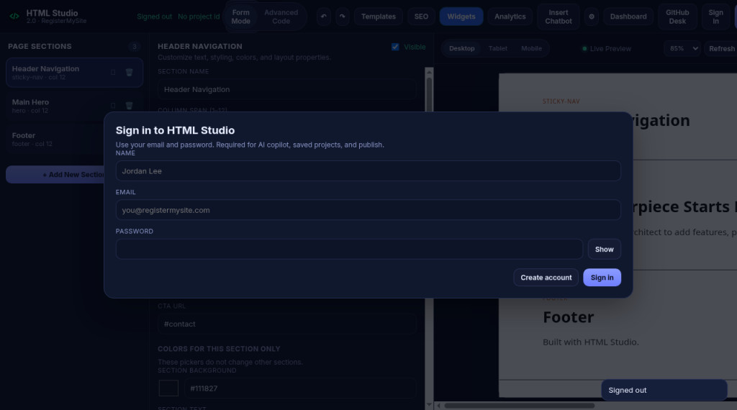
HD
HTML Studio GitHub Desk
STEP 1 OF 7 · HTML Studio
COMPANION DESK
STEP 1
html-studio.registermysite.com
Sign up for HTML Studio
1
Name. Your name or business name.
2
Email. We used a Gmail plus address (below).
1
2
3
Password. Never shown in this guide. Keep yours private.
3
4
Create account. In our run there was no verification email. We were signed straight in.
4
Demo email: registermysite.com+github-desk-demo@gmail.com. Use the same account later in GitHub Desk.
1
Sign up
2
Template
3
Brand
4
Widget
5
Project id
6
Desk folder
7
Import
Notes:
Step one, sign up. Go to html-studio dot registermysite dot com and open the sign-in window. Fill in your name, your email and a password, then click Create account. For this demo we used a Gmail plus address, which you can see on the slide. In our run there was no verification email to click. We were signed straight in. We never show the password in this guide, and please don't share yours either. A password manager is a good home for it.

Slide 5
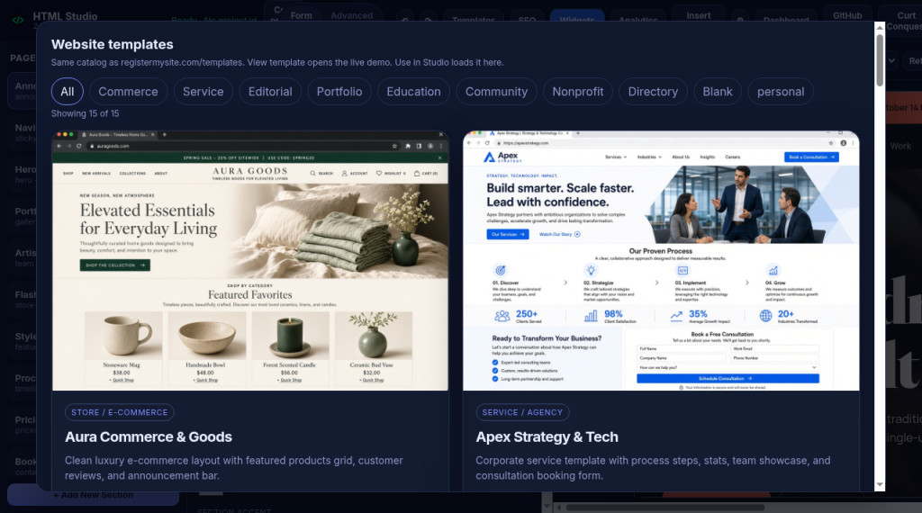
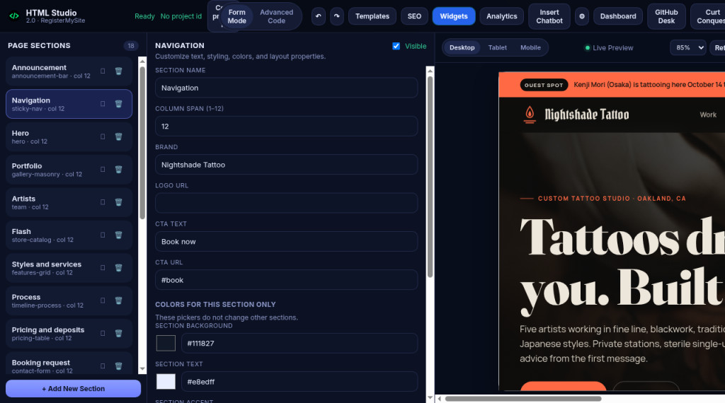
HD
HTML Studio GitHub Desk
STEP 2 OF 7 · HTML Studio
COMPANION DESK
STEP 2
Choose the Nightshade Tattoo template
Templates · Website templates
Nightshade Tattoo loaded
1
4
2
3
1
Templates opens Website templates (15 in the catalog).
2
Filters narrow the list. Scroll to Nightshade Tattoo.
3
Use in Studio loads it. The brand still reads Nightshade Tattoo.
4
Templates button in the top bar, to switch again later.
1
Sign up
2
Template
3
Brand
4
Widget
5
Project id
6
Desk folder
7
Import
Notes:
Step two, choose the template. Click Templates in the top bar. The Website templates window shows the same catalog as registermysite dot com slash templates, with filters along the top. Our picture shows the top of the list, so scroll down to find Nightshade Tattoo, and choose Use in Studio. That loads it right into the canvas. On the right is the page once it's loaded: a dark, editorial tattoo studio site, with the brand still reading Nightshade Tattoo.

Slide 6
HD
HTML Studio GitHub Desk
STEP 3 OF 7 · HTML Studio
COMPANION DESK
STEP 3
html-studio.registermysite.com
Rename the sticky-nav brand
4
1
3
1
Navigation section (sticky-nav) in Page sections.
2
2
Brand field: type exactly html-studio tattoo guide
3
Live preview shows the new brand at the top.
4
Saved in the header means the change is kept.
Before: the Brand field read Nightshade Tattoo (previous slide).
1
Sign up
2
Template
3
Brand
4
Widget
5
Project id
6
Desk folder
7
Import
Notes:
Step three, rename the brand. In Page sections on the left, click Navigation. That's the sticky nav section. In the editor, find the field called Brand, and change it to html-studio tattoo guide, all lowercase, exactly as you see it here. Now watch the live preview on the right. The name at the top of the page updates to html-studio tattoo guide. And the header says Saved, so the change is kept.

Slide 7
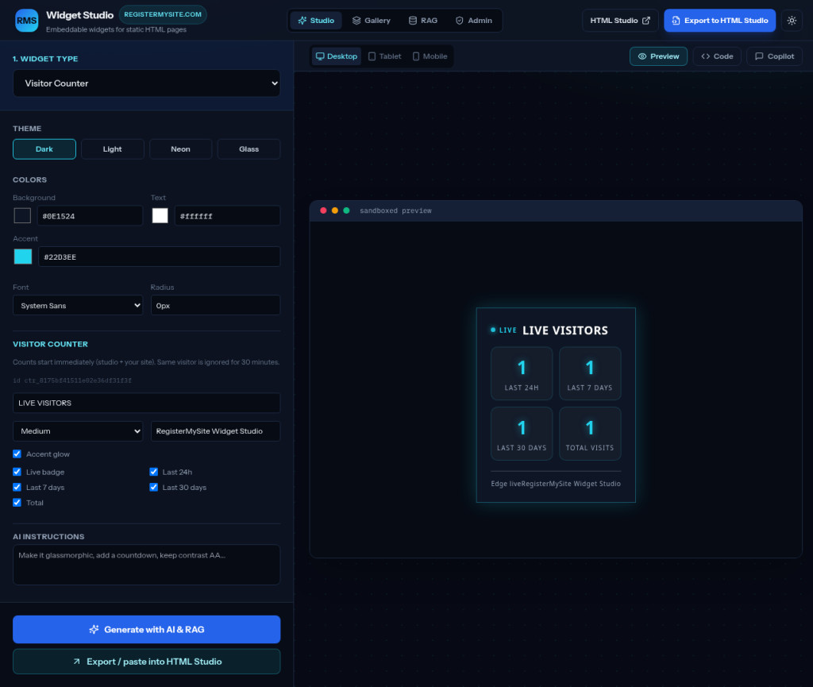
HD
HTML Studio GitHub Desk
STEP 4 OF 7 · Widget Studio
COMPANION DESK
STEP 4
widget-studio.registermysite.com
Make a Visitor Counter in Widget Studio
4
1
1
Widget type: Visitor Counter.
2
2
Theme and colors (optional).
3
Preview: Live Visitors with 24h, 7 days, 30 days and total.
3
4
Export to HTML Studio at the top, or
5
Export / paste into HTML Studio at the bottom.
5
1
Sign up
2
Template
3
Brand
4
Widget
5
Project id
6
Desk folder
7
Import
Notes:
Step four starts in Widget Studio, at widget-studio dot registermysite dot com. Under Widget type, choose Visitor Counter. You can pick a theme and colors if you like. The sandboxed preview shows the counter, called Live Visitors, with boxes for the last twenty four hours, the last seven days, the last thirty days, and total visits. When you're happy with it, use Export to HTML Studio at the top, or the Export, paste into HTML Studio button at the bottom left.

Slide 8
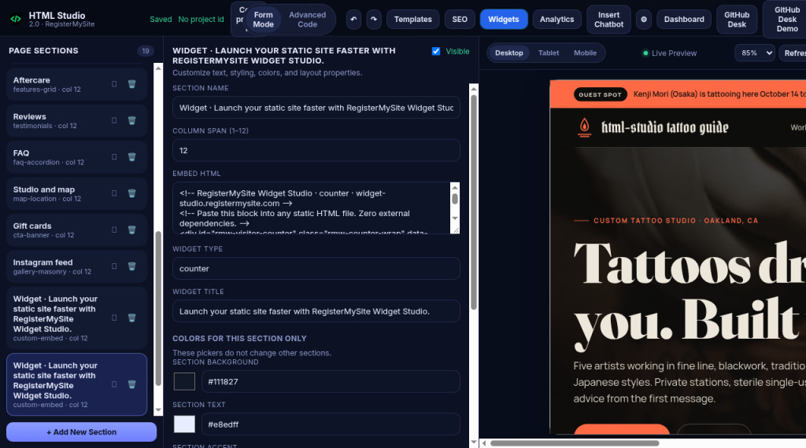
HD
HTML Studio GitHub Desk
STEP 4 OF 7 · HTML Studio
COMPANION DESK
STEP 4, CONTINUED
html-studio.registermysite.com
Export the widget into your page
4
1
Custom-embed section appears in Page sections.
2
Embed HTML holds the counter code.
2
3
Widget type: counter.
3
4
No project id yet. That’s step 5.
1
Honest note: our first export opened a blank, signed-out canvas. Signing back in and exporting again worked.
1
Sign up
2
Template
3
Brand
4
Widget
5
Project id
6
Desk folder
7
Import
Notes:
Back in HTML Studio, the widget arrives as a custom embed section near the bottom of the Page sections list. Click it, and you'll see its Embed HTML, and the widget type, which says counter. Now an honest note from our run. The first time we exported, HTML Studio opened a blank canvas that was signed out, so the widget had nowhere to go. We signed back in, exported again, and this time it landed in our tattoo page. So, sign in to HTML Studio before you export a widget. Notice the header still says No project id. That's our next step.

Slide 9
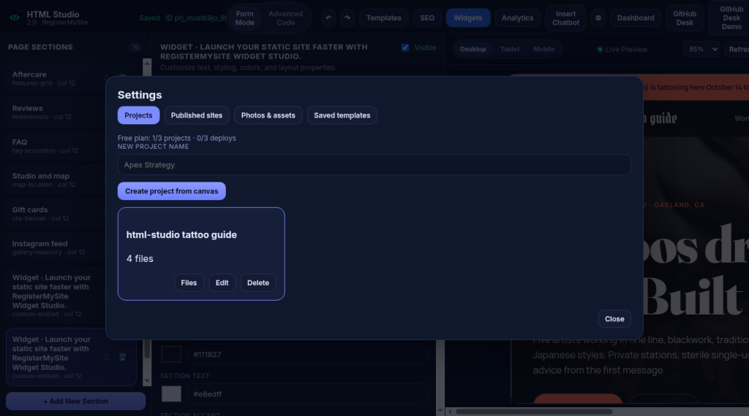
HD
HTML Studio GitHub Desk
STEP 5 OF 7 · HTML Studio
COMPANION DESK
STEP 5
html-studio.registermysite.com
Give the page a project id
5
1
1
Gear opens Settings, Projects tab.
2
New project name: html-studio tattoo guide
2
3
3
Create project from canvas.
4
4
Project card appears: 4 files.
5
Header: No project id becomes an ID.
OUR PROJECT ID
prj_mustb9jo_6t1q17601q
1
Sign up
2
Template
3
Brand
4
Widget
5
Project id
6
Desk folder
7
Import
Notes:
Step five, give the page a project id. Click the gear icon to open Settings, and stay on the Projects tab. Type a new project name. Ours is html-studio tattoo guide. Then click Create project from canvas. A project card appears with that name and four files, and the header changes from No project id to an ID that starts with the letters P R J. Our full id is written on the slide. Copy yours, because GitHub Desk needs it in a moment.

Slide 10
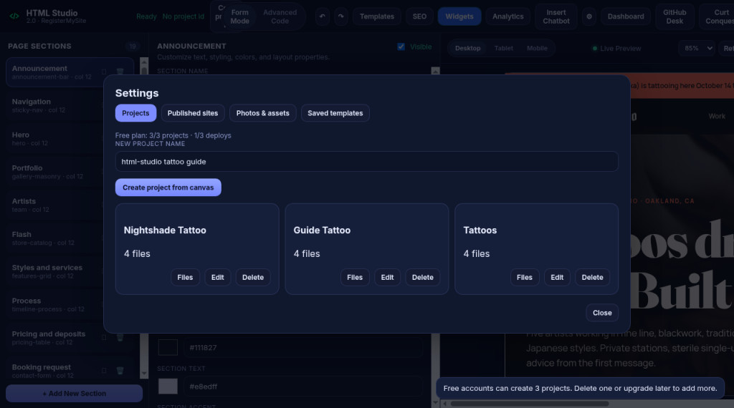
HD
HTML Studio GitHub Desk
STEP 5 OF 7 · HTML Studio
COMPANION DESK
HONEST NOTE
html-studio.registermysite.com
The free plan limit we hit
1
Free plan: 3/3 projects on our first account.
1
2
Nightshade Tattoo, Guide Tattoo, Tattoos. We did not delete these.
3
“Free accounts can create 3 projects. Delete one or upgrade later to add more.”
2
3
What we did: a new demo account was required. Its project id is the one on the previous slide.
1
Sign up
2
Template
3
Brand
4
Widget
5
Project id
6
Desk folder
7
Import
Notes:
Here's something to check before you start. Our first account had already used its free plan: three of three projects, named Nightshade Tattoo, Guide Tattoo, and Tattoos. When we tried to create another one, HTML Studio said free accounts can create three projects, delete one or upgrade later to add more. We did not delete those projects. A new demo account was required, and that's the account behind the project id you saw on the last slide. If you hit this limit, you can delete a project you no longer need, or upgrade.

Slide 11
HD
HTML Studio GitHub Desk
STEP 6 OF 7 · GitHub Desk
COMPANION DESK
STEP 6
Create the GitHub Desk folder html-studio-tattoos
github.registermysite.com
github.registermysite.com
1
2
3
5
4
1
+ New Project Folder on Workspace Projects.
2
Name: html-studio-tattoos
3
One file: index.html
4
Toast: Project created with index.html skeleton
5
Preview: a placeholder welcome page.
1
Sign up
2
Template
3
Brand
4
Widget
5
Project id
6
Desk folder
7
Import
Notes:
Step six happens in GitHub Desk, at github dot registermysite dot com. Use the same account you used in HTML Studio. On Workspace Projects, click New Project Folder, and name it html-studio-tattoos, with dashes and no spaces. GitHub Desk opens the new folder, with a green message: Project created with index dot html skeleton. There's one file, index dot html, a starter page in the editor, and a welcome page in the live preview. That's just a placeholder. Next, we'll fill it with our tattoo page.

Slide 12
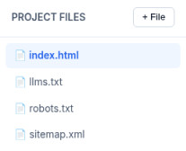
HD
HTML Studio GitHub Desk
STEP 7 OF 7 · GitHub Desk
COMPANION DESK
STEP 7
1
Import with the project id
Import Project from HTML Studio
1
Import from HTML Studio in the folder toolbar.
5
HTML Studio Project ID
prj_mustb9jo_6t1q17601q
2
2
HTML Studio Project ID: paste your prj_ id.
3
New Local Project Name: html-studio-tattoos
New Local Project Name
html-studio-tattoos
3
Real screenshot after import: index.html, llms.txt, robots.txt, sitemap.xml.
4
Import from Studio. Then watch for the toast.
4
Cancel
Import from Studio
5
Files list now shows 4 files.
Recreated with the values we typed. The real dialog is on the next slide.
Imported 4 files from HTML Studio
1
Sign up
2
Template
3
Brand
4
Widget
5
Project id
6
Desk folder
7
Import
Notes:
Step seven, the import. Inside the folder, click Import from HTML Studio along the top. In the window that opens, find the box called HTML Studio Project ID, and paste your project id, the one that starts with P R J. In New Local Project Name, type html-studio-tattoos. Then click Import from Studio. In our run, a green message said Imported 4 files from HTML Studio, and the file list filled up with index dot html, L L M S dot T X T, robots dot T X T, and sitemap dot X M L.

Slide 13
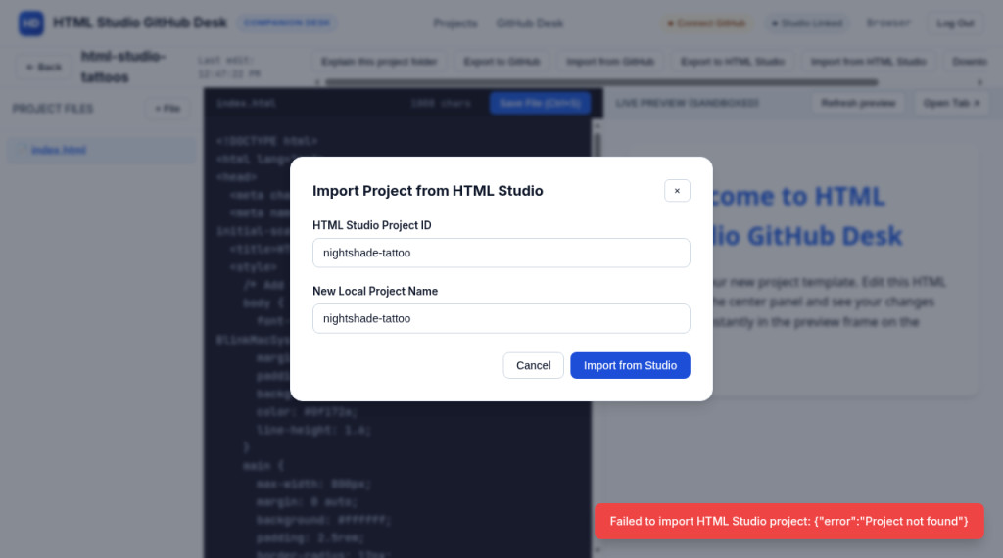
HD
HTML Studio GitHub Desk
STEP 7 OF 7 · GitHub Desk
COMPANION DESK
HONEST CONTRAST
github.registermysite.com
A template name is not a project id
1
We typed the template slug nightshade-tattoo into HTML Studio Project ID.
1
2
Red toast: Failed to import HTML Studio project: Project not found
Fix: paste the id from step 5, prj_mustb9jo_6t1q17601q
2
Remember: the import works with the project id HTML Studio gives you, not a template name.
1
Sign up
2
Template
3
Brand
4
Widget
5
Project id
6
Desk folder
7
Import
Notes:
Here's the mistake we made first, so you don't have to. We typed the template's name, nightshade-tattoo, into the HTML Studio Project ID box. GitHub Desk answered with a red message: Failed to import HTML Studio project, Project not found. That's because a template name is not a project id. The import only works with the id HTML Studio gives you when you create a project from the canvas, the one starting with P R J.

Slide 14
HD
HTML Studio GitHub Desk
STEP 7 OF 7 · GitHub Desk
COMPANION DESK
DONE
github.registermysite.com
Your page, now in GitHub Desk
4
2
1
Four files imported into html-studio-tattoos.
1
2
index.html now holds the full page code.
3
3
Live preview: the tattoo page with the brand html-studio tattoo guide.
4
Open Tab for a wider view. The narrow panel cuts the name short.
Next: edit, Save File, and refresh the preview, all in one place.
1
Sign up
2
Template
3
Brand
4
Widget
5
Project id
6
Desk folder
7
Import
Notes:
And here's the payoff. The html-studio-tattoos folder now holds the tattoo page. On the left are the four imported files. In the middle, index dot html has the full page code, far longer than the starter skeleton. And in the live preview on the right is the tattoo page, with our brand at the top: html-studio tattoo guide. The preview is narrow, so the name is cut short with dots, but it's all there. From here you can edit the code, click Save File, and use Open Tab for a bigger view.

Slide 15
HD
HTML Studio GitHub Desk
RegisterMySite client guide
COMPANION DESK
TIPS
Six things that save time
1
2
3
Project id, not template name
Check the free plan first
Sign in before exporting a widget
Ids start with prj_. A slug like nightshade-tattoo won’t import.
In our run the limit was 3 projects. See Settings → Projects.
Otherwise it may open a blank, signed-out canvas.
4
5
6
Same account everywhere
Name folders with dashes
Brand ≠ page title
Use one sign-in for HTML Studio and GitHub Desk.
Like html-studio-tattoos. No spaces.
Brand changes the nav only. The page <title> still said Nightshade Tattoo.
Notes:
A few tips. Use the project id, not the template name. Ids start with P R J. Check your free plan before you begin. In our run the limit was three projects, and you'll find it under Settings, then Projects. Sign in before you export a widget, so it lands in your page and not a blank canvas. Use the same account on HTML Studio and GitHub Desk. Name folders with dashes, like html-studio-tattoos. And remember, the Brand field changes the name in the navigation, but the page title in the code still said Nightshade Tattoo. Edit it in GitHub Desk if you want it changed too.

Slide 16
HD
HTML Studio GitHub Desk
RegisterMySite client guide
COMPANION DESK
TROUBLESHOOTING
Real messages from our run, and what to do
What you see
What it means
What to do
Failed to import HTML Studio project: Project not found
You typed a template name.
Paste the prj_ project id.
Free accounts can create 3 projects. Delete one or upgrade later to add more.
Free plan at 3/3.
Delete one you don’t need, or upgrade.
Blank, signed-out canvas after exporting a widget
You weren’t signed in.
Sign in and export again.
No project id (in the HTML Studio header)
The canvas isn’t a project yet.
Settings → Projects → Create project from canvas.
Project created with index.html skeleton
Normal: a starter page.
Go ahead and import.
Brand looks cut off: html-studio tattoo gui…
The preview panel is narrow.
Use Open Tab for a wider view.
Notes:
Here are the real messages we saw, and what to do. Failed to import HTML Studio project, Project not found, means you typed a template name. Paste the project id instead. Free accounts can create three projects means you're at the limit. Delete one you don't need, or upgrade. A blank, signed-out canvas after exporting a widget means you weren't signed in. Sign in and export again. No project id in the header means the canvas isn't a project yet. Use Create project from canvas. Project created with index dot html skeleton is normal. It's the starter page, so go ahead and import. And if the brand looks cut off in the preview, it's just a narrow panel. Try Open Tab.

Slide 17
HD
HTML Studio GitHub Desk
RegisterMySite client guide
COMPANION DESK
RECAP
From template to editable folder
Sign up at html-studio.registermysite.com.
Create a project from the canvas to get its prj_ id.
1
5
Choose the Nightshade Tattoo template.
Create the html-studio-tattoos folder in GitHub Desk.
2
6
Rename the brand to html-studio tattoo guide.
Import with the project id. Edit and preview.
3
7
Add a Visitor Counter from Widget Studio, signed in.
Your page is ready to edit in GitHub Desk.
4
Notes:
Let's recap. Sign up at HTML Studio. Choose the Nightshade Tattoo template. Rename the brand to html-studio tattoo guide. Make a Visitor Counter in Widget Studio, and export it into the page while you're signed in. Create a project from the canvas to get your project id. In GitHub Desk, create the html-studio-tattoos folder. Then import with the project id, and your page is ready to edit and preview.

Slide 18
HD
HTML Studio GitHub Desk
RegisterMySite client guide
COMPANION DESK
CONTACT
Want a hand with this?
HD
The tools
We’ll walk through it with you, from your first template to your GitHub Desk folder.
HTML Studio
html-studio.registermysite.com
Widget Studio
WEB
registermysite.com
widget-studio.registermysite.com
GitHub Desk
PHONE
(562) 751-4597
github.registermysite.com
EMAIL
info@registermysite.com
Demo account email
registermysite.com+github-desk-demo@gmail.com
IN PERSON
Los Angeles and Orange County
Notes:
That's it from me. If you'd like a hand, we're happy to walk through this with you, from your first template to your GitHub Desk folder. You can find us at registermysite dot com, call 562 751 4597, or email info at registermysite dot com. We also meet in person in Los Angeles and Orange County. Thanks so much for your time, and happy building.

