Slide 1
HD
EdgeTrack
CLIENT GUIDE
RegisterMySite client guide
REGISTERMYSITE · CLIENT TRAINING
EdgeTrack
WHAT THE CARD SAYS
Isolated analytics workspaces on Cloudflare.
A private analytics workspace, and a small tracker you paste into a page you already publish.
A private dashboard, and a drop-in tracker snippet. Other customers cannot see your data.
Walkthrough on 3 October 2026. EdgeTrack V1.2. The bakery page is the one this guide follows.
Account
Snippet
Publish
Read
edgetrack.registermysite.com · V1.2
1
This guide lives at https://registermysite.com/guides/edgetrack-guide/
Notes:
Hi, and welcome. This is EdgeTrack, version 1.2, at edgetrack dot registermysite dot com. It gives you a private dashboard, and a small tracker you paste into a page you already publish. We walked through it on the third of October, 2026, with a bakery page from HTML Studio. The signup card says isolated analytics workspaces on Cloudflare, and that other customers cannot see your data. This guide lives at registermysite dot com slash guides slash edgetrack-guide. I'll only describe what that walkthrough actually showed on the screen.

Slide 2
HD
EdgeTrack
CLIENT GUIDE
RegisterMySite client guide
SIX STEPS
The path, in order
Account, the site, the snippet, the HTML Studio embed, publish, then the analytics sections.
1
Create the account
Create account is the selected tab.
2
Add the website
Add New Website. Sample text is still in the boxes.
3
Copy the snippet
Embed Tracking Script. Then Copy Code.
4
Paste the embed
HTML Studio, the custom-embed section.
5
Publish the page
Export and deploy, then Publish slug.
6
Read the sections
Overview through Exit Analysis.
Tip
The signup card and the add-site dialog still show sample placeholders. Replace them with your own.
2
Order: account, add the site, copy the snippet, paste it into the HTML Studio custom embed, publish, then the analytics sections.
Notes:
Here is the whole path, before we look at a screen. Create the account. Add the website. Copy the tracking snippet from Embed and Settings. Paste it into the custom embed in HTML Studio. Publish the page. Then read Overview, Real-time, Pages, Visitor Profiles, Engagement and Heatmaps, and Exit Analysis. A tip from these pictures: the signup card and the add-site dialog still show sample placeholders. You replace those with your own. On the analytics screens, Seed Demo Data sits in the header. This walkthrough did not press it. We'll take the steps one at a time.

Slide 3
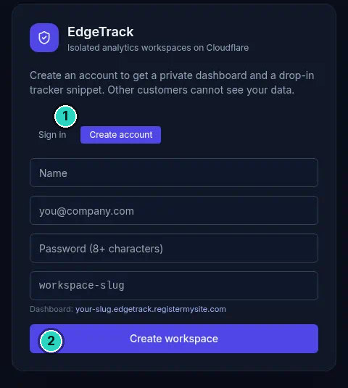
HD
EdgeTrack
CLIENT GUIDE
STEP 1 OF 6 · ACCOUNT
SLIDE 3 OF 14
Create the workspace
Create account is selected. The four boxes are still the sample placeholders.
Tip
Name, you@company.com, the eight-character box, and workspace-slug are placeholders on this card.
3
“Create an account to get a private dashboard and a drop-in tracker snippet. Other customers cannot see your data.”
Notes:
This is the signup card at edgetrack dot registermysite dot com. The line under the name says isolated analytics workspaces on Cloudflare. Then it says, create an account to get a private dashboard and a drop-in tracker snippet. Other customers cannot see your data. Sign in is there, and Create account is the selected tab. We've marked that tab, and the Create workspace button. The four boxes are placeholders. Name. you at company dot com. A box that asks for eight or more characters. And workspace hyphen slug. Under them it says, Dashboard, your hyphen slug dot edgetrack dot registermysite dot com. This picture does not show a verification message, so we are not calling the account verified here.

Slide 4
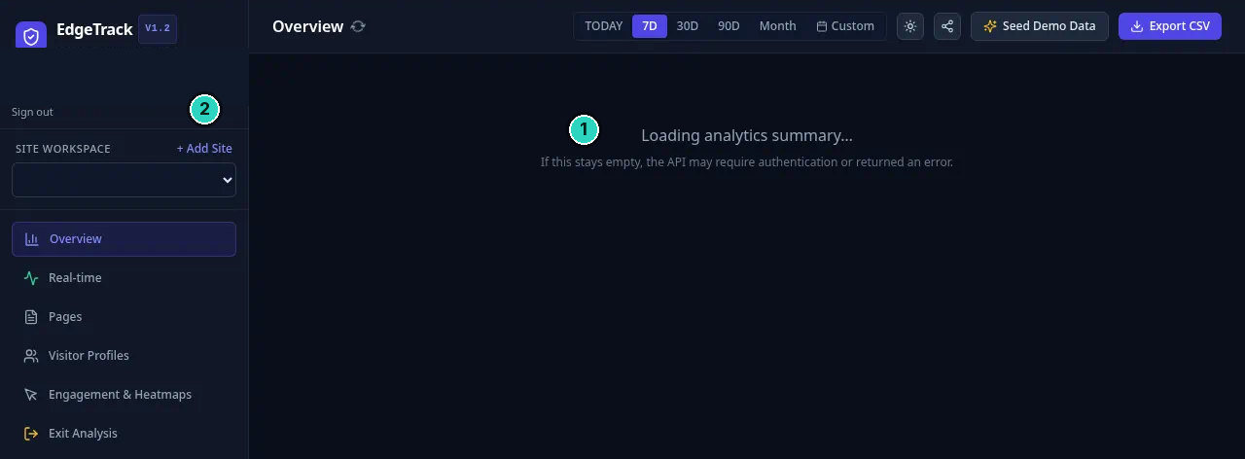
HD
EdgeTrack
CLIENT GUIDE
RegisterMySite client guide
SLIDE 4 OF 14
The home screen
Overview is still loading. The workspace menu does not show a site name yet.
!
Warning
If this stays empty, the API may require authentication or returned an error.
4
“Loading analytics summary...” and “If this stays empty, the API may require authentication or returned an error.”
Notes:
Once you are in, the page title is Overview, and the corner says EdgeTrack version 1.2. The middle says, Loading analytics summary. Under that, if this stays empty, the API may require authentication or returned an error. That second line is on the screen, and we've marked it. We've also marked Add Site, beside Site workspace. This capture does not show a site name in that menu yet. The left nav reads Overview, Real-time, Pages, Visitor Profiles, Engagement and Heatmaps, Exit Analysis, Embed and Settings, and Interactive Test Sandbox. The footer says zero cookies required, and D one, plus D O, plus K V. We did not open the sandbox, and there is no picture of it.

Slide 5
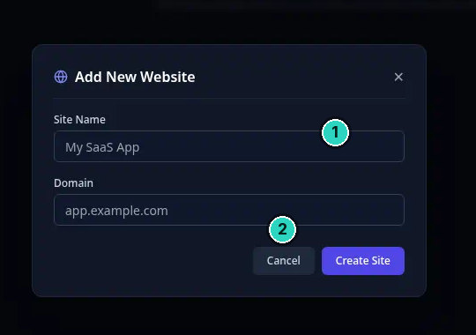
HD
EdgeTrack
CLIENT GUIDE
STEP 2 OF 6 · ADD SITE
SLIDE 5 OF 14
Add a website
The dialog is Add New Website. The fields still show the sample placeholders.
Tip
My SaaS App and app.example.com are sample placeholders. They are not the bakery site.
5
Placeholders on this dialog: Site Name “My SaaS App”, Domain “app.example.com”. Buttons: Cancel and Create Site.
Notes:
Press Add Site, and this dialog opens. The title is Add New Website. Site Name still says My SaaS App. Domain still says app dot example dot com. Those are placeholders, and we've marked the name field. Cancel is beside Create Site, and we've marked Create Site. This picture does not show the bakery name typed in, so we won't pretend it does. On the later screens, the workspace menu reads Maple Street Bakery Studio Guide. The page that shows up in Pages is the Maple Street address on sites dot registermysite dot com. Replace the sample text before you press Create Site. There is no confirmation message in this capture.

Slide 6
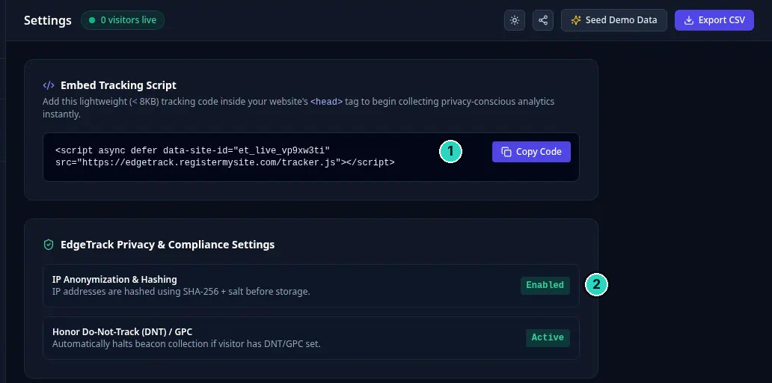
HD
EdgeTrack
CLIENT GUIDE
STEP 3 OF 6 · SNIPPET
SLIDE 6 OF 14
Copy the snippet
Settings. The embed card, the site id, and two privacy rows that are already on.
Tip
Copy Code is the button. The card says the snippet is under 8KB and goes in the head tag.
6
“Add this lightweight (< 8KB) tracking code inside your website's <head> tag to begin collecting privacy-conscious analytics instantly.”
Notes:
Open Embed and Settings. This capture is titled Settings, and it says zero visitors live. The card is Embed Tracking Script. Add the lightweight code, under 8 kilobytes, inside the head tag. We've marked Copy Code. The site id is et underscore live underscore v p 9 x w 3 t i, and the file is tracker dot js. Under that, I P hashing with SHA 256 plus salt says Enabled. Honor Do Not Track and G P C says Active. Just left of this crop, the workspace reads Maple Street Bakery Studio Guide.

Slide 7
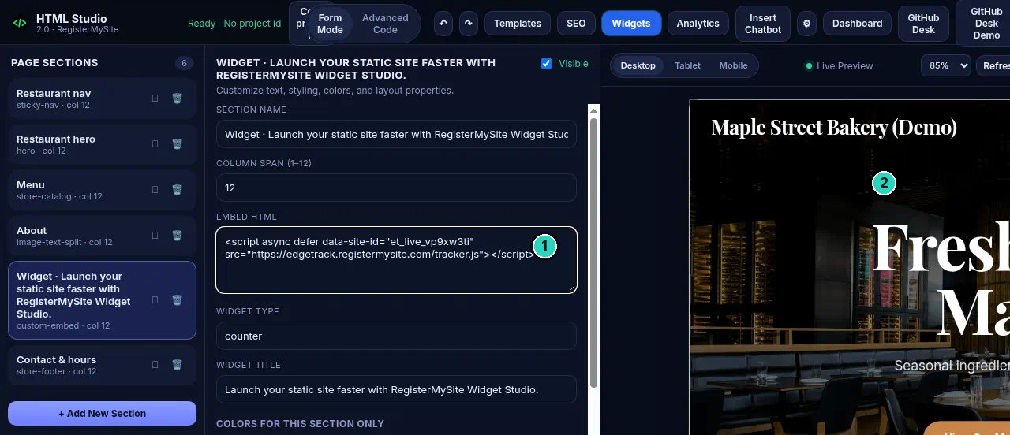
HD
EdgeTrack
CLIENT GUIDE
STEP 4 OF 6 · PASTE
SLIDE 7 OF 14
Paste it in HTML Studio
The snippet is in EMBED HTML, on the custom-embed section. This picture is not the publish dialog.
!
Warning
The header still says Ready and No project id. This picture is the embed, not the publish dialog.
7
EMBED HTML shows the tracker snippet. This capture does not show Export & Deploy, so it does not show a zone or a slug. tracker.js was confirmed on the live page in the walkthrough.
Notes:
In HTML Studio, the snippet went into the custom embed of the project that publishes the Maple Street page. This capture is that section. The list says custom hyphen embed. Column span is 12. We've marked EMBED HTML, and the box shows the same script and the same site id. Widget type says counter. The header still says Ready, and No project id. Live Preview shows the brand Maple Street Bakery, Demo. The hero starts with Freshly, and the window cuts the rest, so we won't read a full headline from this crop. This picture is not Export and deploy, so it does not show a zone or a slug. After publish, the walkthrough confirmed tracker dot js on the live page. There is no separate picture of that source.

Slide 8
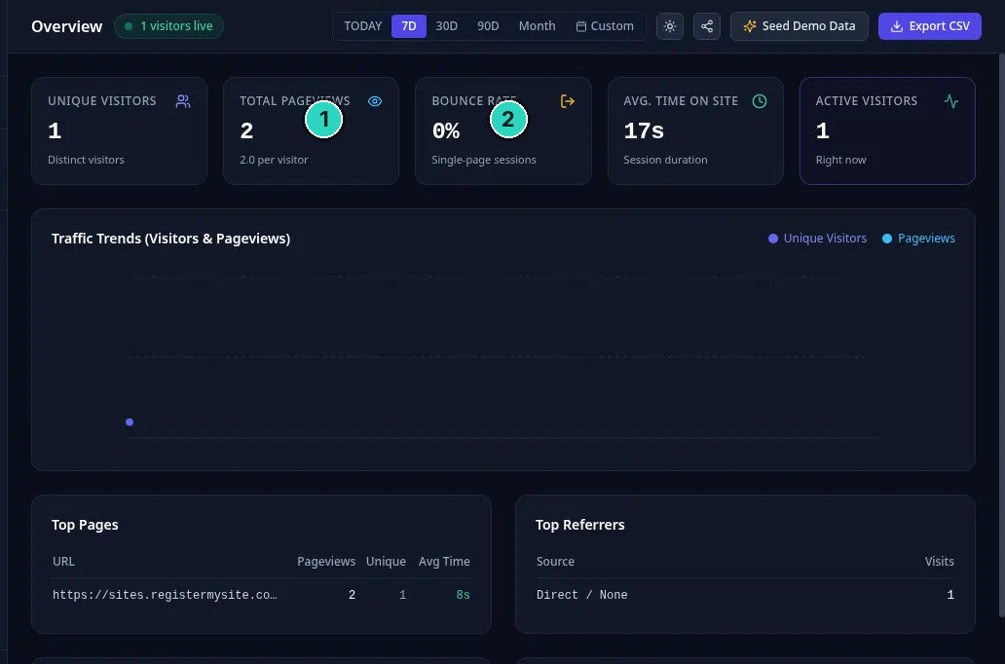
HD
EdgeTrack
CLIENT GUIDE
STEP 6 OF 6 · ANALYTICS
SLIDE 8 OF 14
The 7 day overview
7D is selected. One visitor, two pageviews, and a chart with a single small point.
Tip
Seed Demo Data is in the header. This walkthrough did not press it. The chart is one small point, not a trend.
8
7D. 1 visitors live. Unique visitors 1. Pageviews 2, 2.0 per visitor. Bounce 0%. Average time 17s. Active 1. Top page is truncated on screen. Direct / None, 1 visit.
Notes:
Overview, with 7 D selected. The bar also has Today, 30 D, 90 D, Month, and Custom. The badge says 1 visitor live. Unique visitors, 1. Pageviews, 2, at 2.0 per visitor. Bounce rate, 0 percent. Average time, 17 seconds. Active visitors, 1. We've marked pageviews and bounce. The chart is one small point, not a trend. Top Pages cuts the address, with 2 pageviews, 1 unique, and 8 seconds. Direct slash None has one visit. Device Types and Geographic Locations sit below this crop, so those numbers are not shown. Seed Demo Data is in the header. We did not press it.

Slide 9
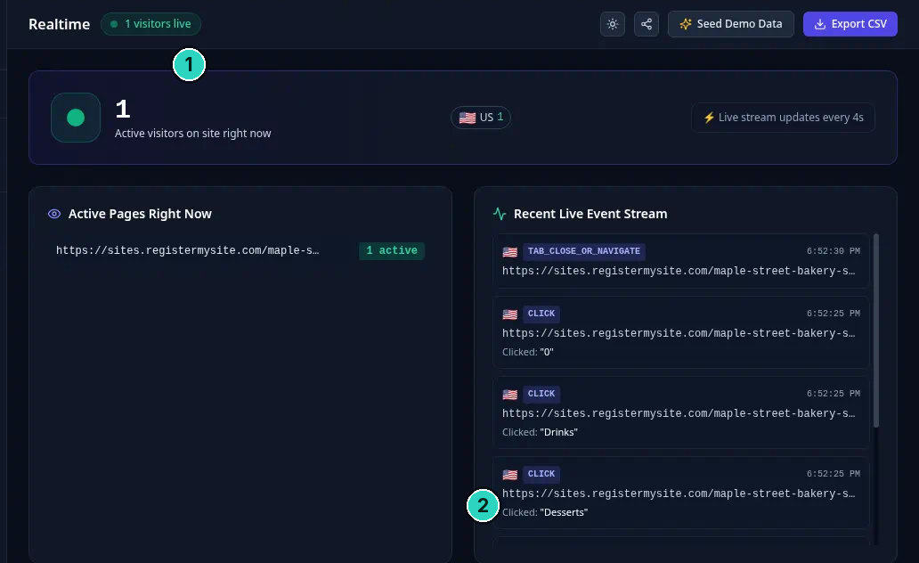
HD
EdgeTrack
CLIENT GUIDE
STEP 6 OF 6 · ANALYTICS
SLIDE 9 OF 14
Real-time
One person on the site, a US flag, and four events you can read. The list can scroll.
9
“1 Active visitors on site right now.” US 1. “Live stream updates every 4s.” Events at 6:52:30 PM and 6:52:25 PM, as printed.
Notes:
Real-time says 1 visitor live. The card reads 1, active visitors on site right now. A US flag shows 1, and the stream updates every 4 seconds. We've marked that count. Active pages truncates the address at maple hyphen s, with a badge that says 1 active. Four events are readable. Tab close or navigate at 6 52 and 30 seconds P M. A click on quote 0, at 6 52 and 25. Then Drinks, at 25 seconds. Then Desserts, at 25 seconds. We've marked Drinks. The addresses are cut off, and the card can scroll, so nothing below this picture is included.

Slide 10
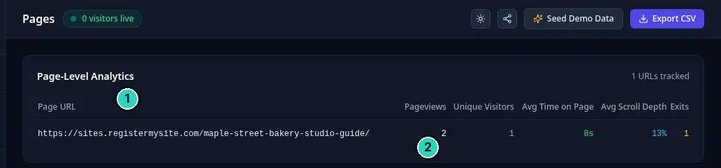
HD
EdgeTrack
CLIENT GUIDE
STEP 6 OF 6 · ANALYTICS
SLIDE 10 OF 14
Pages
One URL, written out. Two pageviews, one unique visitor, eight seconds, 13 percent scroll, one exit.
10
1 URLs tracked. https://sites.registermysite.com/maple-street-bakery-studio-guide/ — pageviews 2, unique visitors 1, avg time 8s, avg scroll depth 13%, exits 1.
Notes:
The Pages screen says zero visitors live. That is this capture, a moment after the overview that said one. The card is Page Level Analytics, and it says 1 URL tracked. The page address is written out. https, sites dot registermysite dot com, slash maple hyphen street hyphen bakery hyphen studio hyphen guide, slash. Pageviews, 2. Unique visitors, 1. Average time on page, 8 seconds. Average scroll depth, 13 percent. Exits, 1. We've marked the address and the pageview count. This is the same page the overview had to truncate. Nothing else is in the table. The rest of the screen under the row is empty, and we left it out of the crop so the row stays readable.

Slide 11
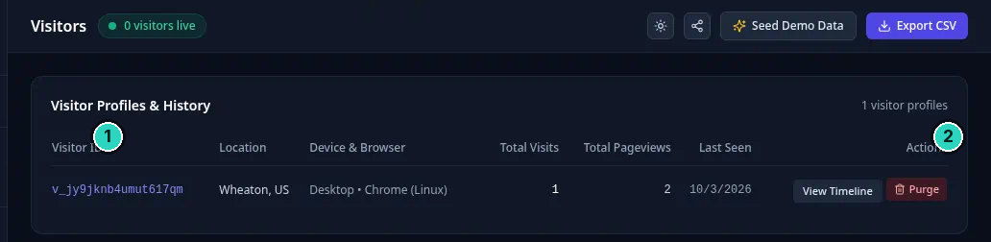
HD
EdgeTrack
CLIENT GUIDE
STEP 6 OF 6 · ANALYTICS
SLIDE 11 OF 14
Visitor Profiles
The page title is Visitors. One profile, last seen on 3 October 2026.
!
Warning
Purge is the red button on this row. This capture does not say what it clears.
11
1 visitor profile. Wheaton, US. Desktop · Chrome (Linux). Total visits 1. Total pageviews 2. Last seen 10/3/2026. Actions: View Timeline and Purge.
Notes:
The nav item is Visitor Profiles. The page title is Visitors, and this capture says zero visitors live. The card is Visitor Profiles and History, 1 visitor profile. We've marked the id. It reads v underscore j y 9 j k n b 4 u m u t 6 1 7 q m. Location, Wheaton, U S. Device and browser, Desktop, Chrome, Linux. Total visits, 1. Total pageviews, 2. Last seen, 10 slash 3 slash 2026, the day of this walk. The actions are View Timeline, and a red button that says Purge. We've marked Purge. The label is all this picture tells us about that button. Under the row, the screen is empty.

Slide 12
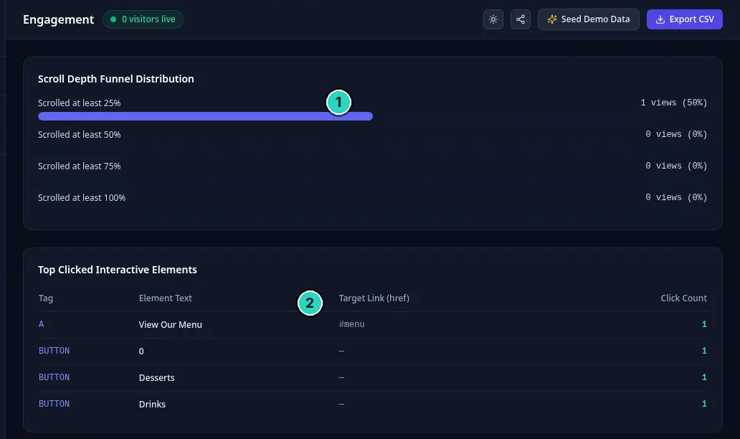
HD
EdgeTrack
CLIENT GUIDE
STEP 6 OF 6 · ANALYTICS
SLIDE 12 OF 14
Engagement & Heatmaps
The nav name is Engagement and Heatmaps. This capture is a scroll funnel and a click table. No heat spots.
Tip
This screen does not draw heat spots. It shows the scroll funnel and the click table.
12
Scrolled at least 25%: 1 views (50%). 50%, 75%, and 100%: 0 views (0%). Clicks: View Our Menu #menu, button “0”, Desserts, Drinks. One each.
Notes:
The nav says Engagement and Heatmaps. The page title is Engagement, and this capture says zero visitors live. There is no painted heat map here, so we are not drawing spots. Scroll depth: at least 25 percent is 1 view, shown as 50 percent. At least 50, 75, and 100 percent are zero views. The product prints 1 views, with that plural. We've marked the 25 percent row. Top clicked elements. View Our Menu, an A tag, target hash menu, one click. A button whose text is 0, one click. Desserts, one. Drinks, one. The button rows show a dash, not a link. We've marked View Our Menu. That matches the clicks you can read on the real-time screen.

Slide 13
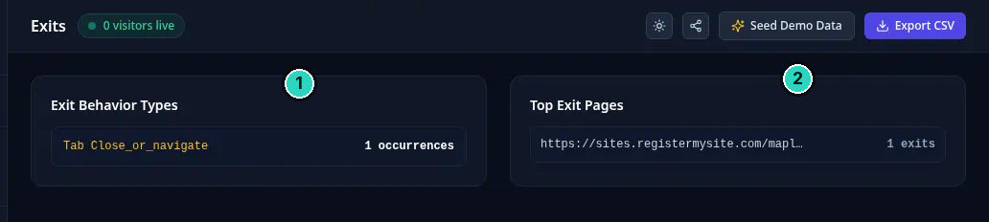
HD
EdgeTrack
CLIENT GUIDE
STEP 6 OF 6 · ANALYTICS
SLIDE 13 OF 14
Exit Analysis
One exit behavior, and one exit page. Both counts are 1.
13
Tab Close_or_navigate — 1 occurrence. Top exit page https://sites.registermysite.com/mapl... — 1 exit.
Notes:
The nav says Exit Analysis. The page title is Exits, and this capture says zero visitors live. Exit Behavior Types shows Tab Close underscore or underscore navigate, in gold, and 1 occurrence. We've marked that row. Top Exit Pages shows a truncated address, sites dot registermysite dot com slash mapl, with an ellipsis, and 1 exit. We've marked that too. That is the same kind of close or navigate event from the real-time stream. The address is cut off on this card, the way the overview cut off the page. The Pages screen is the one that writes the full Maple Street address. Under these two cards, the capture is empty.

Slide 14
HD
EdgeTrack
CLIENT GUIDE
RegisterMySite client guide
REGISTERMYSITE
Contact
If you want a hand with the snippet, or with reading the first numbers, start here.
WEB
EDGETRACK
registermysite.com
edgetrack.registermysite.com
PHONE
(562) 751-4597
EMAIL
info@registermysite.com
EdgeTrack V1.2. The tracker snippet lives on Embed and Settings.
IN PERSON
Los Angeles and Orange County
14
registermysite.com · (562) 751-4597 · info@registermysite.com · in person in Los Angeles and Orange County.
Notes:
If you would like a hand with this, you can reach us on the web at registermysite dot com. Call 562, 751, 4597. Or email info at registermysite dot com. We also meet in person in Los Angeles and Orange County. Those are the same details on the slide. EdgeTrack itself stays at edgetrack dot registermysite dot com, version 1.2, if you want to try the steps yourself. This guide stays at registermysite dot com slash guides slash edgetrack-guide. You can download the PowerPoint or the PDF from the More menu. Thanks for following the walkthrough.

