Slide 1

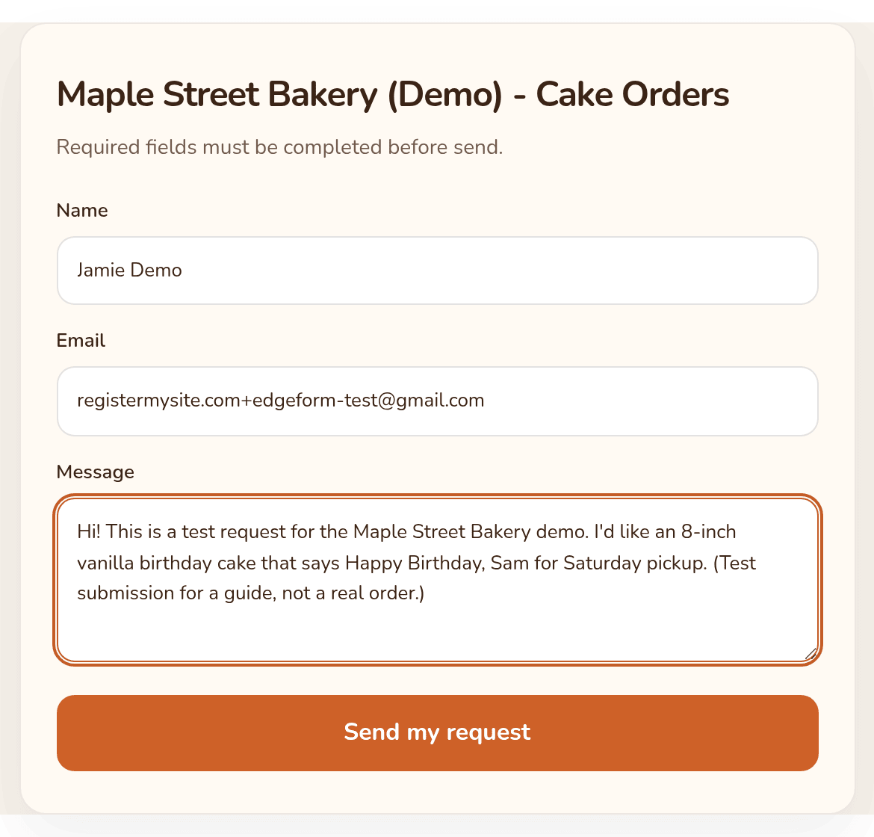
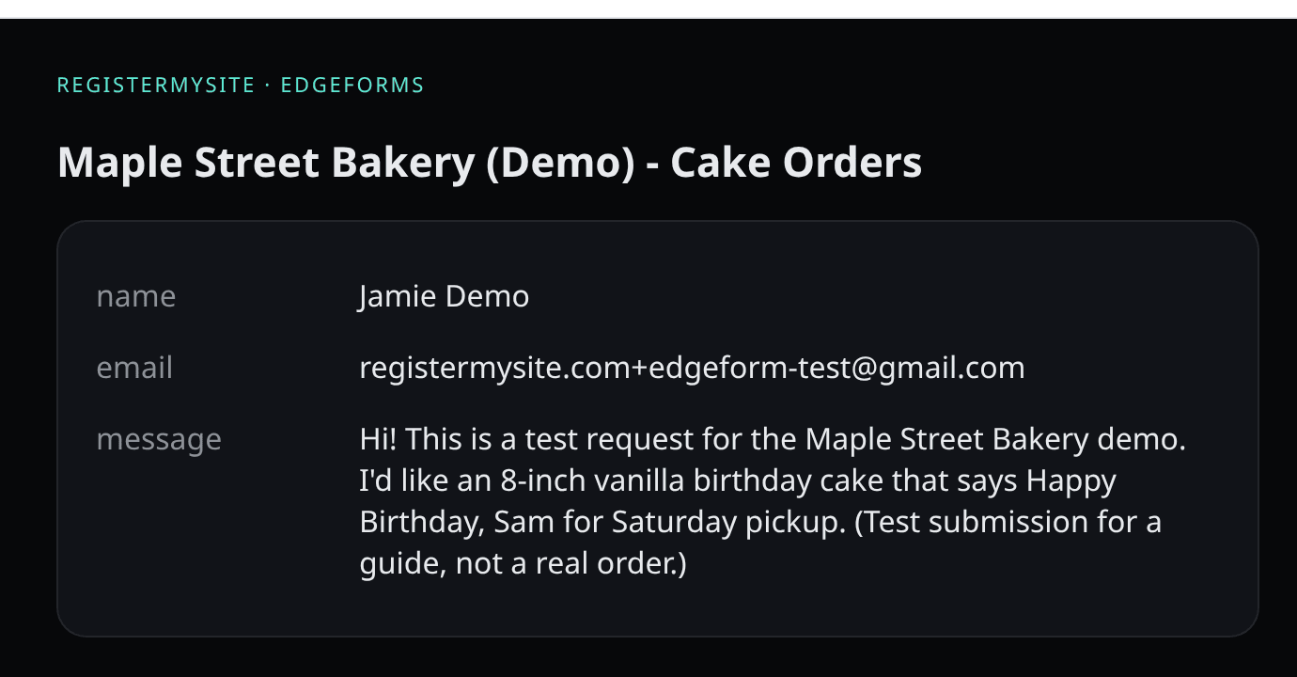

EdgeForm REGISTERMYSITE
Client guide · step by step
Get website form submissions straight to your inbox
EdgeForm, the elite form submission platform. Build a form, put it on your site, and every message lands in your email.
→ inbox
Demo business: Maple Street Bakery (Demo) is made up.
EdgeForm · client guide by RegisterMySite
01
Notes:
Hi everyone, thanks for joining. Today I'll show you EdgeForm, one of our RegisterMySite tools. It lets you put a contact or order form on your website, and every time someone fills it out, you get an email. No mailbox setup, no coding. Everything in this guide comes from a real demo we built. The business is Maple Street Bakery, and it's made up, so please don't try to order a cake. On the right is the finished form on a live web page, and below it is the email that landed in our inbox a few seconds after we pressed send.

Slide 2

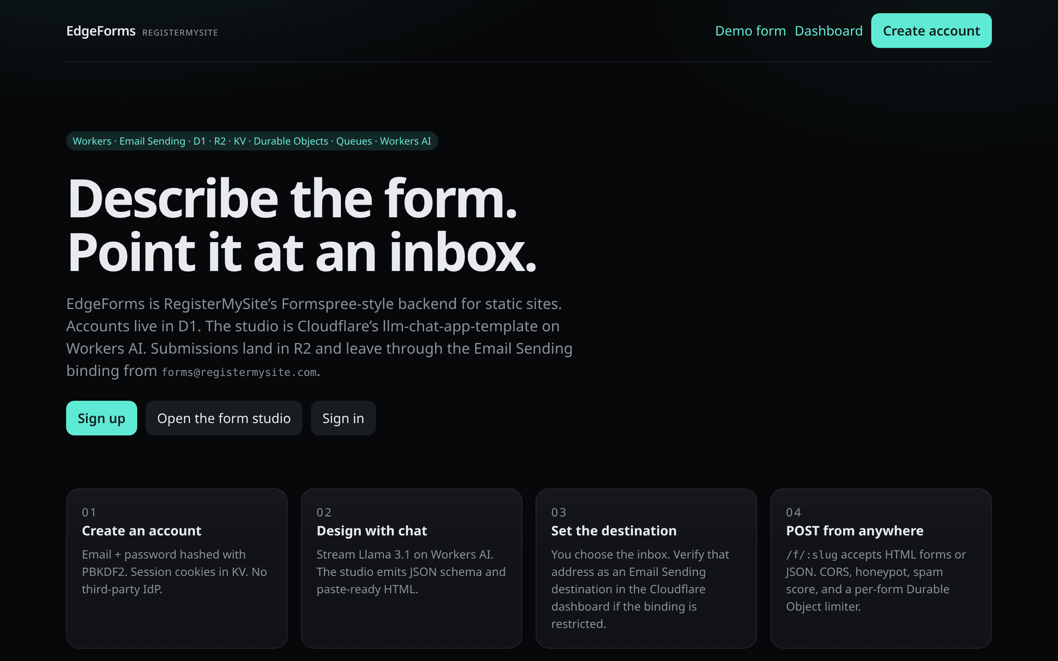




What EdgeForm is
EdgeForm REGISTERMYSITE
A website form that emails you every message
Describe it
Pick your inbox
Tell the form studio what you need in plain words, then publish.
Choose the email address that gets each new submission.
Paste it anywhere
See every message
From the EdgeForm home page: "Describe the form. Point it at an inbox."
forms.registermysite.com
The site header says "EdgeForms". Same product.
Copy the embed code and paste it into any web page.
Each one is emailed to you and listed in your dashboard.
EdgeForm · client guide by RegisterMySite
02
Notes:
So what is EdgeForm? It's a form for your website that emails you every message. Four ideas. One, you describe the form you want in plain words in the form studio, and publish it. Two, you pick the email address where submissions should go. Three, you copy the embed code and paste it into any web page. And four, every submission is emailed to you and also listed in your dashboard. The home page sums it up nicely: describe the form, point it at an inbox. You'll notice the site header says EdgeForms with an s. It's the same product.

Slide 3







The journey
EdgeForm REGISTERMYSITE
Nine small steps, from sign-up to your inbox
1
2
3
4
5
Sign up
Create
Style
Settings
Embed code
Name, email, password
Describe it, publish
Font, colors, button
Inbox, reply-to, sites
Copy the HTML
6
7
8
9
HTML Studio
Go live
Submit
Inbox
Paste into your page
Publish the page
Test it yourself
Email and dashboard
Every screen in this guide is a real screenshot from our demo account. Passwords are hidden.
EdgeForm · client guide by RegisterMySite
03
Notes:
Here's the whole trip on one slide. We sign up, create a form by describing it, and style it to match the business. We check a few settings, like which inbox gets the emails. Then we copy the embed code, paste it into a page in HTML Studio, and publish that page. Finally we submit a test ourselves and look at the result in our email and in the dashboard. The little bar at the bottom of each slide shows where we are. Every screen you'll see is a real screenshot from our demo account.

Slide 4
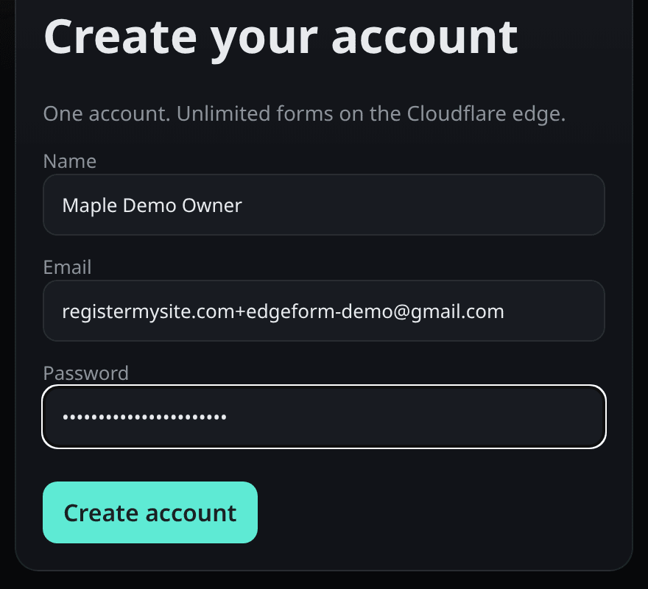

Step 1 · Sign up
EdgeForm REGISTERMYSITE
Create your free account
Go to forms.registermysite.com
Click "Sign up" (or "Create account" at the top).
1
Name
Your name or your business name. We used "Maple Demo Owner".
2
Email
1
An address you check. This is how you sign in.
3
Password
Pick a strong one and keep it in a password manager. It shows as dots.
2
4
Create account
3
That's it. In our test there was no code to type and no confirmation email.
4
No card needed
We used the free sign-up only. No payment details were asked for.
EdgeForm · client guide by RegisterMySite
Sign up
Create
Style
Settings
Embed code
HTML Studio
Go live
Submit
Inbox
04
Notes:
Step one is signing up. Go to forms dot registermysite dot com and click Sign up. Fill in three things: your name, which can be your business name, your email, and a password. Then click Create account. When we did this there was no code to type and no confirmation email, and no payment details. It took us straight to the dashboard. Keep your password somewhere safe, like a password manager.

Slide 5
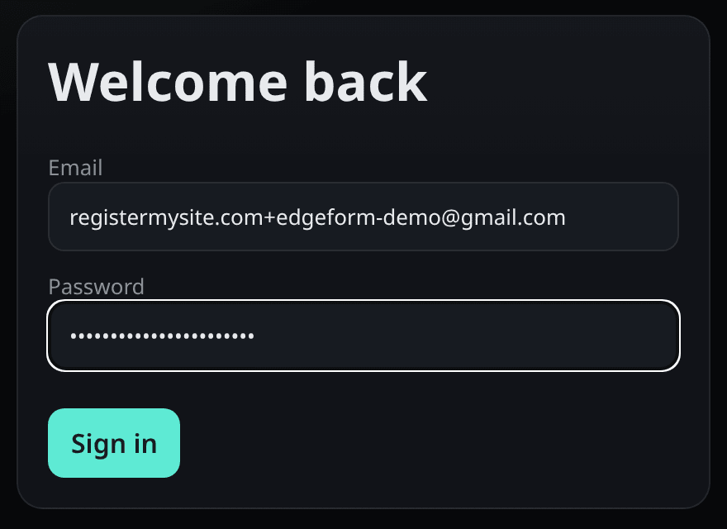
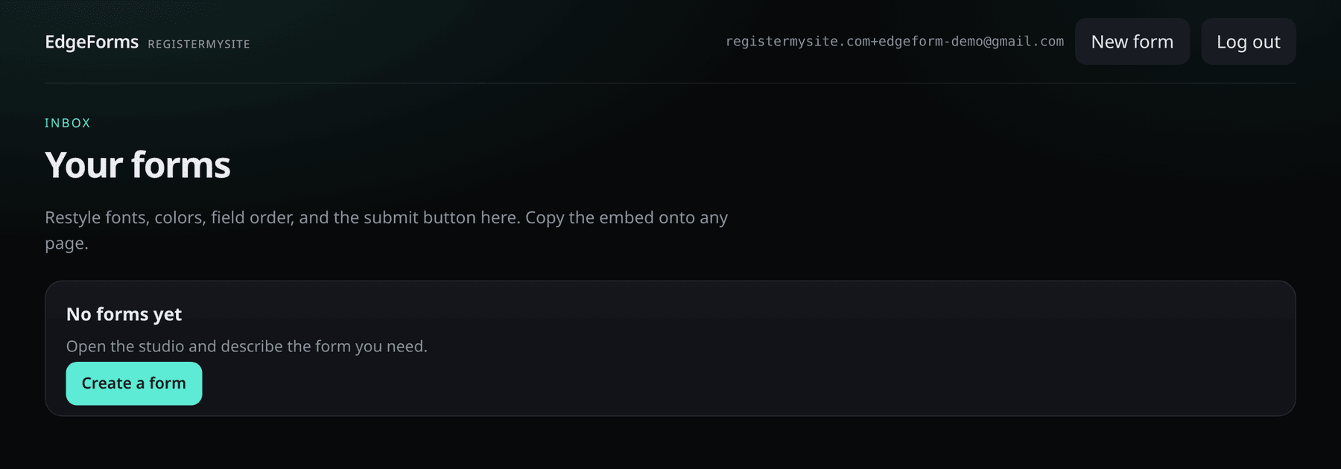
Step 1 · Sign in
EdgeForm REGISTERMYSITE
Coming back later? Sign in, then find Your forms
5
1
4
2
3
4
"No forms yet"
A brand-new account starts empty. Click Create a form.
5
New form
Same thing, any time: the button at the top opens the form studio.
forms.registermysite.com/login
Type your email (1) and password (2), then click Sign in (3).
EdgeForm · client guide by RegisterMySite
Sign up
Create
Style
Settings
Embed code
HTML Studio
Go live
Submit
Inbox
05
Notes:
Whenever you come back, sign in at the login page with the same email and password. You land on Your forms, which is your inbox of forms. A brand-new account says No forms yet, with a Create a form button. The New form button at the top does the same thing any time. Both open the form studio, which is our next step.

Slide 6
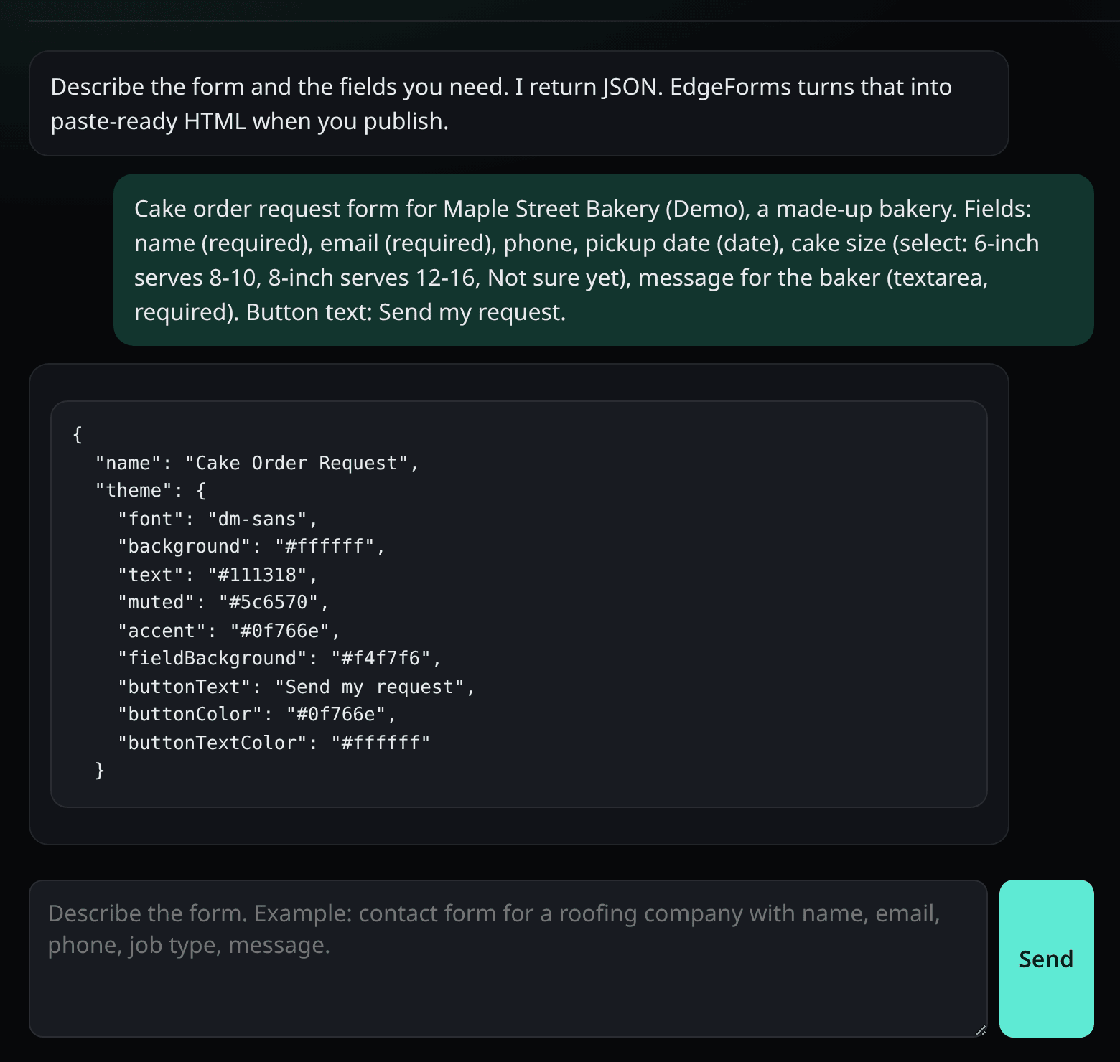

Step 2 · Create your form
EdgeForm REGISTERMYSITE
Describe the form you need in the studio
1
Describe your form
In plain words. We asked for a cake order form: name, email, phone, pickup date, cake size and a message.
3
2
Click Send
The studio is an AI helper.
3
Your request shows up
So you can check what you asked for.
4
The studio replies
It answers in code. You don't need to read it.
4
What happened in our test
2
The reply had colors but no list of fields. The studio said "The model did not return a fields array." EdgeForm then made its standard contact form: Name, Email, Message.
1
EdgeForm · client guide by RegisterMySite
Sign up
Create
Style
Settings
Embed code
HTML Studio
Go live
Submit
Inbox
06
Notes:
Step two, create your form. The studio works like a chat. In the box at the bottom, describe the form you want in plain words. We asked for a cake order form with name, email, phone, pickup date, cake size and a message. Click Send. Your request appears in the conversation, and the studio replies in code. You don't need to read that code. Now, full honesty: in our test the reply only had colors, not the list of fields, and the studio said the model did not return a fields array. We tried twice and got the same thing. So EdgeForm used its standard contact form, with name, email and message. That's still a perfectly good contact form, and it's what we used for the rest of this guide. We've reported this to the EdgeForm team.

Slide 7
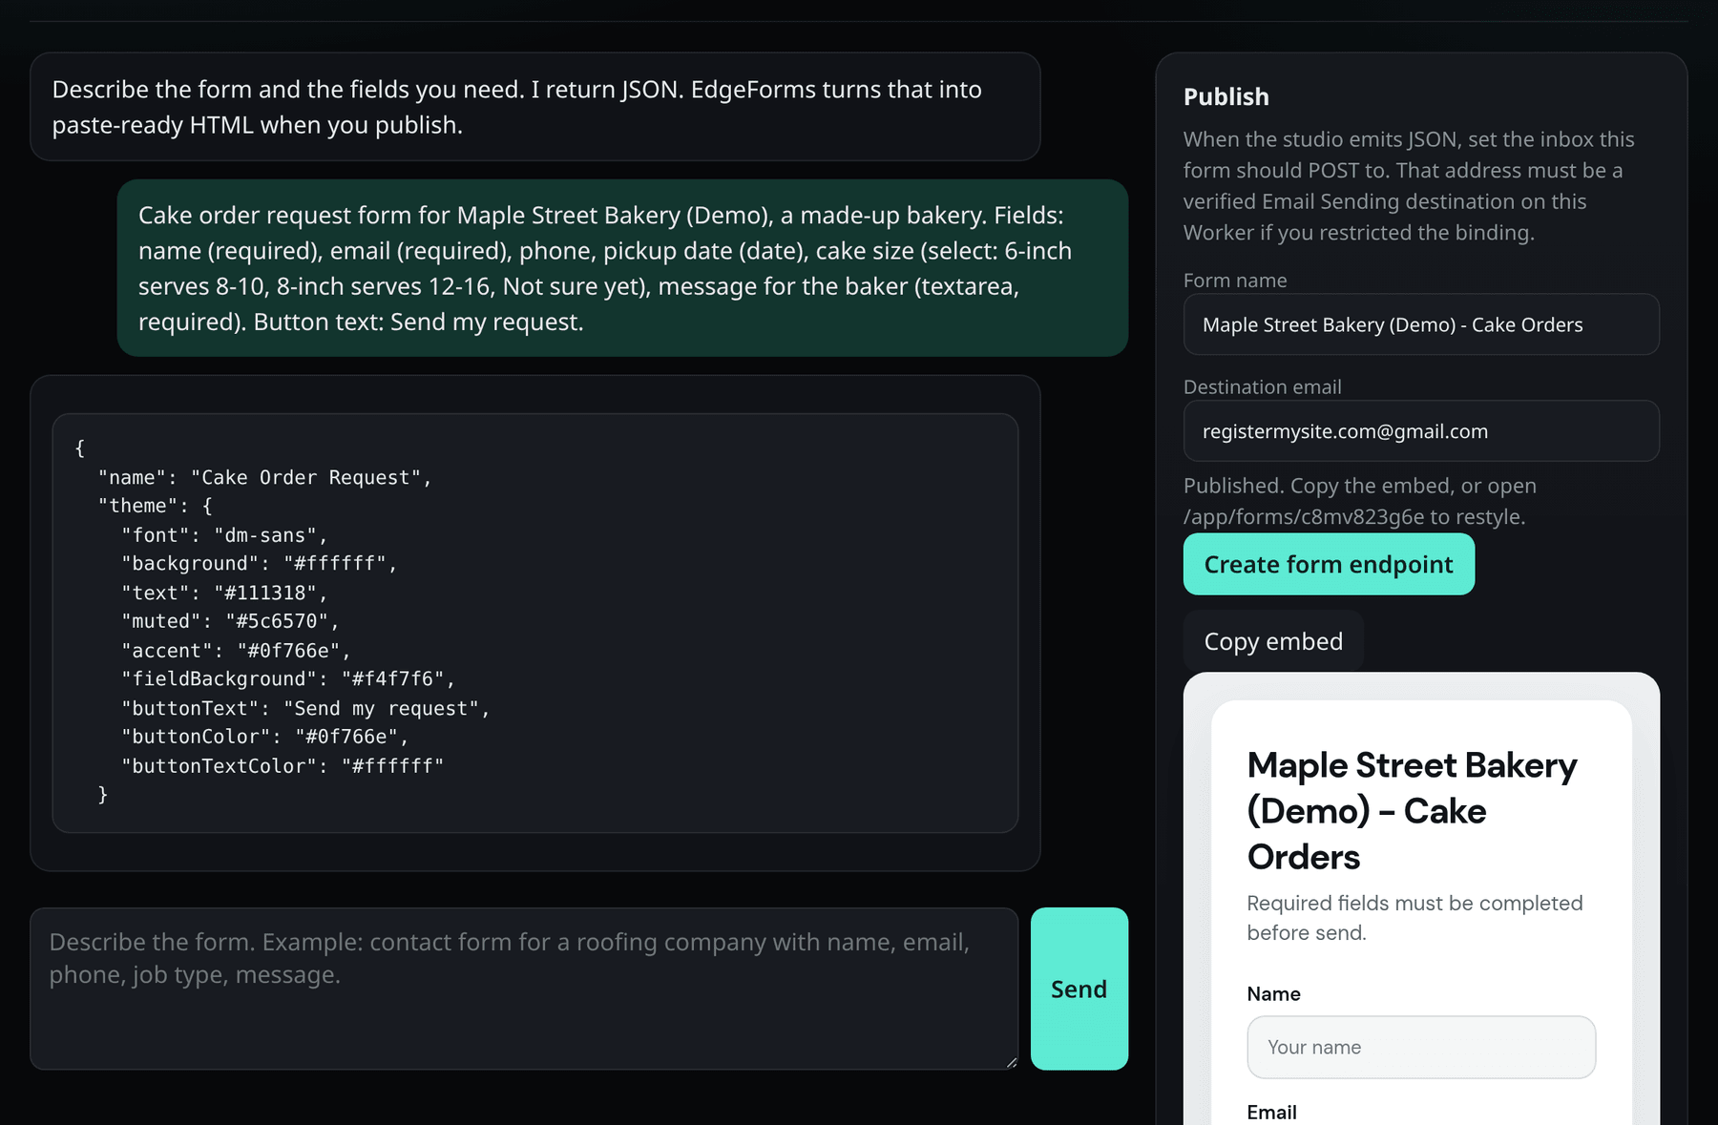
Step 2 · Publish
EdgeForm REGISTERMYSITE
Name it, pick your inbox, create the form
1
Form name
We used "Maple Street Bakery (Demo) - Cake Orders".
2
Destination email
1
Where every submission is emailed. We used our Gmail.
2
4
3
Create form endpoint
Click it to publish.
3
4
"Published."
It worked. The form is ready to use.
5
Preview
A first look at your form.
5
EdgeForm · client guide by RegisterMySite
Sign up
Create
Style
Settings
Embed code
HTML Studio
Go live
Submit
Inbox
07
Notes:
Still in the studio, look at the Publish panel on the right. Number one, give the form a name. Ours is Maple Street Bakery, Demo, Cake Orders. Two, the destination email. This is the address that gets an email every time someone fills out the form, so use an inbox you really check. Three, click Create form endpoint. Four, the word Published means it worked. And five, you get a preview of the form underneath. Ours has the three standard fields: name, email and message.

Slide 8
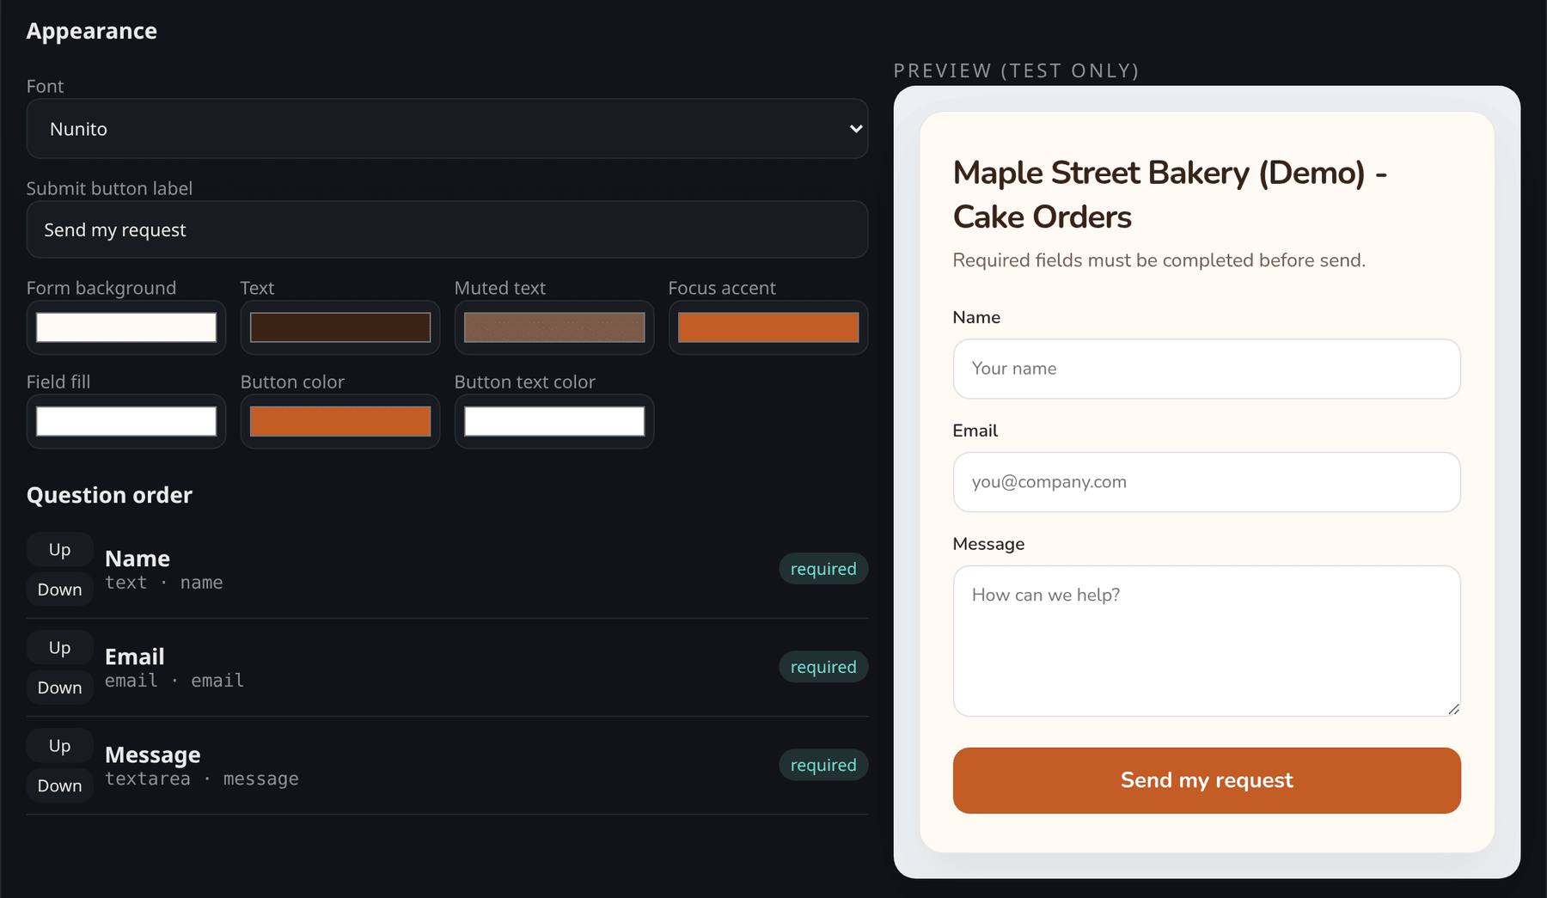
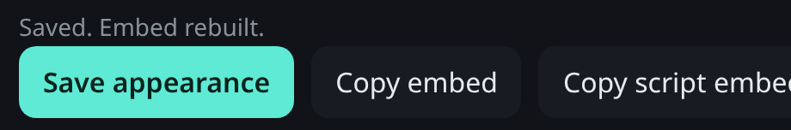
Step 3 · Style it
EdgeForm REGISTERMYSITE
Make the form match your brand
Open your form
5
Your forms, then Open next to the form.
1
1
Font
2
We picked Nunito.
2
Button label
Ours says "Send my request".
3
3
Colors
Background, text, accent, fields and button. We used bakery cream and orange.
4
Question order
Move questions Up or Down.
4
5
Preview
Shows your changes.
6
Save
Saves and updates the embed code.
Click Save appearance. You'll see "Saved. Embed rebuilt."
6
EdgeForm · client guide by RegisterMySite
Sign up
Create
Style
Settings
Embed code
HTML Studio
Go live
Submit
Inbox
08
Notes:
Step three is making it look like your business. Go to Your forms and click Open next to your form. Under Appearance: one, pick a font. We chose Nunito, the same friendly font the bakery site uses. Two, the button label. Ours says Send my request. Three, the colors: background, text, accent, the fill inside each box, and the button. We used the bakery's cream and warm orange. Four, question order lets you move questions up or down. There's no button here to add new questions, just to reorder them. Five, the preview shows your changes. Six, click Save appearance, and you'll see Saved, Embed rebuilt, which means your embed code now includes the new look.

Slide 9
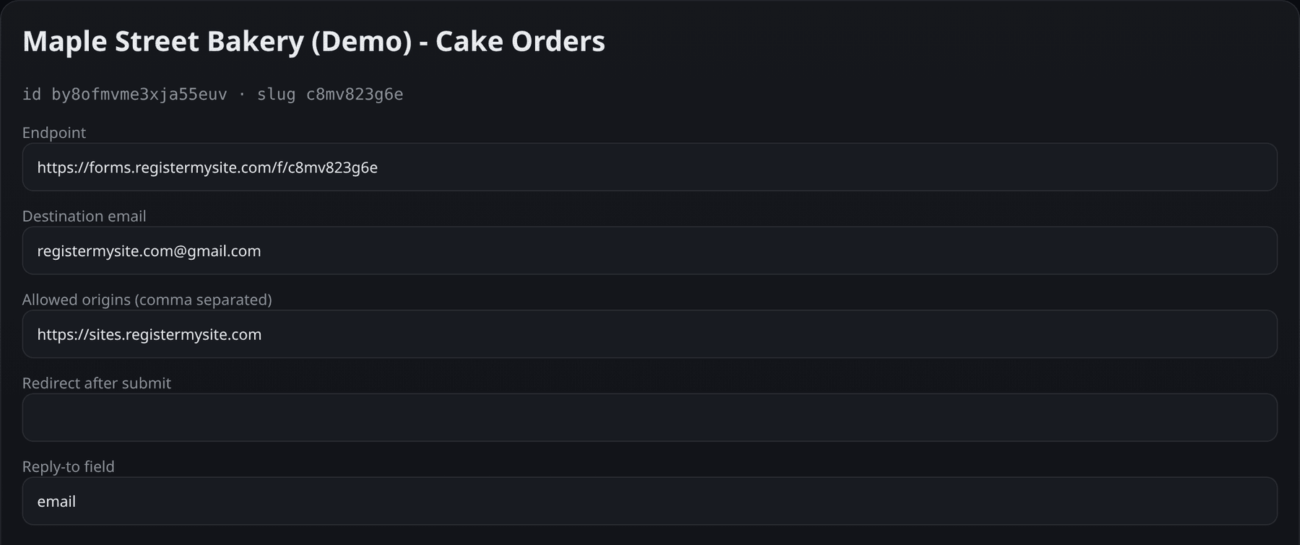

Step 4 · Notifications & settings
EdgeForm REGISTERMYSITE
Where emails go, and who can use your form
1
Destination email
Every new submission is emailed here.
2
Reply-to field
Set to "email", so clicking Reply in your inbox answers the customer.
1
3
Allowed origins
3
Only your website can send to this form. Ours: https://sites.registermysite.com
4
4
Redirect after submit
Optional. Leave it blank to use EdgeForm's "Message received" page.
2
Built-in spam trap
Pause any time
Heads-up
The form includes a hidden "Leave blank" box. People never see it; spam bots fill it in.
The Pause button (next to Copy endpoint) stops new submissions.
Allowed origins also blocks the dashboard's own "Preview (test only)" send. Test on your live page instead.
EdgeForm · client guide by RegisterMySite
Sign up
Create
Style
Settings
Embed code
HTML Studio
Go live
Submit
Inbox
09
Notes:
Step four, a few settings that matter. Number one, the destination email. Every new submission gets emailed here. Two, the reply-to field. We left it set to email, which means when the notification arrives and you click Reply, you're replying straight to the customer. Three, allowed origins. This says which websites may use your form. We put in our site's address, so nobody can copy the form onto another site and flood you. Four, redirect after submit is optional. Leave it blank and people see EdgeForm's Message received page. There's also a hidden spam trap built into the form that people never see, and a Pause button if you ever want to stop new submissions. One heads-up from our test: once you set allowed origins, the dashboard's own test preview gets blocked with Origin is not allowed for this form. That's the lock doing its job. Just test on your real page instead.

Slide 10
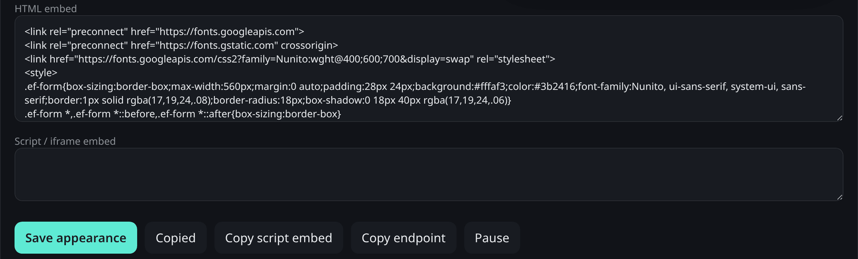

Step 5 · Get the embed code
EdgeForm REGISTERMYSITE
One copy gives you the whole form
1
HTML embed
1
Your whole form: its look and its questions.
2
Copy embed
Copies it. The button changes to "Copied".
4
3
Copy endpoint
2
3
Just the address the form sends to. For web designers.
4
Script / iframe embed
Empty in our test. Use the HTML embed.
INSIDE THE EMBED (SIMPLIFIED)
<form action="https://forms.registermysite.com/f/c8mv823g6e"
method="POST">
<input name="name" required>
<input name="email" type="email" required>
<textarea name="message" required></textarea>
<button type="submit">Send my request</button>
</form>
Good to know
Copy it again after any style change, so your page gets the new look.
EdgeForm · client guide by RegisterMySite
Sign up
Create
Style
Settings
Embed code
HTML Studio
Go live
Submit
Inbox
10
Notes:
Step five, get the embed code. Scroll down on your form's page to HTML embed. Number one, that box holds your whole form, its look and its questions. Two, click Copy embed and the button changes to Copied. Three, Copy endpoint copies just the web address the form sends to, which is handy if a web designer is building the form by hand. Four, there's a Script or iframe embed box. In our test it was empty, and its copy button copied nothing, so use the HTML embed. At the bottom left is a simplified look at what's inside. You don't need to understand it, just paste it. And if you change the style later, copy it again so your page gets the new look.

Slide 11
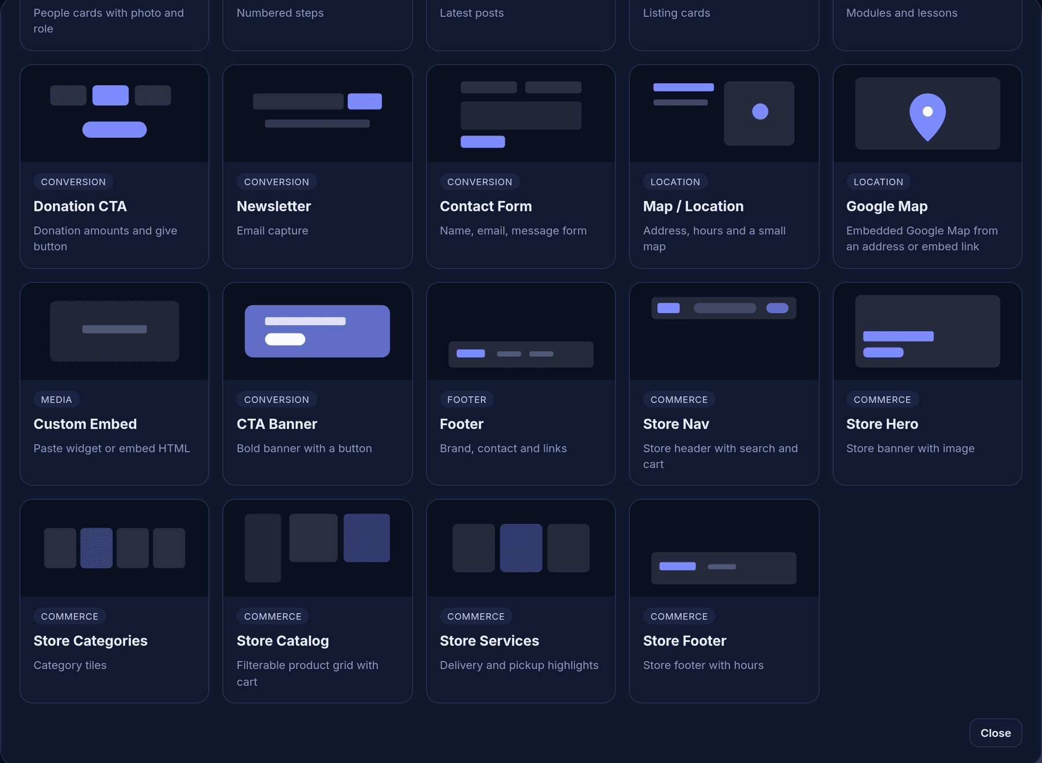
Step 6 · Add it in HTML Studio
EdgeForm REGISTERMYSITE
Add a Custom Embed section to your page
Open your page in HTML Studio
html-studio.registermysite.com. We used our Maple Street Bakery demo page.
Click "+ Add New Section"
At the bottom of the Page Sections list on the left.
1
1
Choose Custom Embed
Under Media: "Paste widget or embed HTML".
Why not "Contact Form"?
HTML Studio has its own Contact Form section too (grey box). We used Custom Embed so the form is your EdgeForm, with your inbox, settings and dashboard.
EdgeForm · client guide by RegisterMySite
Sign up
Create
Style
Settings
Embed code
HTML Studio
Go live
Submit
Inbox
11
Notes:
Step six, put the form on your website. We used HTML Studio, our website builder. Open your page and click Add New Section at the bottom of the list on the left. A menu of section types pops up. Choose Custom Embed, under Media. It says paste widget or embed HTML, which is exactly what we have. You'll also see a Contact Form section, in the grey box. That's HTML Studio's own form. We used Custom Embed so we get the EdgeForm we just set up, with our inbox, our settings and our dashboard.

Slide 12
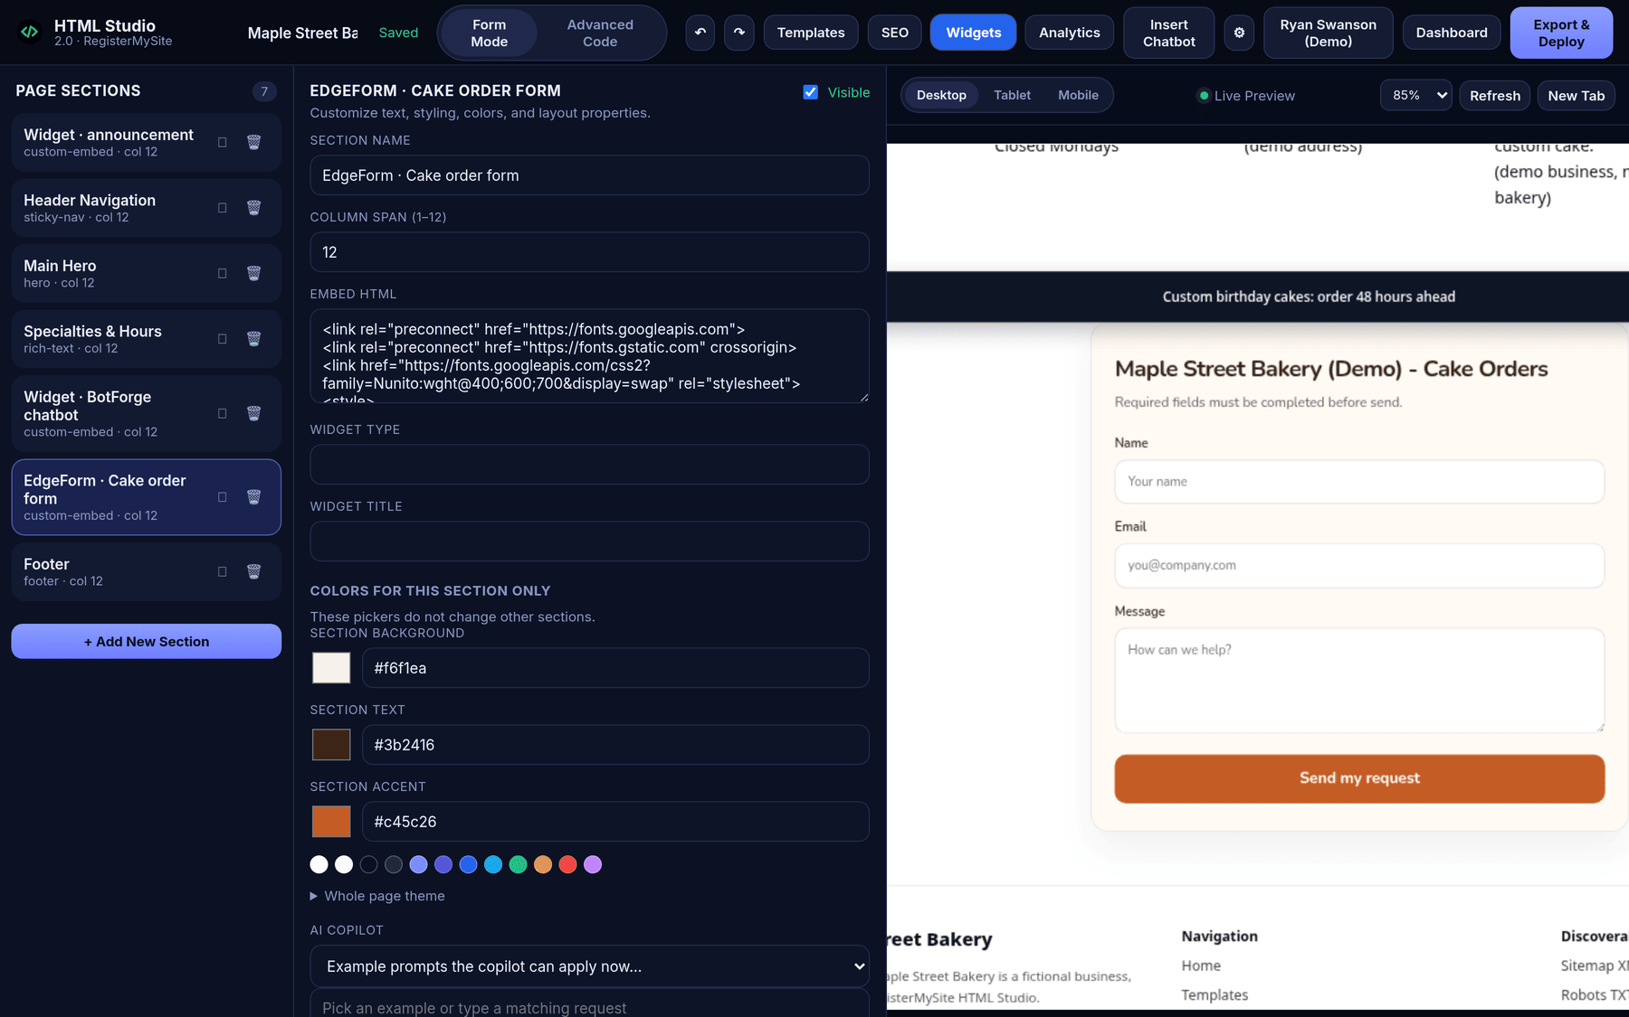
Step 6 · Paste the code
EdgeForm REGISTERMYSITE
Paste, check the preview, and style the section
1
The new section
We dragged it above the footer.
2
2
Section name
5
Ours: "EdgeForm · Cake order form".
3
3
Embed HTML
Paste the code you copied here.
4
Section colors
Optional. We used bakery cream behind the form.
1
5
Live Preview
Your form appears right away.
4
EdgeForm · client guide by RegisterMySite
Sign up
Create
Style
Settings
Embed code
HTML Studio
Go live
Submit
Inbox
12
Notes:
The new section shows up in the list on the left. We dragged ours just above the footer, so the form sits near the bottom of the page. Give it a name you'll recognize. Ours is EdgeForm, Cake order form. Then paste the code you copied into the Embed HTML box. You can also pick colors for just this section. We used the bakery's cream so the form blends in. And on the right, the live preview shows your form right away, with the fonts and colors we chose in EdgeForm.

Slide 13
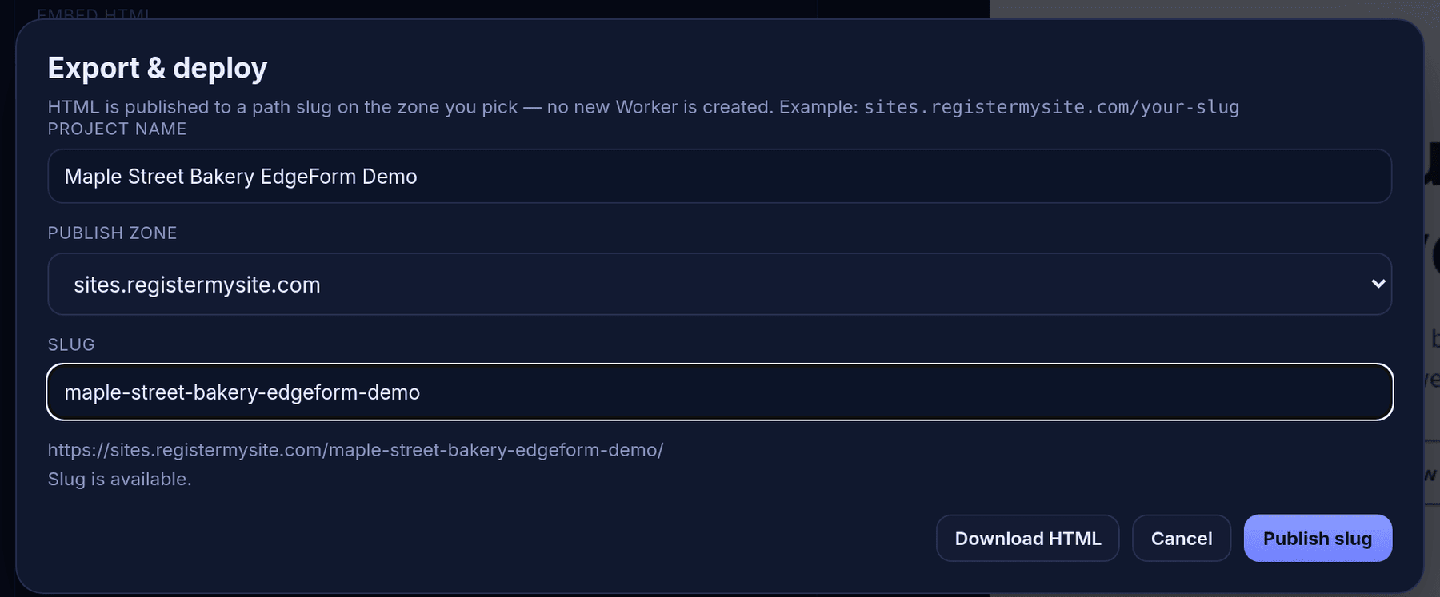
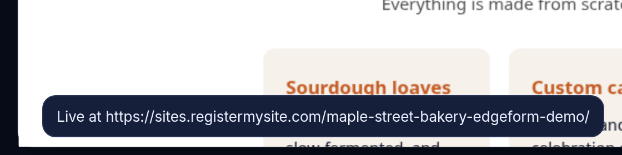
Step 7 · Go live
EdgeForm REGISTERMYSITE
Publish your page with Export & Deploy
Click Export & Deploy
Top right of HTML Studio.
1
1
Project name
"Maple Street Bakery EdgeForm Demo".
2
Slug
The end of your web address: maple-street-bakery-edgeform-demo.
2
"Slug is available."
3
3
Good, nobody else has it.
4
4
Publish slug
Click it.
5
"Live at …"
Your page is on the internet.
5
EdgeForm · client guide by RegisterMySite
Sign up
Create
Style
Settings
Embed code
HTML Studio
Go live
Submit
Inbox
13
Notes:
Step seven, go live. Click Export and Deploy at the top right of HTML Studio. Give the project a name, and pick a slug, which is the last part of your web address. Ours is maple street bakery edgeform demo. When it says Slug is available, nobody else is using it. Click Publish slug, and a moment later you'll see Live at, followed by your page's address. That's it, the page with your form is on the internet.

Slide 14
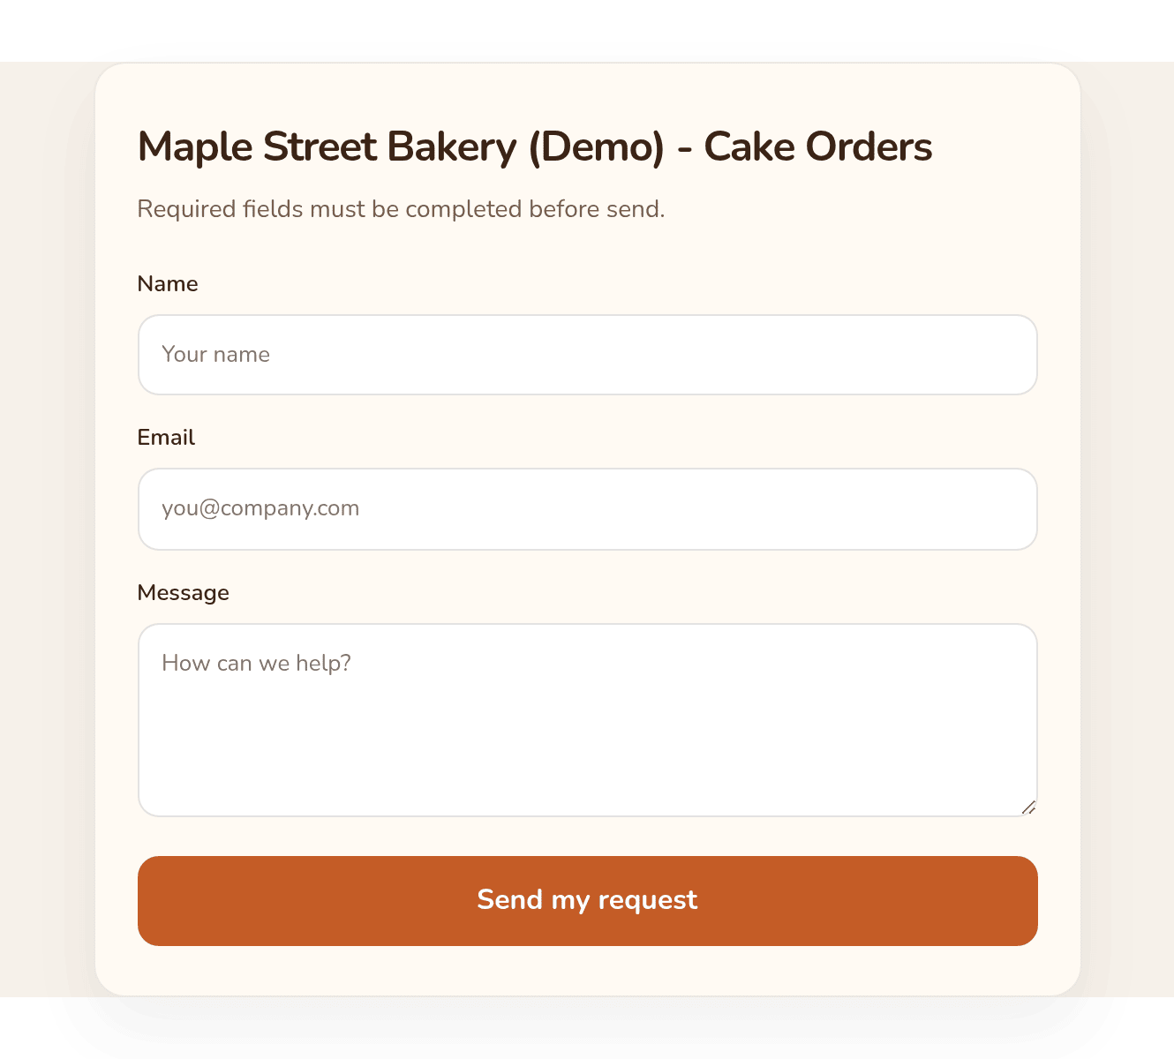


The live form
EdgeForm REGISTERMYSITE
Your form, on your page, ready for customers
Live now: sites.registermysite.com/maple-street-bakery-edgeform-demo/
1
RegisterMySite HTML Studio
Custom Embed section, like we just did.
2
Cloudflare Pages
Paste the embed into your HTML file.
3
Netlify and GitHub Pages
Any static HTML page works the same way.
4
Other site builders
Any that let you add custom HTML.
5
1 Title · 2 Name · 3 Email · 4 Message · 5 Send button
EdgeForm · client guide by RegisterMySite
Sign up
Create
Style
Settings
Embed code
HTML Studio
Go live
Submit
Inbox
14
Notes:
Here it is on the real page. The title, then name, email and message, and our orange Send my request button. The address is on the slide if you'd like to try it. And here's the good news: the embed code isn't tied to HTML Studio. Anywhere you can paste HTML, the form works. That includes static hosting like Cloudflare Pages, Netlify and GitHub Pages, and site builders that let you add custom HTML. Just remember to add that site's address to allowed origins in your form settings.

Slide 15
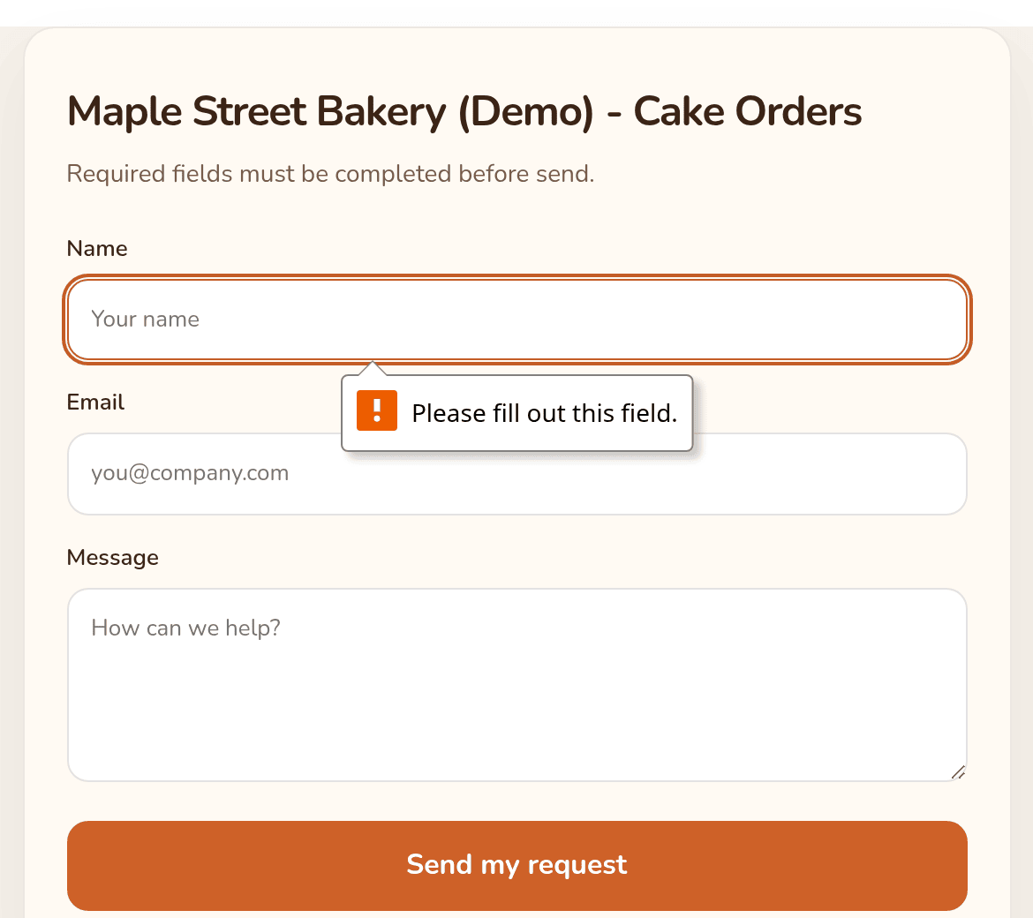
Step 8 · Submit a test
EdgeForm REGISTERMYSITE
Fill it out yourself before your customers do
2 Jamie Demo
3 a test email address
4 a pretend cake order, marked as a test
5 Send my request
All made-up test details.
2
1
3
4
5
1
"Please fill out this field."
Every question is required, so empty sends are stopped.
EdgeForm · client guide by RegisterMySite
Sign up
Create
Style
Settings
Embed code
HTML Studio
Go live
Submit
Inbox
15
Notes:
Step eight, test it yourself before your customers do. First, we tried sending it empty. The browser stopped us with Please fill out this field, because every question is required. Then we filled it out with made-up details: the name Jamie Demo, a test email address, and a pretend order for an eight-inch vanilla birthday cake, clearly marked as a test. Then we clicked Send my request.

Slide 16
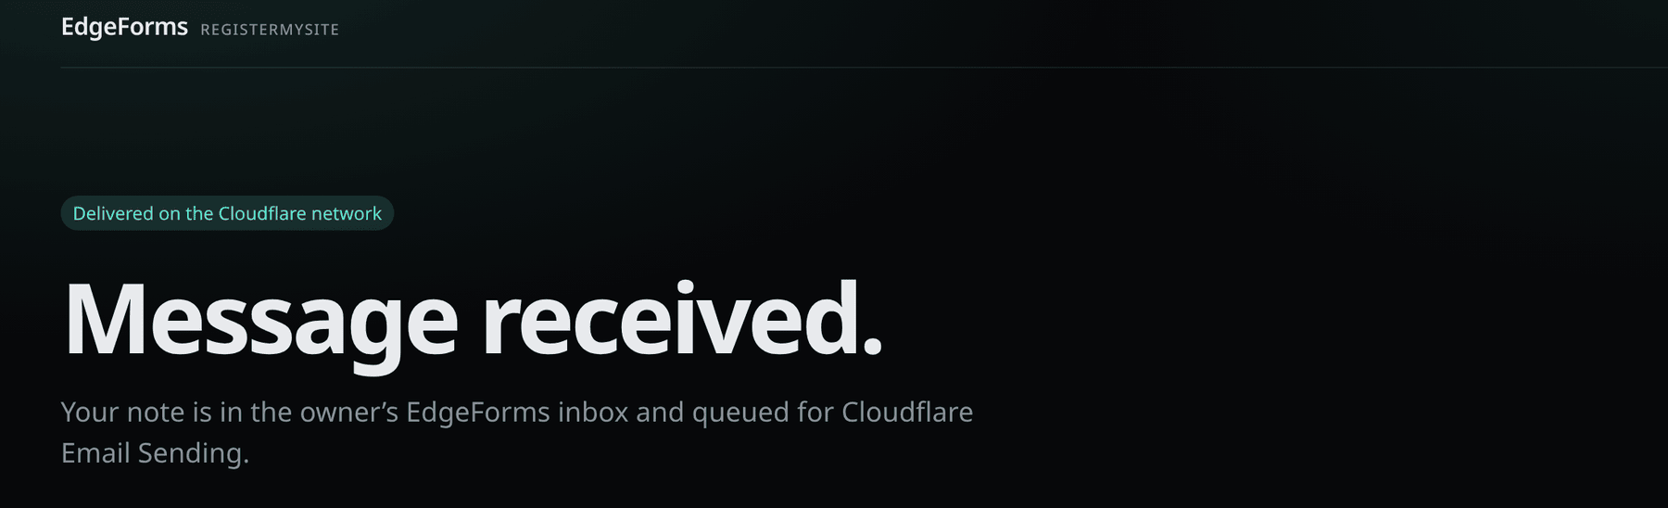
Step 8 · Confirmation
EdgeForm REGISTERMYSITE
What your customer sees after sending
Want your own page?
Make a thank-you page on your site and put its address in "Redirect after submit" in your form settings.
1
2
Heads-up
This page has no link back to your website. A redirect to your own thank-you page fixes that.
1
"Delivered on the Cloudflare network"
A small label at the top.
2
"Message received."
"Your note is in the owner's EdgeForms inbox and queued for Cloudflare Email Sending."
EdgeForm · client guide by RegisterMySite
Sign up
Create
Style
Settings
Embed code
HTML Studio
Go live
Submit
Inbox
16
Notes:
After sending, the customer lands on EdgeForm's confirmation page. It says Message received, and that the note is in the owner's inbox and queued for email. It's clear and reassuring, but it's EdgeForm's page, and it has no link back to your website. If you'd rather keep people on your own site, make a simple thank-you page there and put its address in Redirect after submit in your form settings. We left it blank for this demo, so this is what you get by default.

Slide 17
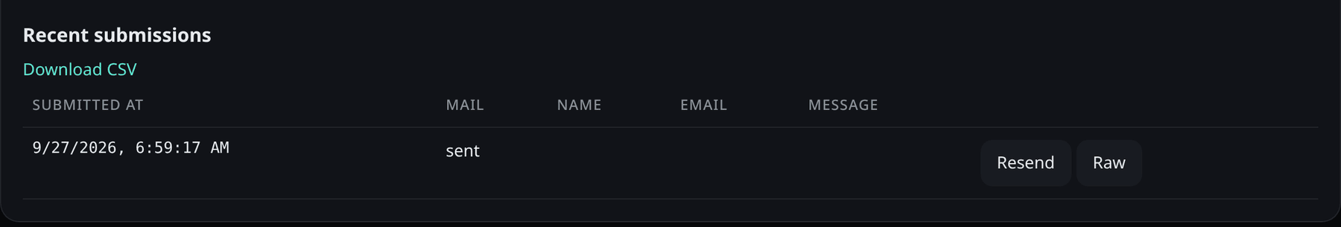
Step 9 · Your dashboard
EdgeForm REGISTERMYSITE
Every submission is counted and listed
What we saw in our test
1
The Name, Email and Message columns stayed blank, even though the submission was saved.
"Raw" showed only {}.
Download CSV opened the EdgeForm home page instead of a file.
For now, your email notification is the full record of each message. We've reported these to the EdgeForm team.
2
4
5
3
1
"1 submissions"
4
Mail: sent
Your forms list counts each one.
The email notification went out.
2
Download CSV
5
Resend and Raw
Meant for a spreadsheet download.
Resend the email, or peek at the details. We didn't need Resend.
3
Submitted at
6:59:17 AM, seconds after we clicked send.
EdgeForm · client guide by RegisterMySite
Sign up
Create
Style
Settings
Embed code
HTML Studio
Go live
Submit
Inbox
17
Notes:
Step nine, check your dashboard. On Your forms, the count went up to one submission. Open the form and scroll to Recent submissions. You'll see when it came in, 6:59 in the morning, a few seconds after we clicked send, and Mail sent, meaning the email notification went out. There's a Resend button to send the email again and a Raw button to peek at the details. Now, some honest notes from our test. The name, email and message columns stayed blank, even though the submission was saved. Raw showed an empty pair of brackets. And Download CSV opened the EdgeForm home page instead of a spreadsheet. We've reported all three. Until they're fixed, your email notification is the full record of every message, which brings us to the inbox.

Slide 18
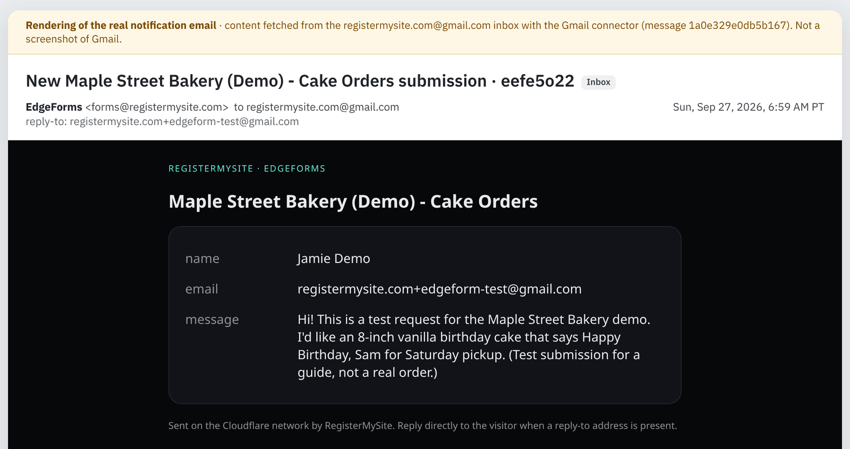
Step 9 · The email notification
EdgeForm REGISTERMYSITE
Each submission lands in your inbox
1
Subject
"New Maple Street Bakery (Demo) - Cake Orders submission"
1
3
2
2
From and reply-to
From EdgeForms. Reply goes straight to the customer.
3
Arrived at 6:59 AM PT
About 8 seconds after we clicked send.
4
The answers
Name, email and message, all there.
4
This is a rendering of the real email, made from the message we fetched from our Gmail inbox. It is not a screenshot of Gmail itself.
EdgeForm · client guide by RegisterMySite
Sign up
Create
Style
Settings
Embed code
HTML Studio
Go live
Submit
Inbox
18
Notes:
And here's the payoff. Every submission arrives in your inbox as an email. The subject tells you which form it came from. It comes from EdgeForms, and the reply-to is the customer's email, so you just hit Reply to answer them. Ours arrived about eight seconds after we clicked send. Inside are all the answers: name, email and the message. One note on this picture: it's a faithful rendering of the real email, which we fetched from our Gmail inbox, not a screenshot of the Gmail screen itself.

Slide 19



Tips
EdgeForm REGISTERMYSITE
Small things that make a big difference
Use an inbox you check daily
Just hit Reply
Lock it to your site
Submissions arrive by email. Add a filter or label so they stand out.
Keep the reply-to field set to "email" so replies go to the customer.
Put your website address in allowed origins.
Test on the live page
Re-copy after restyling
Pause instead of delete
Send yourself a test after every change, and check your inbox.
Save appearance, Copy embed, then paste again in HTML Studio.
Pause stops new submissions but keeps your form.
EdgeForm · client guide by RegisterMySite
19
Notes:
A few tips. Use an inbox you check every day, and consider a Gmail filter or label so form emails stand out. Keep the reply-to field set to email so you can just hit Reply. Lock the form to your site with allowed origins. After any change, send yourself a test from the live page and check your inbox. If you restyle the form, save, copy the embed again and paste it into HTML Studio. And if you want to take a break from submissions, use Pause rather than Delete, so your form is still there when you're ready.

Slide 20

Troubleshooting
EdgeForm REGISTERMYSITE
Real messages we saw, and what to do
"The model did not return a fields array."
"Ask the studio for fields first, or it will publish a default contact form."
The studio didn't build your questions. EdgeForm will publish its standard Name, Email, Message form. Try again, or use the standard form.
A reminder next to Publish. Fine if the standard form is all you need.
"Origin is not allowed for this form"
"Please fill out this field."
The dashboard preview is blocked by allowed origins. Test on your live page instead.
A customer left a question empty. Every question is required.
Blank Name / Email / Message columns
Download CSV opens the home page
Seen in Recent submissions. Your email notification has the full message.
Not working in our test. Keep the emails as your record for now.
Still stuck? Call (562) 751-4597 or email info@registermysite.com and we'll take a look with you.
EdgeForm · client guide by RegisterMySite
20
Notes:
Here are the real messages and issues we ran into. The model did not return a fields array means the studio didn't build your custom questions, so EdgeForm publishes the standard name, email and message form. You can try again or just use the standard form. The reminder about asking for fields first is shown next to Publish, and it's fine if the standard form is all you need. Origin is not allowed for this form showed up when we tried the test preview in the dashboard. That's the allowed origins lock, so test on your live page. Please fill out this field is the browser telling a customer they skipped a question. And in the dashboard, the blank columns and the CSV download didn't work in our test, so rely on your email notifications for now. If you get stuck, call or email us.

Slide 21
Recap
EdgeForm REGISTERMYSITE
Your website form in nine steps
1
Sign up
Name, email, password
2
Create
Describe it in the studio, publish
3
Style
Font, colors, button label
4
Settings
Inbox, reply-to, allowed origins
5
Embed code
Copy embed
6
HTML Studio
Custom Embed section, paste
7
Go live
Export & Deploy, publish slug
8
Submit
Send yourself a test
9
Inbox
Check the email and your dashboard
EdgeForm · client guide by RegisterMySite
21
Notes:
Let's recap. Sign up with your name, email and password. Create your form by describing it in the studio, and publish it. Style it with your font, colors and button label. Check the settings: your inbox, reply-to and allowed origins. Copy the embed code, add a Custom Embed section in HTML Studio and paste it in. Publish the page with Export and Deploy. Send yourself a test, and check the email and your dashboard. That's it. Once it's set up, every message from your website lands right in your inbox.

Slide 22




EdgeForm REGISTERMYSITE
We're here to help
TRY THE LIVE DEMO
Want us to set up your form with you?
The form on a real website
sites.registermysite.com/
maple-street-bakery-edgeform-demo/
Build your own form
registermysite.com
forms.registermysite.com
(562) 751-4597
Build your website
html-studio.registermysite.com
info@registermysite.com
Maple Street Bakery (Demo) is a made-up business. Please send test messages only.
In person in LA and OC
EdgeForm · client guide by RegisterMySite
22
Notes:
That's it from me. If you'd like help, we're happy to set up your form with you, style it to match your brand, and get it onto your website. You can find us at registermysite dot com, call 562 751 4597, or email info at registermysite dot com. We also meet in person across LA and Orange County. On the right is the live demo page, where you can see the form on a real website, plus the addresses for EdgeForm and HTML Studio. If you try the demo form, please only send test messages, since the bakery is made up. Thanks so much for your time. Happy to take any questions.

