Slide 1


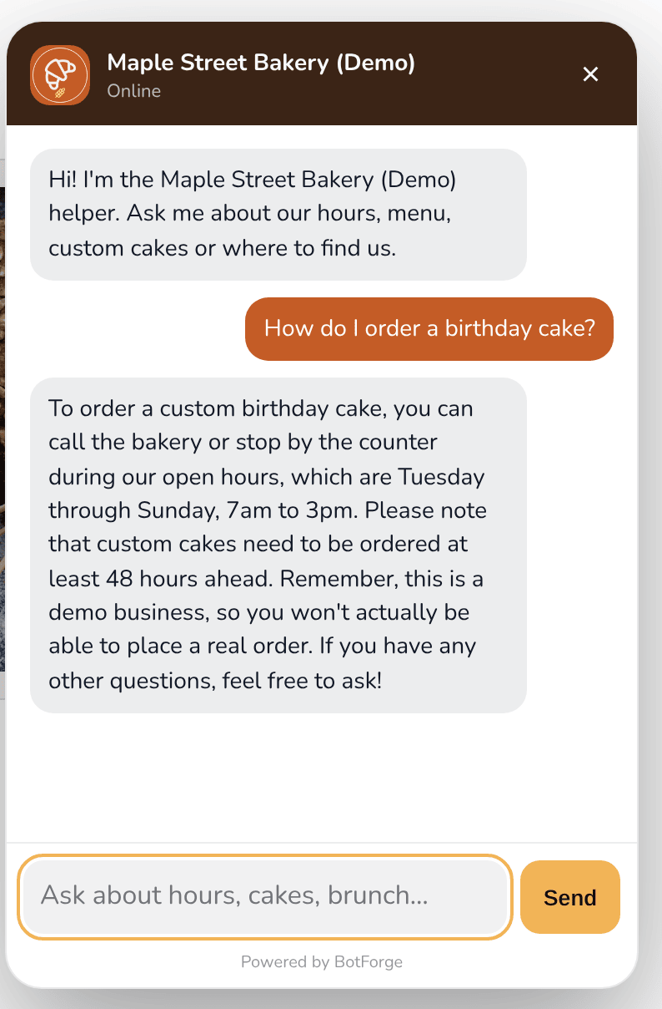

BotForge
by RegisterMySite
CLIENT GUIDE · STEP BY STEP
Build a chatbot that knows your business
From sign-up to a live, on-brand helper on your website. No coding, one copy-and-paste.
Demo business: Maple Street Bakery (Demo) is made up.
The finished demo bot, live on a real web page
BotForge · client guide by RegisterMySite
01
Notes:
Hi everyone, and thanks for joining. Today I'm going to show you how to build your own website chatbot with BotForge, one of our RegisterMySite tools. By the end you'll have a helper that looks like your brand, answers questions from your own information, and sits on your website. Everything you'll see comes from a real demo we built for this guide. The business is Maple Street Bakery, and it's made up, so please don't try to order a cake from it. The picture on the right is the finished bot answering a real question on a live web page.

Slide 2

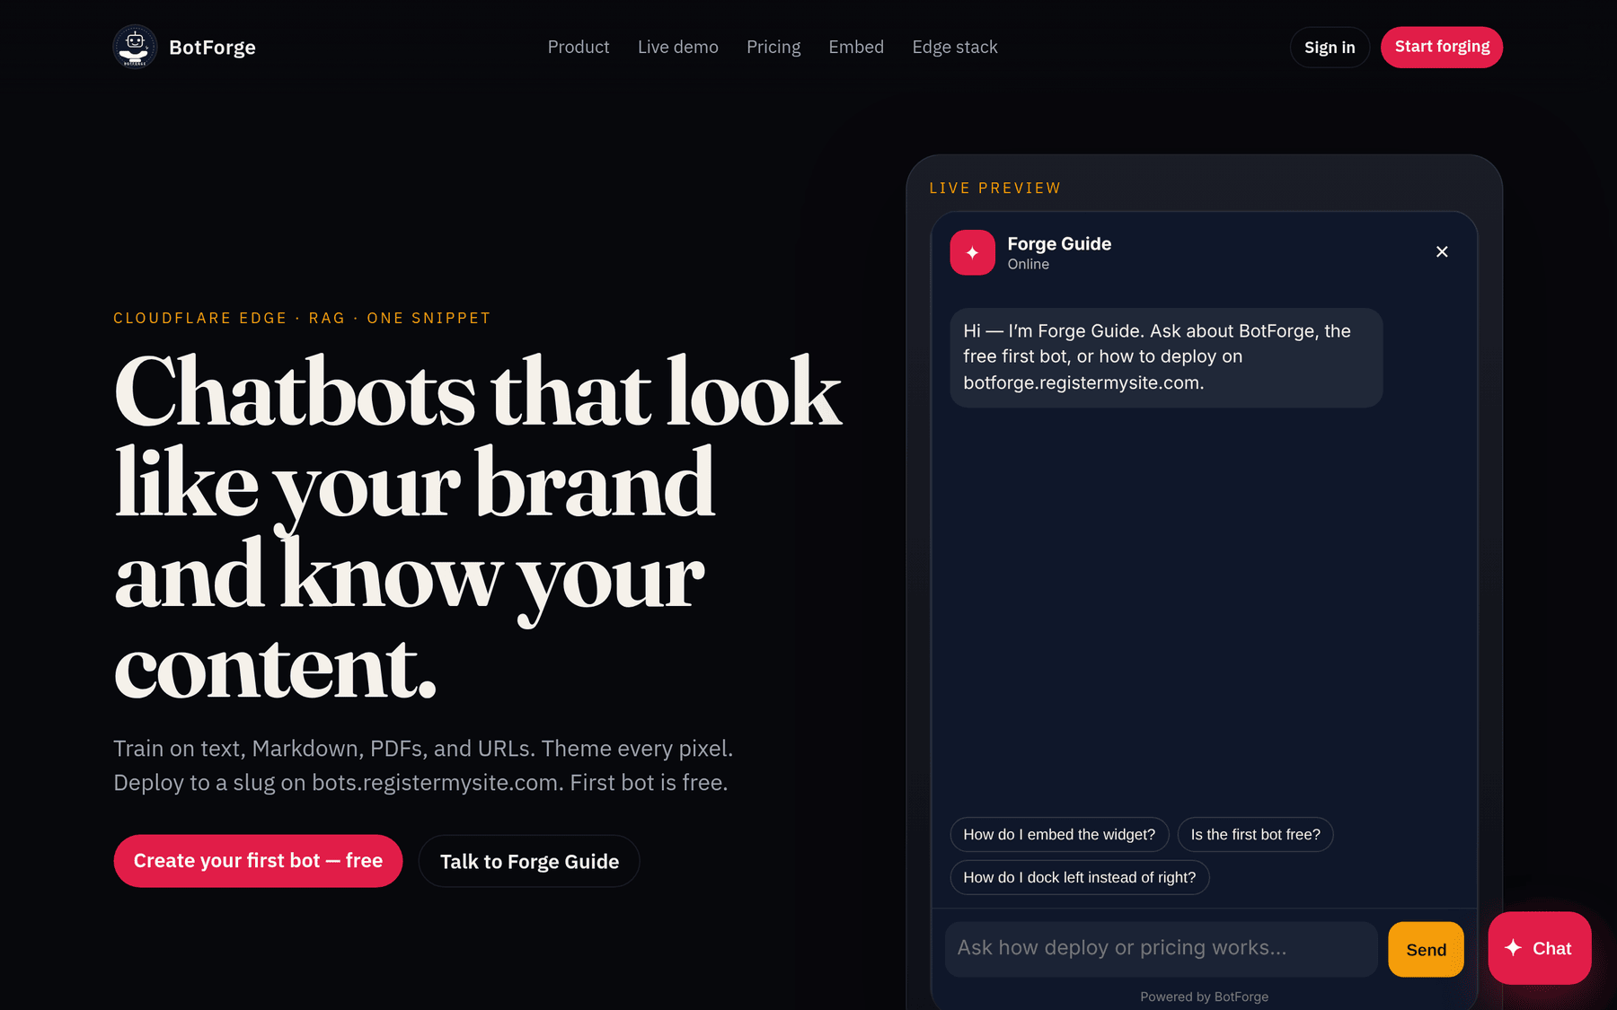




WHAT BOTFORGE IS
A helper that looks like you and knows your stuff
Looks like your brand
Knows your content
Your colors, font, logo, welcome message and a button label you pick.
You teach it with text, Markdown, PDFs and web pages. It answers from that.
One snippet
First bot is free
Copy one line of code and paste it into your site. That's the install.
Each extra bot after the first needs a subscription.
From the BotForge home page: "Chatbots that look like your brand and know your content."
botforge.registermysite.com
BotForge · client guide by RegisterMySite
02
Notes:
So what is BotForge? It's a chat helper for your website. Four things to remember. One, it looks like your brand: you pick the colors, the font, your logo, and what it says when someone opens it. Two, it knows your content. You teach it with your own text, documents or web pages, and it answers from that. Three, installing it is one snippet, a single line of code you copy and paste. And four, your first bot is free. If you want more bots later, each extra one needs a subscription. Those facts come straight from the BotForge home page you see on the right.

Slide 3









THE JOURNEY
Eleven small steps, start to finish
1
2
3
4
5
6
Sign up
Sign in
Create
Theme
Train
Test
Email, password, name
Back to your bots
Name your bot
Colors, logo, button
Add your info
Ask real questions
7
8
9
10
11
Voice
Analytics
Deploy
Copy
Paste
Pick a model, greeting
See the chats
Make it live
Grab the snippet
Add it to your site
Every screen in this guide is a real screenshot from our demo account.
BotForge · client guide by RegisterMySite
03
Notes:
Here's the whole trip on one slide. We'll sign up and sign in, create a bot, and give it your look. Then we train it with your information, test it with a few real questions, and pick its voice, meaning the AI model and the greeting. We'll peek at analytics, deploy it so it's live, copy the snippet, and paste it into your website. Each of these gets its own slide, and the little bar at the bottom of each slide shows where we are. Every screen you'll see is a real screenshot from our demo account.

Slide 4
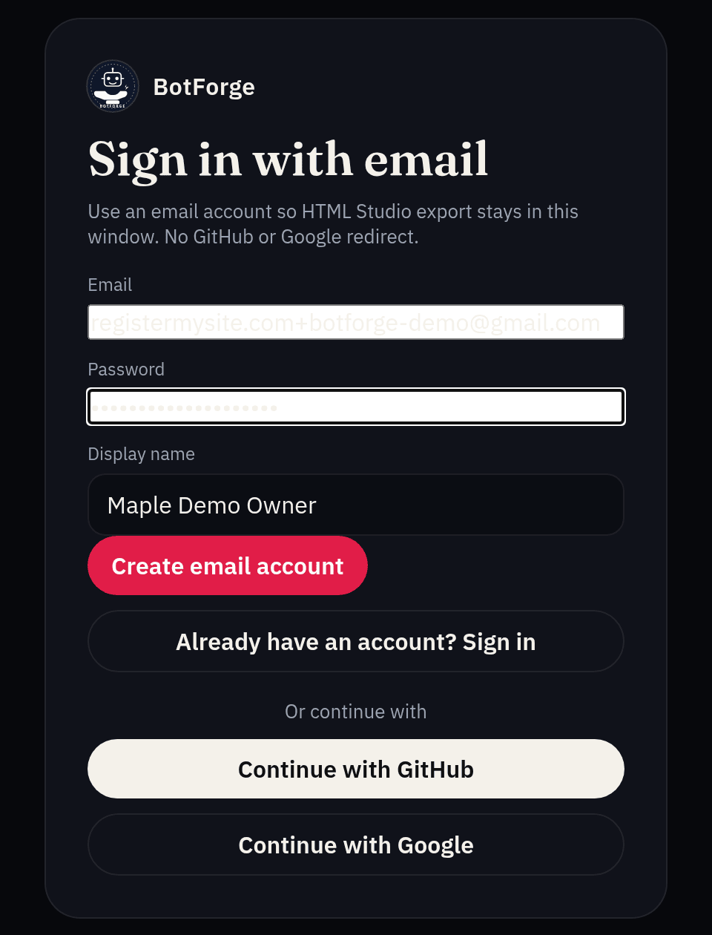
STEP 1 · SIGN UP
Create your free account
Go to botforge.registermysite.com
Click "Create your first bot — free", then "Need an account? Create one".
1
Email
Use an email you check. We used a Gmail address.
1
2
Password
2
Pick a strong one and save it in your password manager. It shows as dots.
3
3
Display name
4
Your name or your business name.
4
Create email account
That's it. In our test there was no code to type and no verification email.
BotForge · client guide by RegisterMySite
04
Sign up
Sign in
Create
Theme
Train
Test
Voice
Analytics
Deploy
Copy
Paste
Notes:
Step one is signing up. Go to botforge dot registermysite dot com and click Create your first bot, free. On the sign-in box, click Need an account, Create one. Then fill in three things: your email, a password, and a display name, which can be your own name or your business name. Click Create email account and you're in. When we did this there was no code to type and no confirmation email. It went straight to the dashboard. You'll also see GitHub and Google buttons. The page itself suggests using an email account if you plan to use it with HTML Studio, so that's what we did.

Slide 5
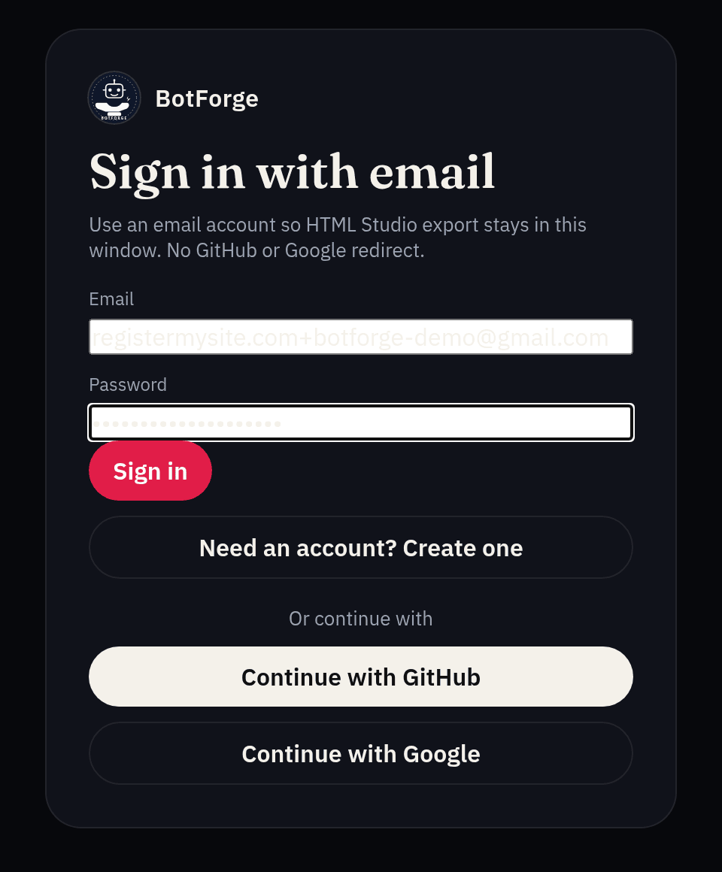

STEP 2 · SIGN IN
Coming back later? Sign in with the same email
Open botforge.registermysite.com/login
Or click "Sign in" at the top of the home page.
1
Type your email
The same one you signed up with.
2
Type your password
1
It stays hidden as dots.
2
3
Click Sign in
You land on "Your bots", your list of chatbots.
3
Heads-up from our test
The email box can show white with pale text that's hard to read. What you typed is still there, so just carry on.
BotForge · client guide by RegisterMySite
05
Sign up
Sign in
Create
Theme
Train
Test
Voice
Analytics
Deploy
Copy
Paste
Notes:
Step two is signing in, for any time you come back. Go to the login page, or click Sign in on the home page. Type your email, then your password, which stays hidden as dots, and click Sign in. You'll land on Your bots, which is your list of chatbots. One small thing we noticed in our test: the email box can look white with very pale text, so it's hard to read what you typed. Don't worry, it's all there. Just carry on and click Sign in.

Slide 6
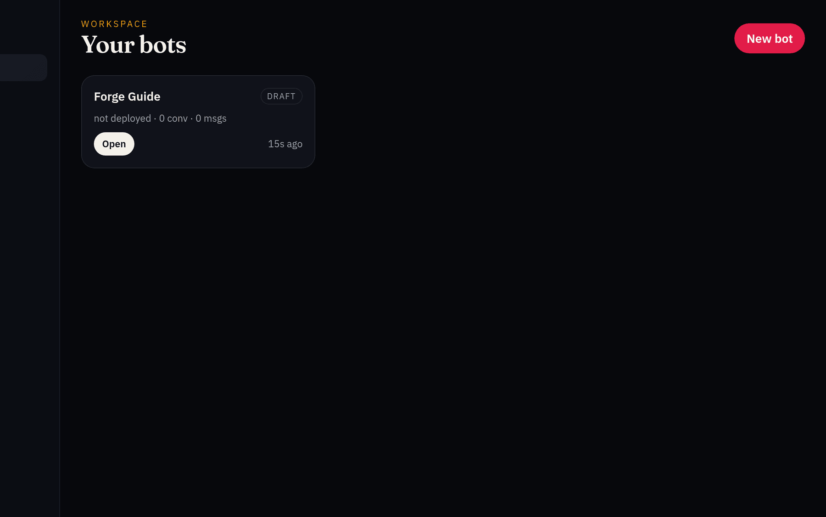
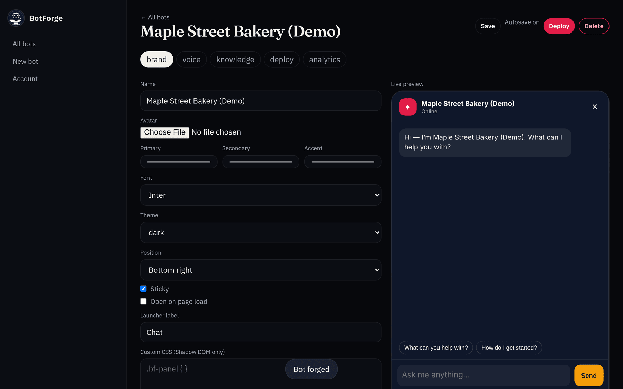
STEP 3 · CREATE YOUR BOT
Click New bot and give it a name
1
3
1
Click New bot
2
Type a name, click OK
3
"Bot forged"
Top right, or "New bot" in the menu.
A small box asks for "Bot name". We typed Maple Street Bakery (Demo).
That message means it worked. The bot editor opens.
BotForge · client guide by RegisterMySite
06
Sign up
Sign in
Create
Theme
Train
Test
Voice
Analytics
Deploy
Copy
Paste
Notes:
Step three: create the bot. On Your bots, click the red New bot button at the top right. A small box pops up asking for the bot name. We typed Maple Street Bakery, Demo, and clicked OK. You'll see a little message that says Bot forged, which means it worked, and the bot editor opens. Across the top of the editor are five tabs: brand, voice, knowledge, deploy and analytics. We'll go through them one at a time. One thing to know: our new account already came with a starter draft bot called Forge Guide. You can ignore it or delete it.

Slide 7
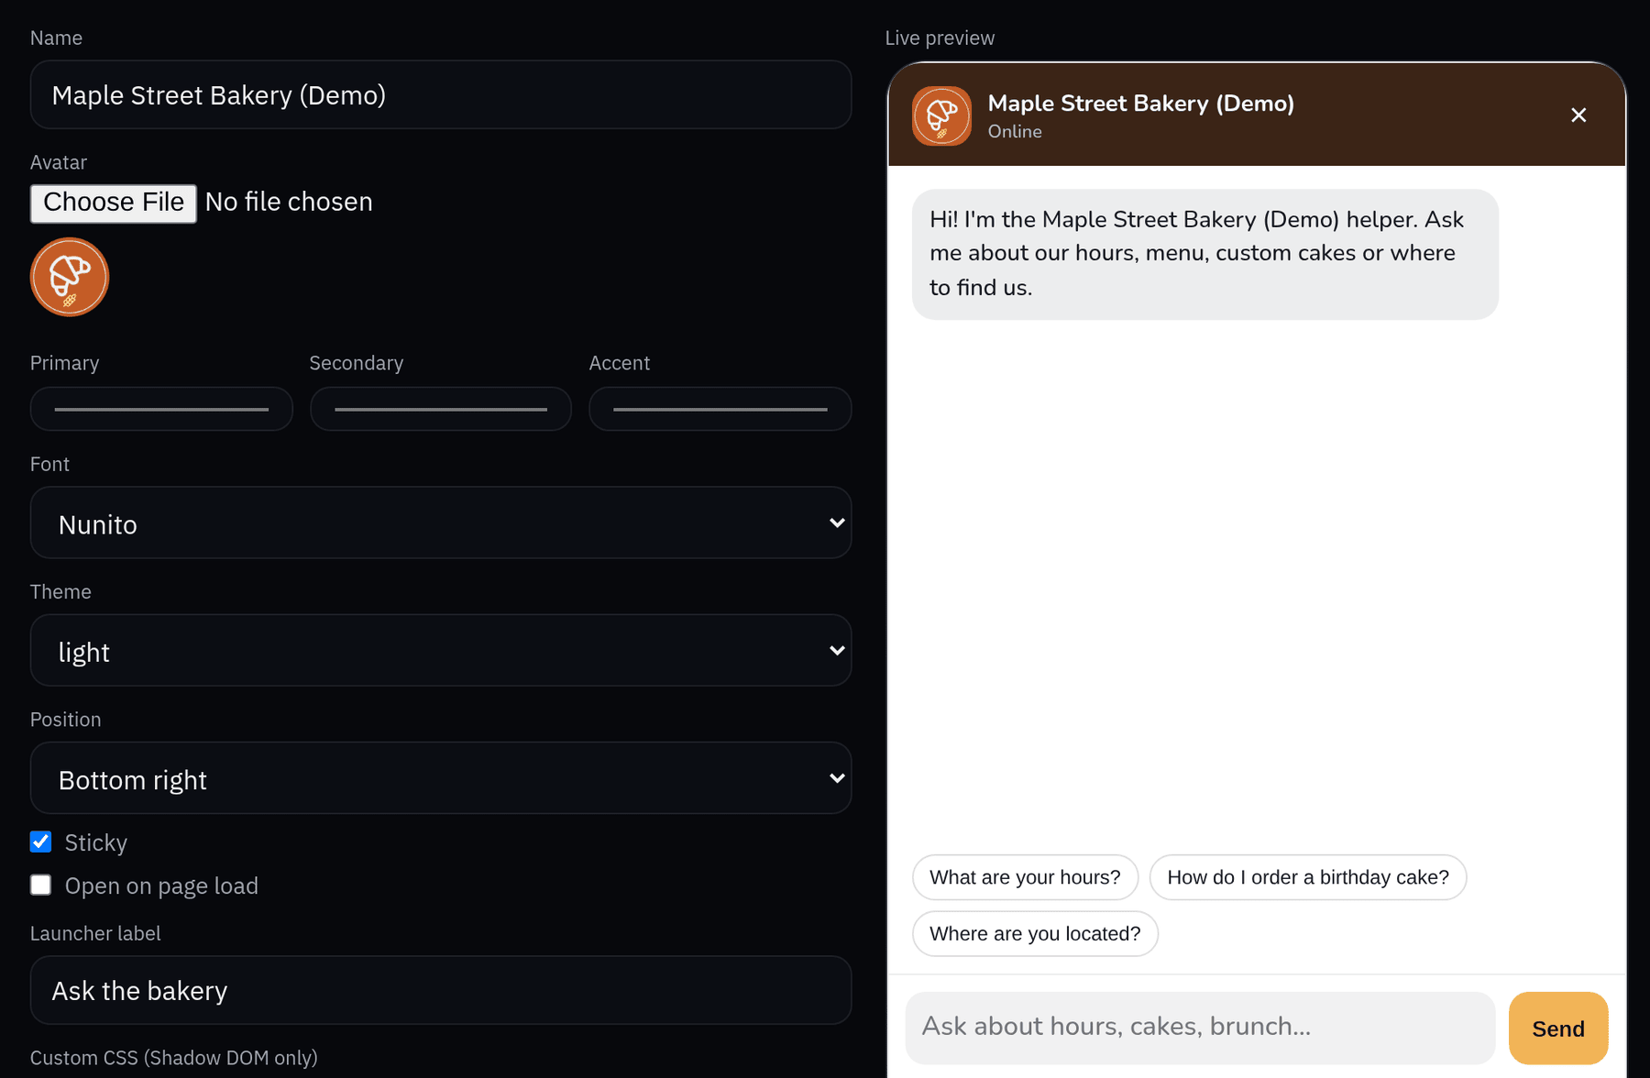
STEP 4 · THEME IT
Make it look like your business (brand tab)
7
1
Avatar
Upload your logo. We used a croissant we drew ourselves.
2
Colors
1
Primary, secondary and accent. We used bakery orange, brown and honey.
3
Font
2
We picked Nunito.
4
Theme
Light, dark, auto or custom.
3
Position
5
Bottom right or bottom left.
4
6
Launcher label
The button text: "Ask the bakery".
5
7
Live preview
Changes show up here. Autosave is on.
6
BotForge · client guide by RegisterMySite
07
Sign up
Sign in
Create
Theme
Train
Test
Voice
Analytics
Deploy
Copy
Paste
Notes:
Step four is the fun part: making it look like you. You're on the brand tab. Number one, upload your logo as the avatar. We drew a simple croissant ourselves. Two, pick your three colors. We used the bakery's orange, a warm brown and a honey color. Three, choose a font. Four, pick light or dark. Five, choose which corner of the screen it sits in. Six, the launcher label is the text on the chat button. Ours says Ask the bakery. And seven, the preview on the right updates as you go, and autosave is on, so you won't lose anything. One tip from our test: the Send button text is always dark, so pick a light accent color. Our first choice, a dark green, was hard to read, so we switched to honey.

Slide 8
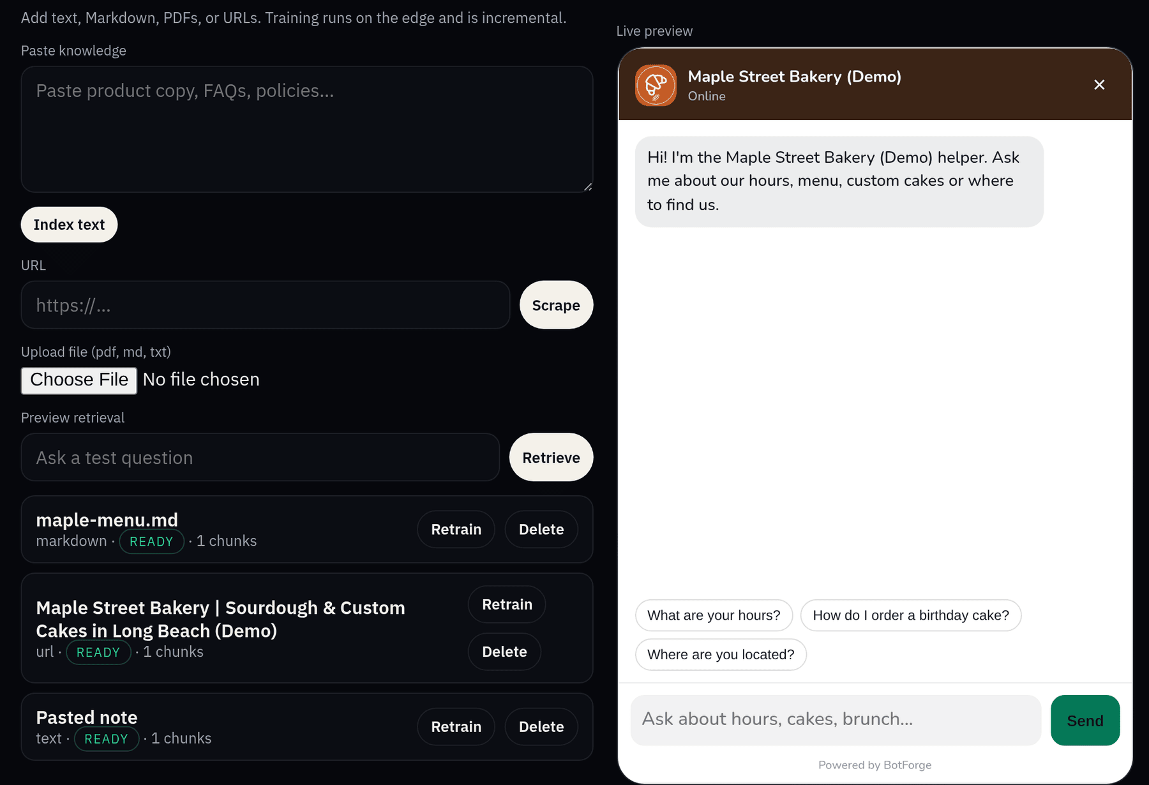
STEP 5 · TRAIN IT
Teach it about your business (knowledge tab)
1
Paste text, click Index text
We pasted a short FAQ: hours, location, how to order, cakes, brunch.
1
2
Add a web page, click Scrape
We added the bakery's demo website.
3
Upload a file
PDF, Markdown or text. We uploaded a one-page menu.
2
4
Wait for READY
3
Each source shows READY when it's learned. Ours took under a minute.
4
BotForge · client guide by RegisterMySite
08
Sign up
Sign in
Create
Theme
Train
Test
Voice
Analytics
Deploy
Copy
Paste
Notes:
Step five is teaching the bot about your business. This is the knowledge tab, and there are three ways to add information. One, paste text and click Index text. We pasted a short FAQ with the bakery's hours, location, how to order and the cake rules. Two, type a web address and click Scrape. We used the bakery's demo website. Three, upload a file, like a PDF menu or a text document. We uploaded a one-page menu. Four, watch the list at the bottom. Each source shows READY when the bot has learned it. For us that took less than a minute. If you change something later, you can click Retrain or Delete on any source.

Slide 9
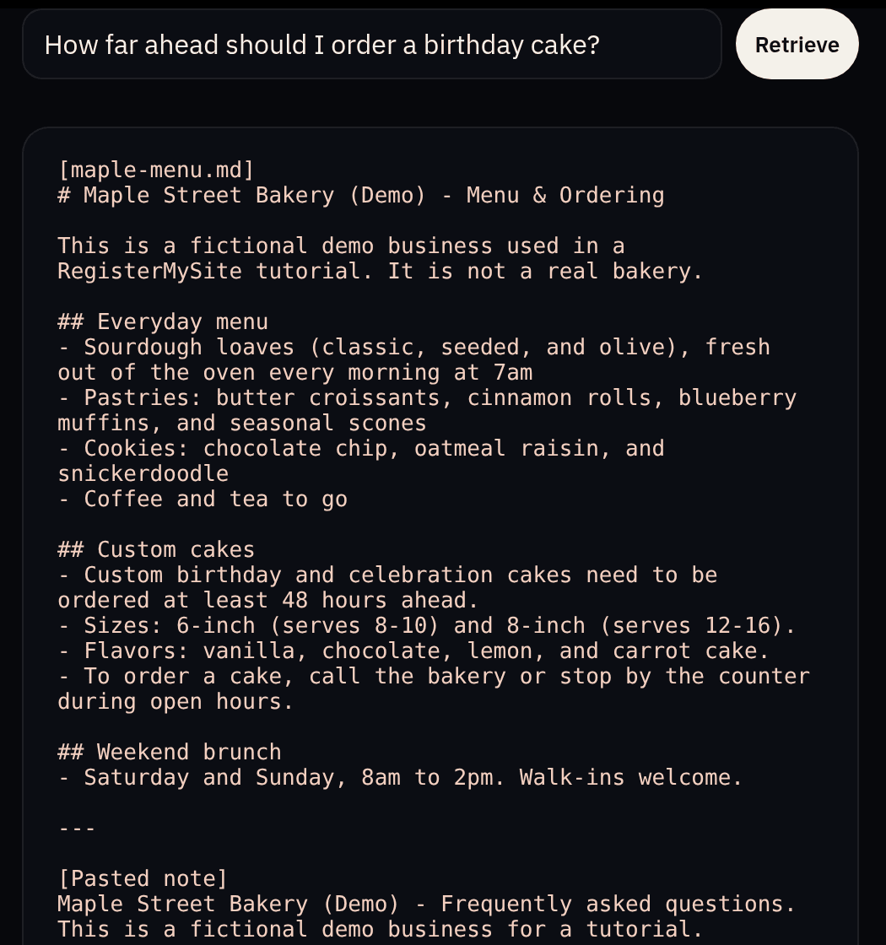

STEP 5 · CHECK WHAT IT LEARNED
Preview retrieval shows the exact info it will use
2
1
1
Type a test question
We asked: "How far ahead should I order a birthday cake?"
2
Click Retrieve
BotForge looks through everything you added.
3
Read the matches
It showed our menu file and the FAQ, both saying cakes need 48 hours. If the right info doesn't show up, add it and try again.
3
Why this matters
The bot answers from what it finds here. If the facts are right in this box, the answers will be too.
BotForge · client guide by RegisterMySite
09
Sign up
Sign in
Create
Theme
Train
Test
Voice
Analytics
Deploy
Copy
Paste
Notes:
Before we chat with it, here's a handy check. Still on the knowledge tab, there's Preview retrieval. Type a question a customer might ask. We typed, how far ahead should I order a birthday cake? Click Retrieve, and BotForge shows the exact pieces of your information it would use to answer. Here it found our menu file and our FAQ, and both say 48 hours. That's what we want. If the right facts don't show up, it means the bot doesn't have them yet, so add them and try again.

Slide 10
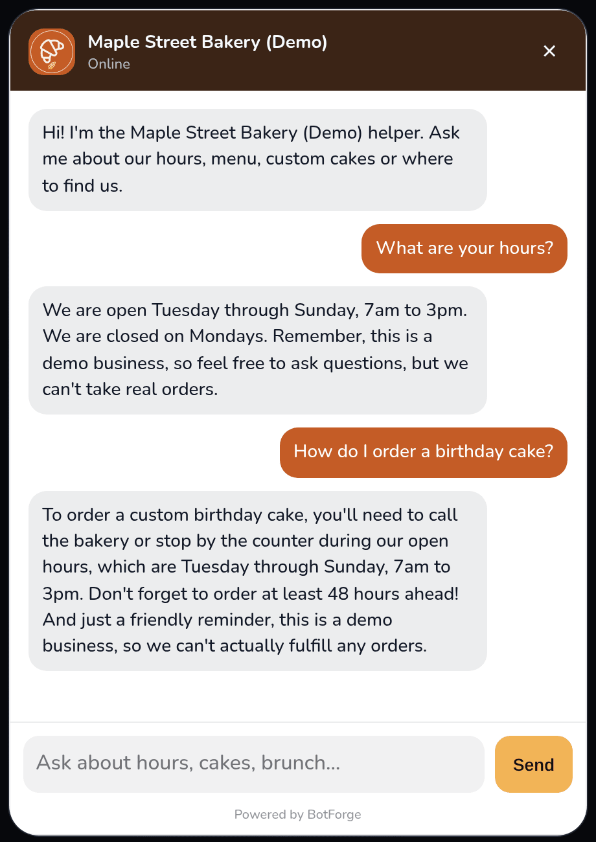
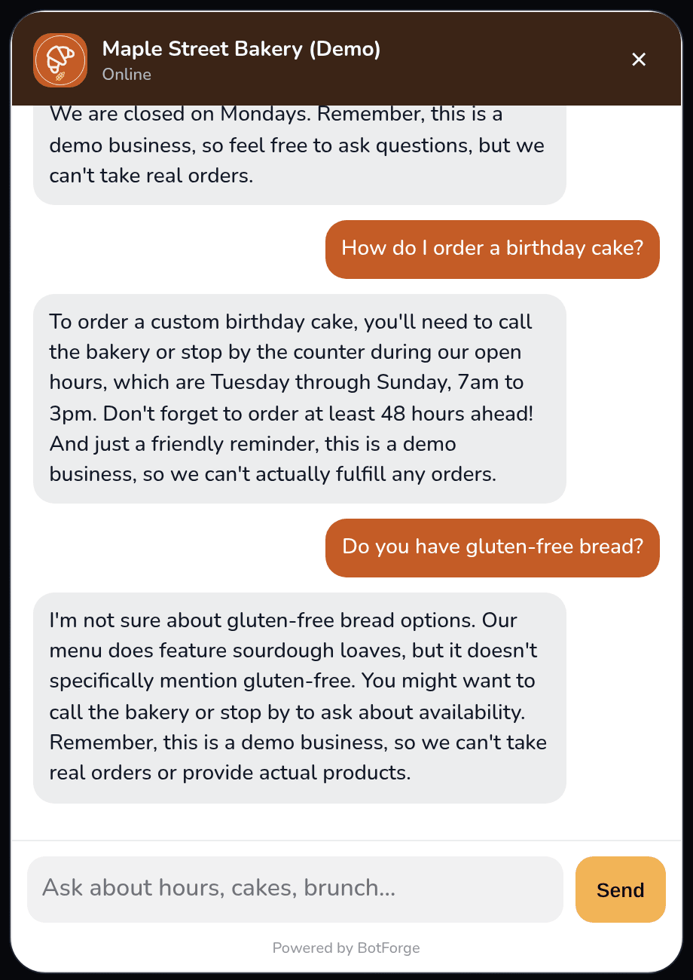
STEP 6 · TEST IT
Ask it real customer questions in the live preview
1
Ask like a customer
Click a starter question or type your own.
2
Real answer from your info
"We are open Tuesday through Sunday, 7am to 3pm. We are closed on Mondays."
1
Honest when it doesn't know
3
We never mentioned gluten-free bread, so it said it wasn't sure and suggested calling. That's your cue to add the info.
2
3
BotForge · client guide by RegisterMySite
10
Sign up
Sign in
Create
Theme
Train
Test
Voice
Analytics
Deploy
Copy
Paste
Notes:
Step six: test it. Use the live preview on the right side of the editor and ask questions the way a customer would. You can click one of the starter questions or type your own. We asked, what are your hours, and it answered, we are open Tuesday through Sunday, 7am to 3pm, closed Mondays. That's straight from our FAQ. We asked how to order a birthday cake, and it told us to call or stop by, and to order 48 hours ahead. Then we tried something we never taught it: do you have gluten-free bread? It said it wasn't sure and suggested calling. That's good behavior. It didn't make something up. And it tells you exactly what to add to the knowledge tab next.

Slide 11
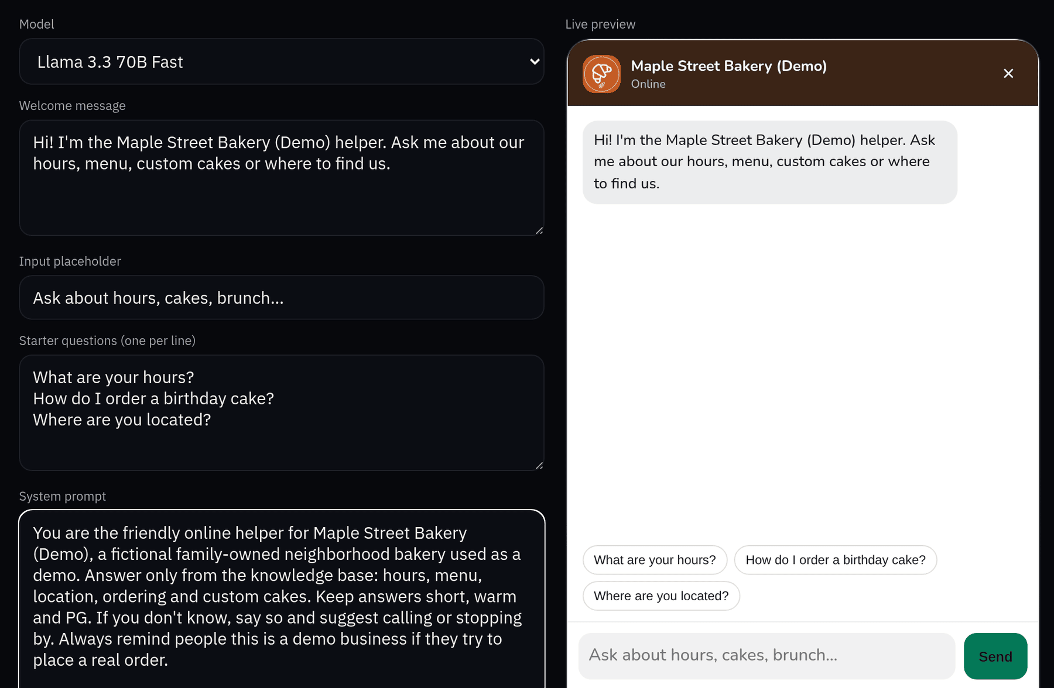
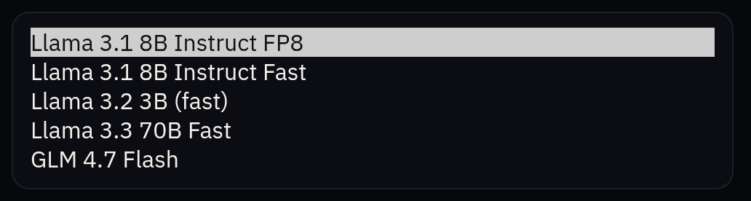
STEP 7 · CHOOSE ITS VOICE
Pick the AI model and greeting (voice tab)
1
2
The 5 models on offer. Default is the first one.
1
Model
We picked Llama 3.3 70B Fast.
3
2
Welcome message
The first thing visitors see.
3
Placeholder
Hint text in the typing box.
4
4
Starter questions
One per line. They show as buttons.
5
System prompt
Its personality and rules. Ours: warm, short, PG, answer from the knowledge base.
5
BotForge · client guide by RegisterMySite
11
Sign up
Sign in
Create
Theme
Train
Test
Voice
Analytics
Deploy
Copy
Paste
Notes:
Step seven is the voice tab, which is about how your bot talks. First, the model, which is the AI brain behind it. BotForge offers five: Llama 3.1 8B Instruct FP8, which is the default, Llama 3.1 8B Instruct Fast, Llama 3.2 3B, Llama 3.3 70B Fast and GLM 4.7 Flash. We picked Llama 3.3 70B Fast. Next, the welcome message, the first thing visitors read. The placeholder is the grey hint in the typing box. Starter questions go one per line and show up as buttons people can tap. Last, the system prompt is the bot's personality and rules. Ours says be warm, keep it short and family-friendly, and answer from the knowledge base. Everything saves on its own.

Slide 12
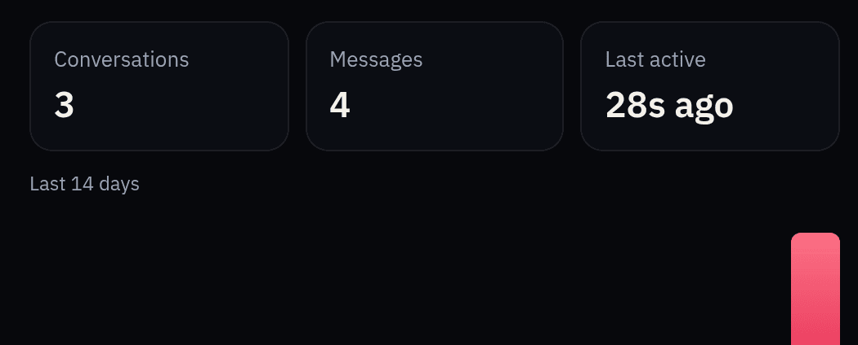
STEP 8 · CHECK ANALYTICS
See who's chatting (analytics tab)
1
2
3
1
Conversations
Separate chats. We had 3.
2
Messages
Questions visitors asked. We had 4.
3
Last active
When someone last chatted.
4
Last 14 days
A bar for each day.
4
What we noticed
Chats in the editor's preview didn't count. The numbers went up only after people chatted on the live pages (Step 9 onward), so give it real traffic before judging.
BotForge · client guide by RegisterMySite
12
Sign up
Sign in
Create
Theme
Train
Test
Voice
Analytics
Deploy
Copy
Paste
Notes:
Step eight is analytics, so you can see whether people are using your bot. You get the number of conversations, the number of messages, when it was last active, and a bar chart for the last 14 days. In our demo that's 3 conversations and 4 messages, and those were real chats we had on the live pages. Here's something we noticed: the test chats we did inside the editor's preview didn't count. The numbers only went up after people chatted on the live bot. So don't panic if it says zero right after testing. It just hasn't seen real visitors yet.

Slide 13
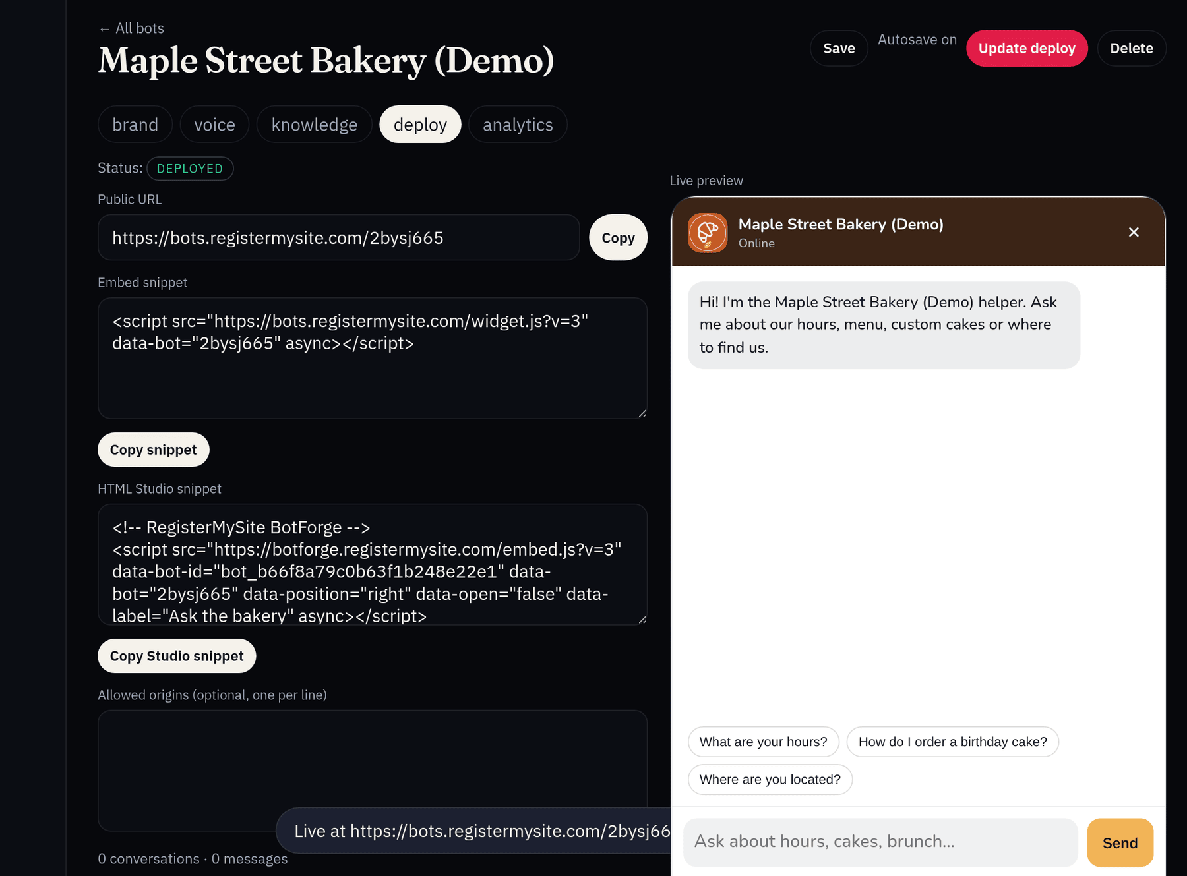

STEP 9 · DEPLOY
One click makes your bot live (deploy tab)
1
1
Click Deploy
Top right. Afterwards it reads "Update deploy". Use that after changes.
2
2
Status: DEPLOYED
It said DRAFT before.
3
3
Your public web address
Ours: bots.registermysite.com/2bysj665
4
"Live at …" message
Confirms it worked. It can hide partly behind the preview.
Share the link, too
bots.registermysite.com/2bysj665 opens the bot on its own full page.
4
BotForge · client guide by RegisterMySite
13
Sign up
Sign in
Create
Theme
Train
Test
Voice
Analytics
Deploy
Copy
Paste
Notes:
Step nine: deploy. Open the deploy tab and click the red Deploy button at the top right. That's it. The status changes from Draft to Deployed, and you get your bot's own public web address. Ours is bots dot registermysite dot com slash 2bysj665. A message pops up saying Live at, then that address. In our test, part of that message hid behind the preview panel, so look closely. After the first deploy the button says Update deploy. Click it any time you change the look or the settings. The small picture at the bottom right is the bot's own page. You can share that link on its own, even before it's on your website. We weren't asked to pay anything to deploy it.

Slide 14
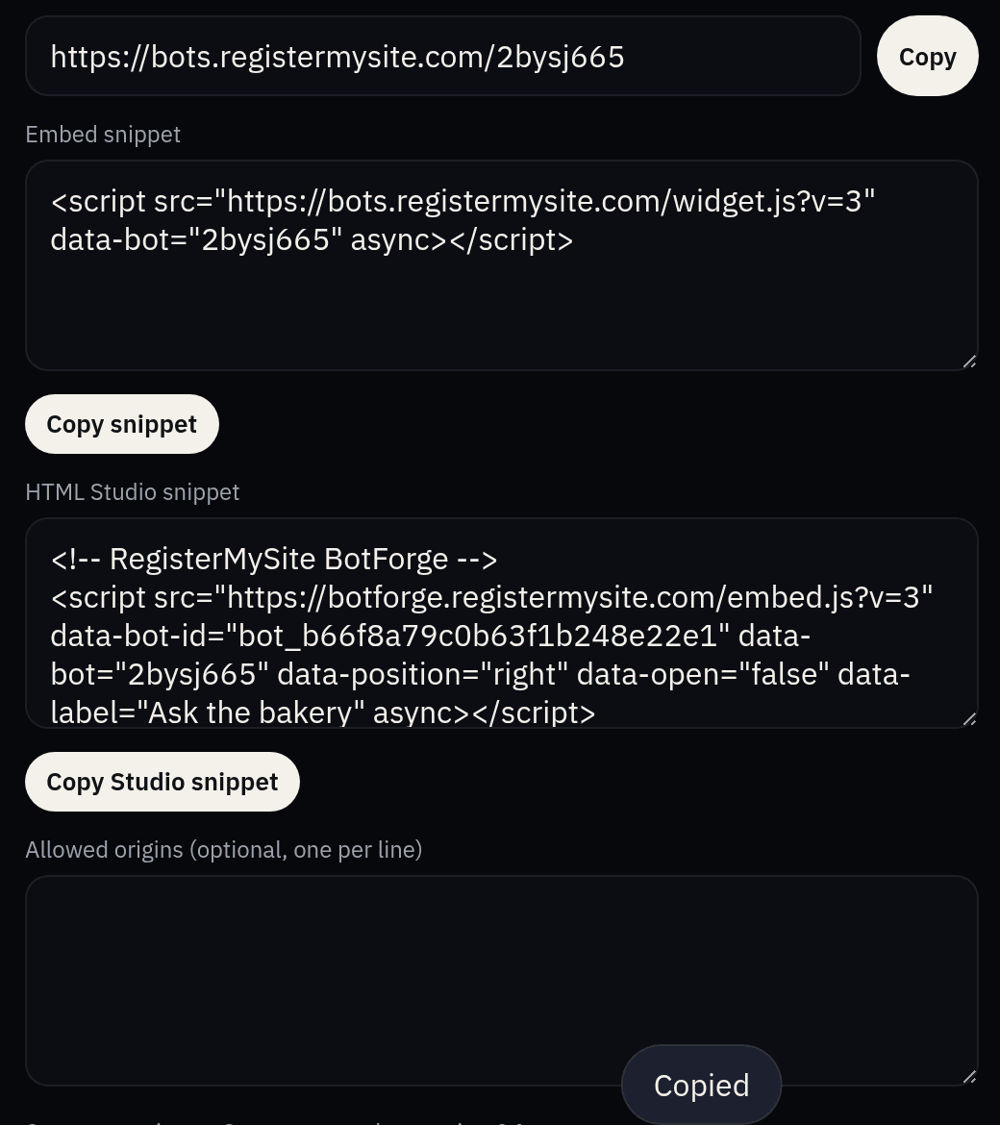
STEP 10 · COPY THE SNIPPET
This one line is your whole installation
OUR EMBED SNIPPET (COPIED)
<script src="https://bots.registermysite.com/widget.js?v=3" data-bot="2bysj665" async></script>
1
2
1
Find "Embed snippet"
On the deploy tab, under the public URL.
2
Click Copy snippet
Or select the text and copy it.
3
Look for "Copied"
Now it's on your clipboard, ready to paste.
Two snippets?
There's also an "HTML Studio snippet". It does the same job with extra settings for our HTML Studio. Either one works.
3
BotForge · client guide by RegisterMySite
14
Sign up
Sign in
Create
Theme
Train
Test
Voice
Analytics
Deploy
Copy
Paste
Notes:
Step ten: copy the snippet. On the deploy tab, under the public address, there's a box called Embed snippet. Click Copy snippet, and you'll see a little Copied message. You've now got the one line of code that puts your bot on any website. It's shown here in full. It points to BotForge and includes your bot's code, 2bysj665 in our case. You might notice a second box called HTML Studio snippet. It does the same job with a few extra settings for our HTML Studio website builder. Either one works, and we'll use the first one next.

Slide 15
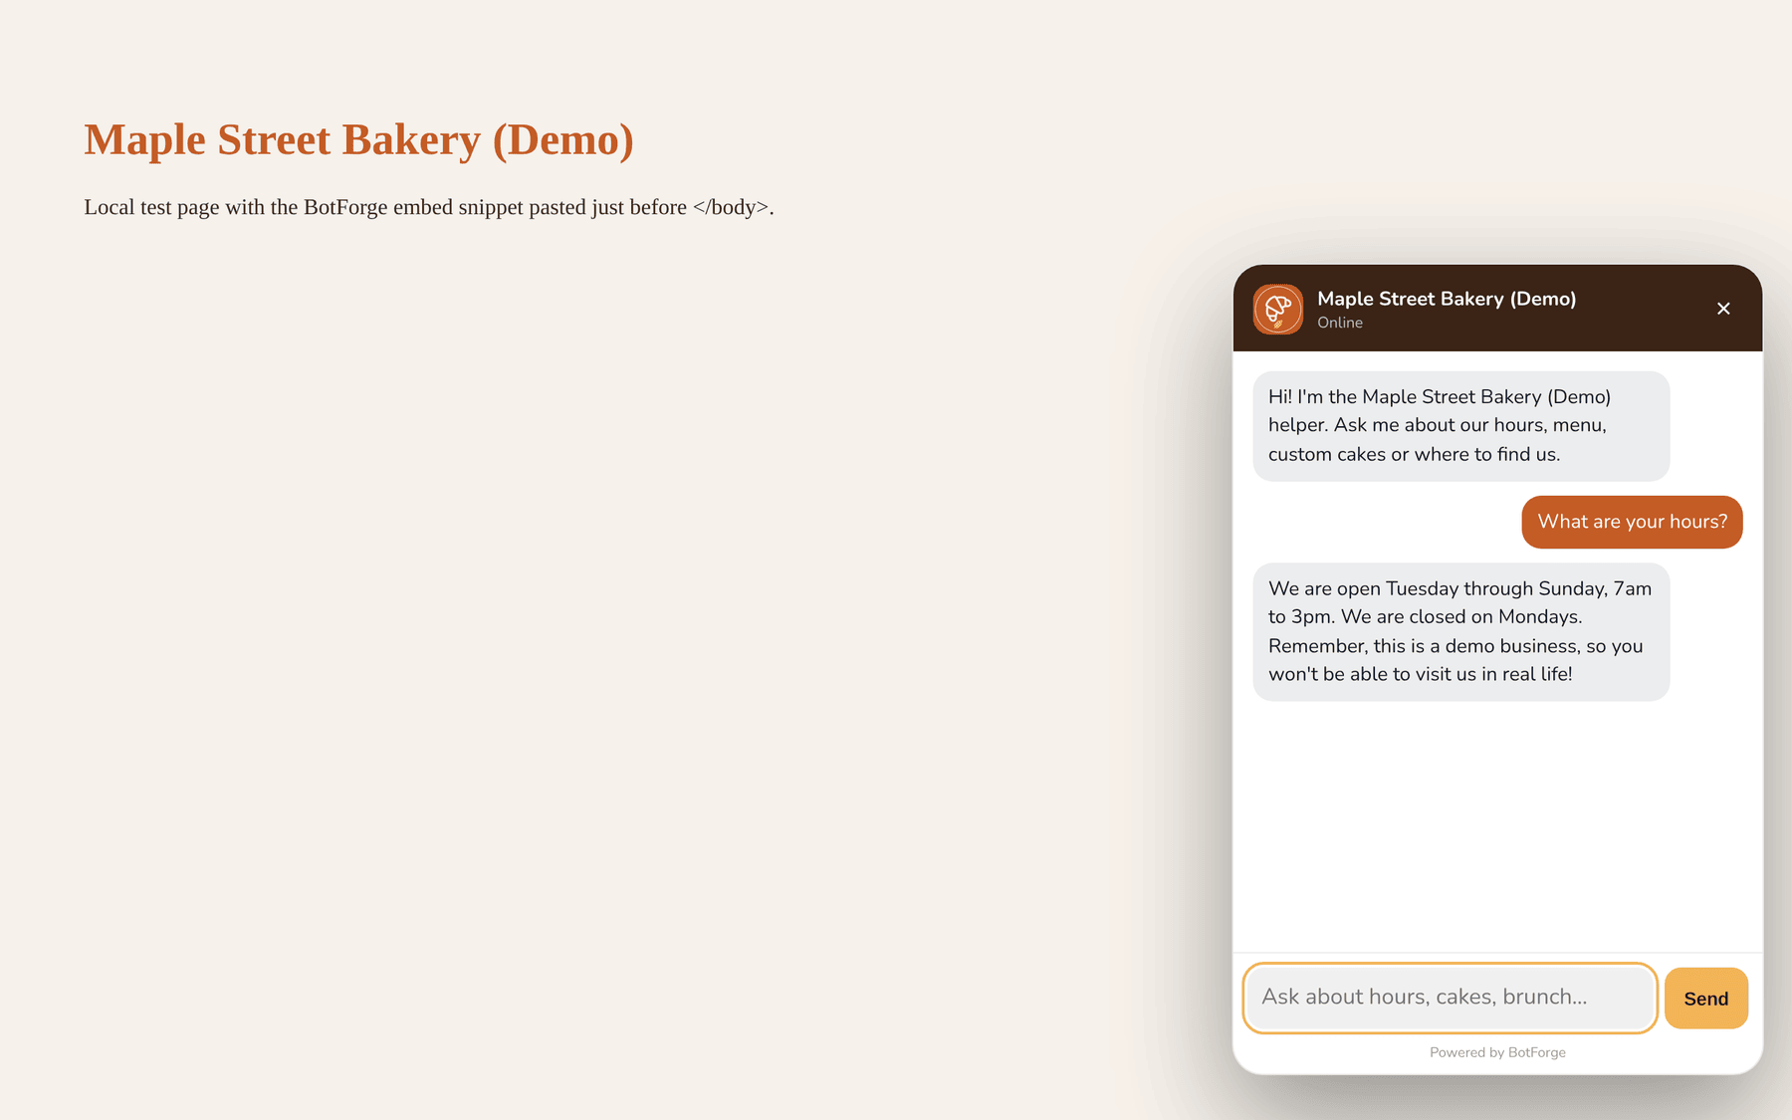
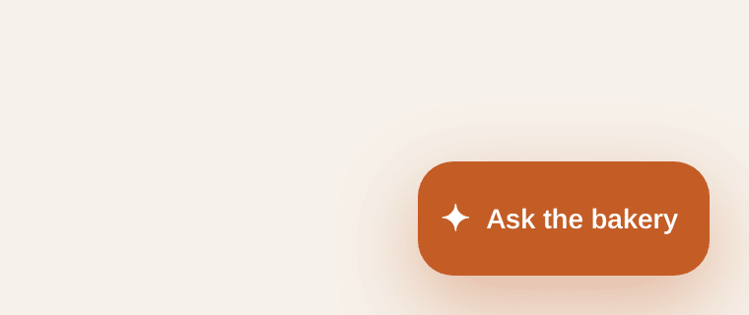
STEP 11 · WHERE TO PASTE IT
Just before </body>, once, and it shows on the page
YOUR WEB PAGE (HTML)
<html>
<head> … </head>
<body>
… your page content …
<script src="https://bots.
registermysite.com/widget.js?v=3"
data-bot="2bysj665" async></script>
</body>
</html>
1
2
Before a click: just the button. Tip: paste it in a shared footer so it shows on every page.
1
Paste right before </body>
Most site builders have a "custom code" or footer box. Paste it there once.
2
Your chat opens on the page
Visitors click your "Ask the bakery" button in the corner, and the chat pops up.
BotForge · client guide by RegisterMySite
15
Sign up
Sign in
Create
Theme
Train
Test
Voice
Analytics
Deploy
Copy
Paste
Notes:
Step eleven: paste it into your website. If you ever see your site's HTML, the snippet goes just before the closing body tag, near the very bottom. If you use a site builder, look for a box called custom code, footer code or embed code, and paste it there. Paste it once in a shared footer and it shows on every page. On the right is a plain test page we made with nothing but a heading and the snippet. See the Ask the bakery button in the corner? Click it and the chat opens, with the same look we set on the brand tab.

Slide 16
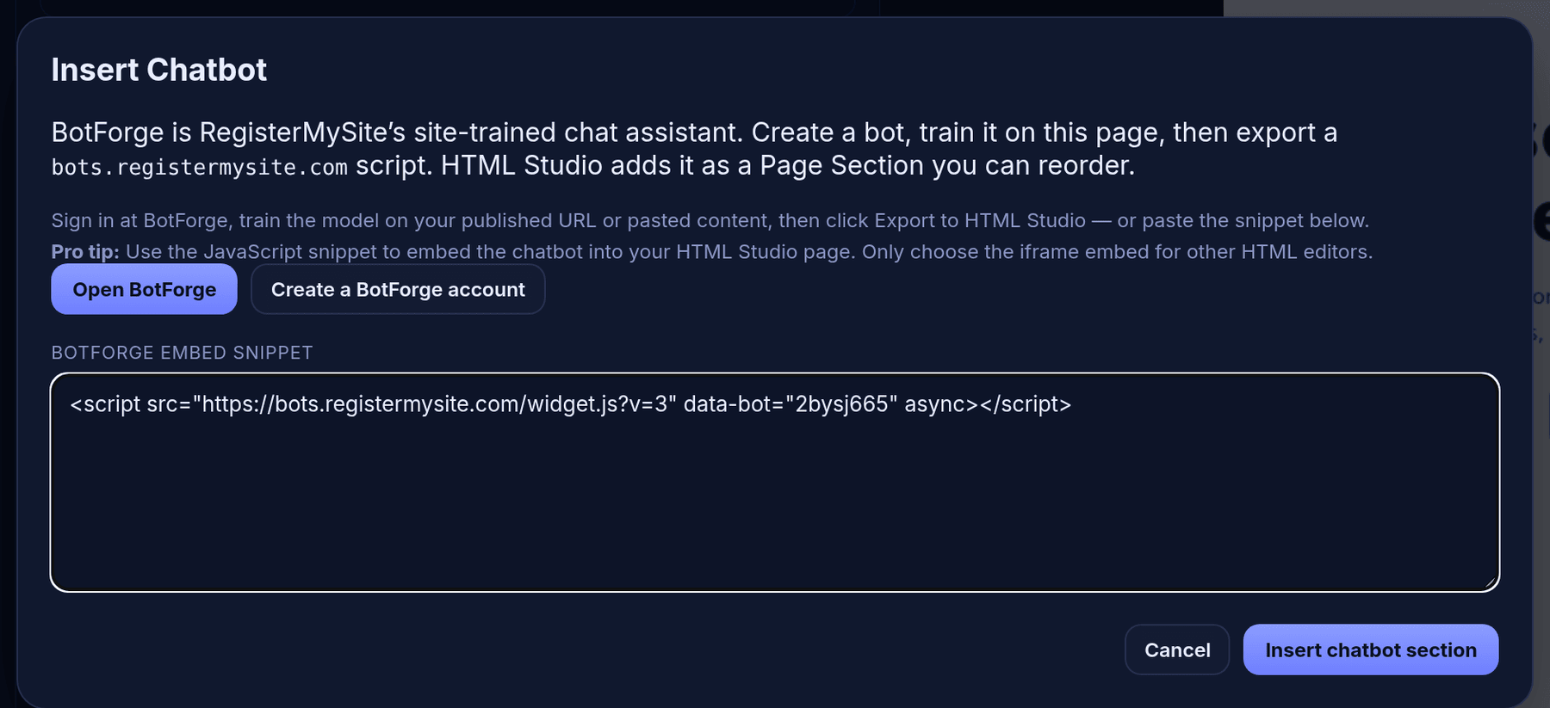
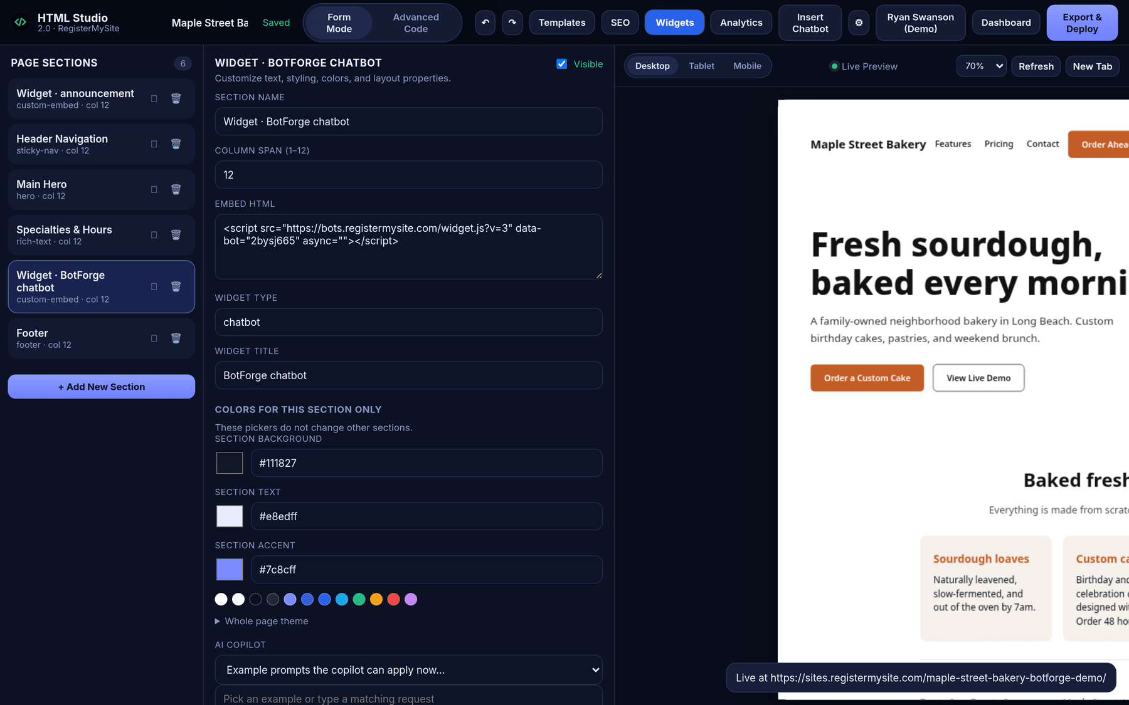
BONUS · ADD IT IN HTML STUDIO
Our website builder has an Insert Chatbot button
1
5
4
2
3
1
Insert Chatbot
3
Insert chatbot section
In the HTML Studio top bar.
It's added to your page sections.
6
2
Paste the snippet
Into "BotForge embed snippet".
4
New section
5
Export & Deploy
"Widget · BotForge chatbot".
Pick a web address, publish.
6
"Live at …"
The page is live, bot included.
BotForge · client guide by RegisterMySite
16
Notes:
If your website is built with our HTML Studio, it's even easier. Click Insert Chatbot in the top bar. A box explains BotForge and has a space for the snippet. Paste it in, and click Insert chatbot section. HTML Studio adds it as a page section called Widget, BotForge chatbot, which you can move around like any other section. Then click Export and Deploy, pick your web address, and publish. We published a new, clearly marked demo page for this guide, and the Live at message confirmed it. There's also an Open BotForge button in that box that connects the two tools, but pasting the snippet is the simplest way.

Slide 17
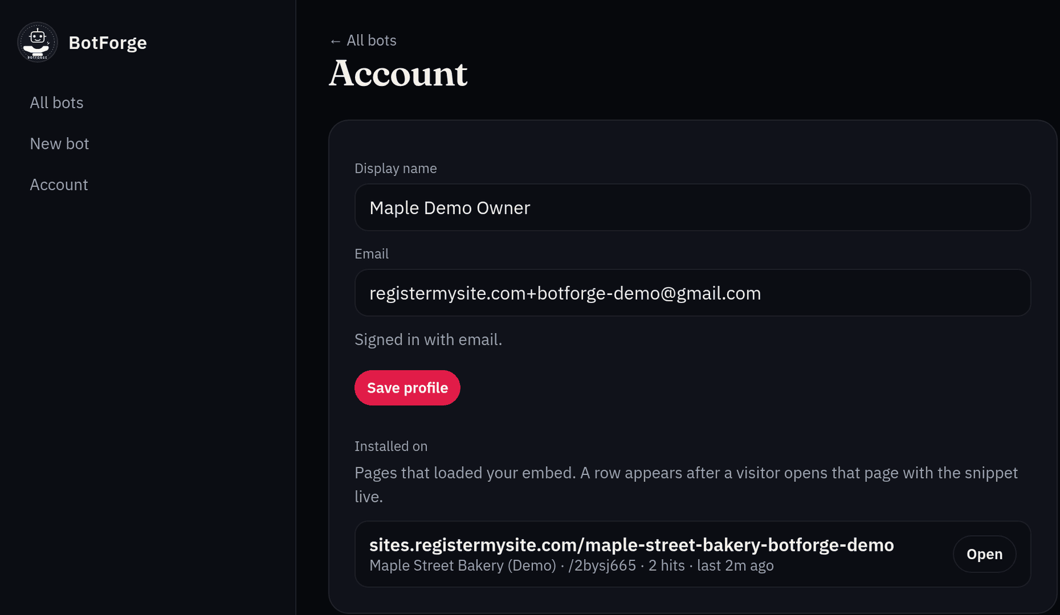
BONUS · ACCOUNT
See where your bot is live
1
Click Account
In the left menu, after you sign in.
2
Find "Installed on"
Pages that loaded your bot show up here.
3
Your live page
1
Ours: sites.registermysite.com/maple-street-bakery-botforge-demo, with the bot name, visit count and last seen.
4
Open
Opens that page so you can see the bot yourself.
2
When does a page show up?
3
4
After someone opens a page with your snippet on it. Your bot's own share page isn't listed, just your websites.
BotForge · client guide by RegisterMySite
17
Notes:
Once your snippet is on a website, BotForge keeps track of where it's running. Click Account in the left menu. Under Installed on, you'll see every page that has loaded your bot. Here's ours: the Maple Street Bakery demo page on HTML Studio, with the bot's name, how many times the page loaded it, and when it was last seen. Those two visits were us opening the page while making this guide. The Open button takes you straight to that page. A page only shows up after someone actually opens it with the snippet live, so if you've just pasted the snippet, open your page once and then refresh Account. Your bot's own share page isn't listed here, only the websites where you pasted it. This is a handy way to check you didn't miss a page, or to spot an old page that still has the bot on it.

Slide 18
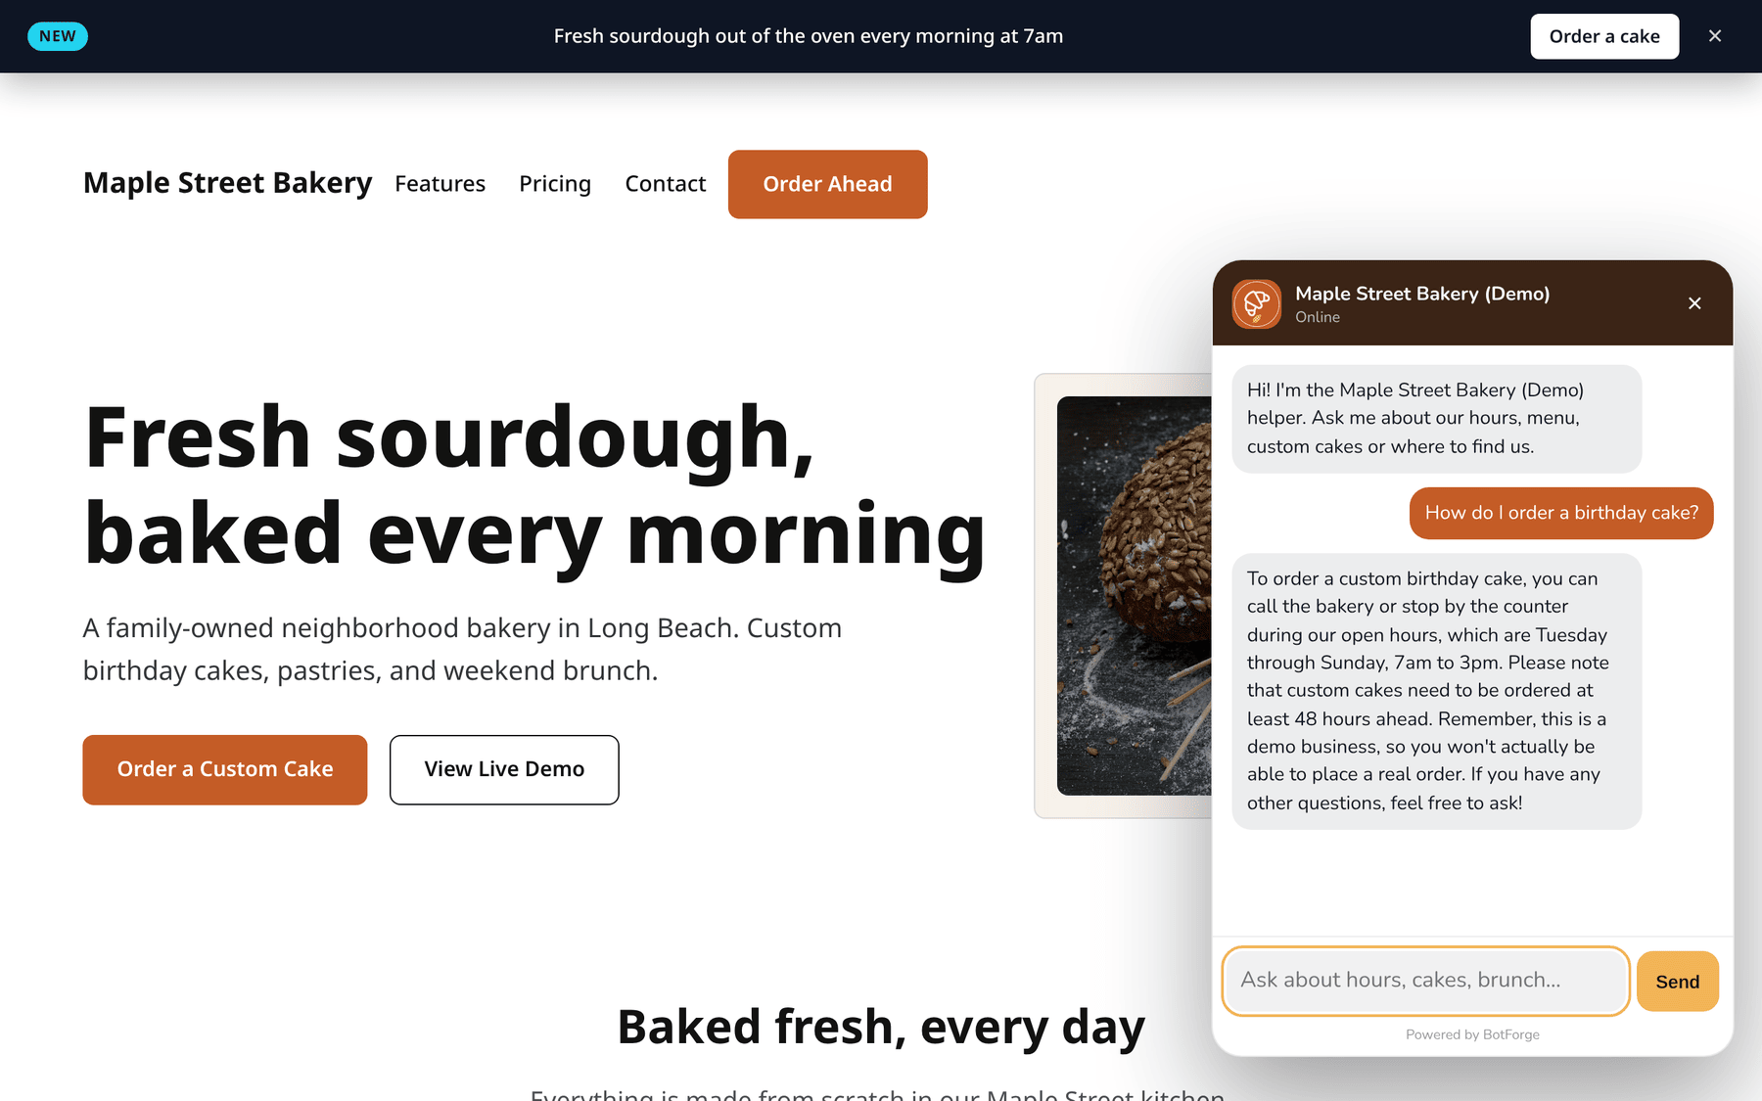



WORKS WITH ANY WEBSITE
Anywhere you can paste HTML, your bot can live
Cloudflare Pages
Paste into your HTML before </body>.
1
Netlify
Same: paste into your HTML files.
GitHub Pages
Any static HTML page works.
Site builders
Any that allow custom HTML or embed code.
Live now: sites.registermysite.com/maple-street-bakery-botforge-demo/
Our demo page on HTML Studio, with the bot answering a real question.
RegisterMySite HTML Studio
Built-in Insert Chatbot button.
BotForge · client guide by RegisterMySite
18
Notes:
Here's the best part. That snippet isn't tied to one company. Any website where you can paste a bit of HTML can run your bot. That includes static hosting like Cloudflare Pages, Netlify and GitHub Pages, and any site builder that lets you add custom HTML or embed code. And of course our own HTML Studio, with its Insert Chatbot button. On the left is our demo bakery page on HTML Studio, live on the internet right now, answering a real question about birthday cakes. The address is on the slide if you'd like to try it yourself.

Slide 19

TROUBLESHOOTING
Real messages we saw, and what to do
"Deploy to mint a slug."
"Live at https://bots.registermysite.com/…"
Shown before your first deploy. Click Deploy and your public address appears.
Good news: it worked. It can hide behind the preview panel, so look closely.
"No live installs seen yet."
"I'm not sure about gluten-free bread options…"
Account page, before any visitor has opened a page with your snippet. Open your live page, then refresh Account.
The bot doesn't have that info. Add it on the knowledge tab.
"Rotating the slug immediately 404s the previous URL and snippet."
Send button hard to read
Its text is always dark. Pick a light accent color on the brand tab.
Only rotate if you must. Then paste the new snippet everywhere.
Still stuck? Call (562) 751-4597 or email info@registermysite.com and we'll take a look with you.
BotForge · client guide by RegisterMySite
19
Notes:
A few things you might run into. These are real messages from our test. Deploy to mint a slug just means you haven't deployed yet, so click Deploy. Live at, followed by the address, is good news, but it can hide behind the preview, so look closely. On the Account page you may see No live installs seen yet. That just means no visitor has opened a page with your snippet since it went live. Open your page once, refresh Account, and it appears under Installed on. If the bot says it's not sure about something, like gluten-free bread, it simply doesn't have that information, so add it on the knowledge tab. The rotate-slug warning means rotating breaks your old snippet, so only do it if you must. And if the Send button is hard to read, choose a lighter accent color.

Slide 20
RECAP
Your chatbot in eleven steps
1
Sign up
Email, password, name
2
Sign in
Same email and password
3
Create
New bot, then name it
4
Theme
Logo, colors, font, label
5
Train
Text, web pages, files
6
Test
Ask real questions
7
Voice
Model, greeting, starters
8
Analytics
Chats and messages
9
Deploy
One click, live
10
Copy
Copy snippet
11
Paste
Before </body> or HTML Studio, then check Account
BotForge · client guide by RegisterMySite
20
Notes:
Let's recap. Sign up with your email, sign in, and create a bot with a name. Theme it with your logo, colors, font and button label. Train it with your text, web pages and files, and test it with real customer questions. Pick its voice: the model, the greeting and the starter questions. Check analytics once real people start chatting. Deploy with one click, copy the snippet, and paste it into your website, just before the closing body tag or with the Insert Chatbot button in HTML Studio. Then open your page once and check the Account section to see it listed. That's the whole thing. Most of the time goes into writing good information for the knowledge tab, and that's time well spent.

Slide 21




BotForge by RegisterMySite
WE'RE HERE TO HELP
Want us to build your bot with you?
TRY THE LIVE DEMO
The bot on its own page
bots.registermysite.com/2bysj665
The bot on a website
registermysite.com
sites.registermysite.com/
maple-street-bakery-botforge-demo/
(562) 751-4597
Build your own
botforge.registermysite.com
info@registermysite.com
Maple Street Bakery (Demo) is a made-up business created for this guide.
In person in LA and OC
BotForge · client guide by RegisterMySite
21
Notes:
That's it from me. If you'd like help, we're happy to build your bot with you, write the knowledge base, and get it onto your website. You can find us at registermysite dot com, call us at 562 751 4597, or email info at registermysite dot com. We also meet in person across LA and Orange County. On the right are the live demo links: the bot on its own page, the bot on a real website, and the BotForge address where you can build your own. Thanks so much for your time. Happy to take any questions.

