Slide 1
HD
Domain search
CLIENT GUIDE
RegisterMySite client guide
REGISTERMYSITE · CLIENT TRAINING
Advanced domain search
WHAT THE PAGE SAYS
Instant Multi-TLD Domain Availability.
Type a keyword or a full domain. The page checks real-time availability and pricing, and shows what you can buy.
A free domain tool, powered by Cloudflare. Real-time availability and pricing via the Cloudflare Registrar API.
Walkthrough on 4 October 2026. Purchase was not clicked. Nothing was bought.
Keyword
Chat
Taken
Other TLD
advanced-domain-search.registermysite.com
1
Guide: https://registermysite.com/guides/advanced-domain-search-guide/ · Tool: https://advanced-domain-search.registermysite.com/
Notes:
Hi, and welcome. This is advanced domain search, at advanced hyphen domain hyphen search dot registermysite dot com. The badge says free domain tool, powered by Cloudflare. The title is Instant Multi hyphen T L D Domain Availability. You type a keyword, or a full domain. The page checks real-time availability and pricing through the Cloudflare Registrar A P I, and it shows what you can buy. We walked the page on the fourth of October, 2026. Purchase was never clicked, and nothing was bought. This guide lives at registermysite dot com, slash guides, slash advanced hyphen domain hyphen search hyphen guide. I'll only describe what these pictures actually show.

Slide 2
HD
Domain search
CLIENT GUIDE
RegisterMySite client guide
FIVE MOVES
The path, in order
Check a keyword. Describe the business in the chat. Read available against taken. If the .com is taken, try another TLD on that same page. Then the domain hack tool, which you still have to verify.
1
Check a keyword
Type it, then press Check Availability.
2
Describe the business
Use the chat. Read the keywords it suggests.
3
Read available vs taken
Green count, red count, then the rows.
4
If the .com is taken
Try another TLD already on that same page.
5
Then Domain Hack
Ideas only. You still have to verify them.
Tip
Purchase was on the available rows in this walk. It was not clicked. Nothing was bought.
2
Order: keyword check, describe the business in the chat, read available versus taken, try another TLD on that same page, then Domain Hack ideas you still verify.
Notes:
Here is the path, before we look at a screen. First, type a keyword and press Check Availability. Second, describe the business in the chat, and read the keywords it suggests. Third, read Available against Taken. Fourth, if a dot com you like says Taken, stay on that same results page. It already lists other endings. That is not a second search. Fifth, Domain Hack is only for ideas. It does not check availability. You come back here to check. Purchase was on the available rows, and we did not click it. Nothing was bought. We'll take the screens one at a time.

Slide 3
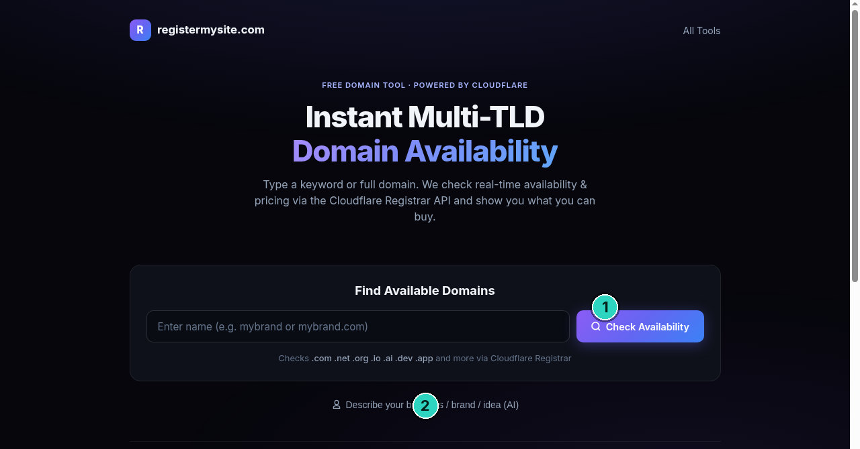
HD
Domain search
CLIENT GUIDE
STEP 1 OF 5 · KEYWORD
SLIDE 3 OF 9
The start screen
The box is still the sample placeholder. Check Availability is on the right. The chat link sits under the card.
Tip
“Enter name (e.g. mybrand or mybrand.com)” is the sample placeholder. Replace it with your own keyword or full domain.
3
“Type a keyword or full domain. We check real-time availability & pricing via the Cloudflare Registrar API and show you what you can buy.”
Notes:
This is the start screen. The header reads registermysite dot com, and All Tools. The title is Instant Multi hyphen T L D Domain Availability. Under it, type a keyword or full domain. The page checks real-time availability and pricing via the Cloudflare Registrar A P I, and shows what you can buy. The card says Find Available Domains. We've marked Check Availability. The box still shows the sample placeholder, enter name, for example mybrand or mybrand dot com. The helper lists dot com, dot net, dot org, dot io, dot ai, dot dev, dot app, and more. We've also marked the chat link. Nothing is typed yet.

Slide 4
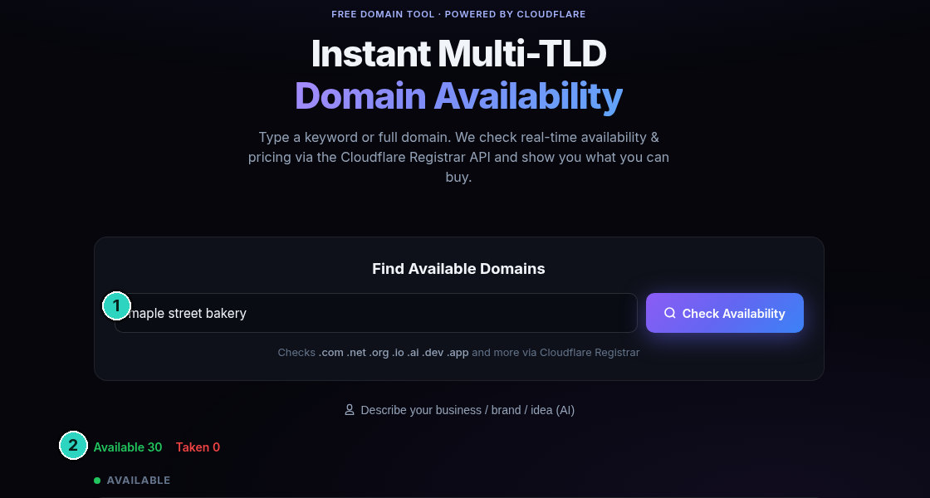
HD
Domain search
CLIENT GUIDE
STEP 1 OF 5 · KEYWORD
SLIDE 4 OF 9
A keyword check
The box says maple street bakery. The page says Available 30 and Taken 0. The names continue below this crop.
Tip
Available 30 is what the page says. This crop does not show all 30 rows, so those names are not listed here.
4
This crop shows Available 30 and Taken 0, then the AVAILABLE heading. The rows continue below, so no domain name or price from that list is printed from this picture.
Notes:
The keyword typed here is maple street bakery. Then Check Availability. We've marked the words in the box, and the counts. The page says Available 30, in green, and Taken 0, in red. Under that, the heading is AVAILABLE. This picture is only the top of the results. The list continues below the fold, so this image does not show the names, and it does not show the prices. We will not invent a name that is not on the crop. The next picture is scrolled further, and it is the first place a name from this check is readable. Purchase is not on this crop, because the rows themselves are below it.

Slide 5
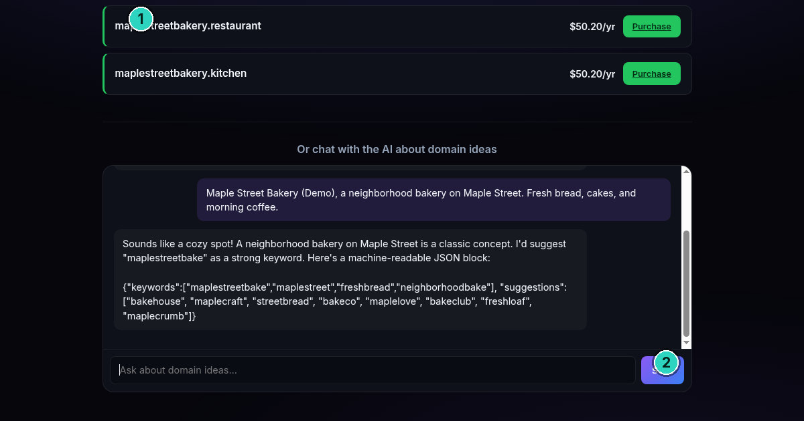
HD
Domain search
CLIENT GUIDE
STEP 2 OF 5 · CHAT
SLIDE 5 OF 9
Ideas from the chat
Two rows are still on screen above the chat. The reply suggests maplestreetbake, then a short list of keywords.
Tip
These keywords came from the chat after Send. Purchase on the two rows above was not clicked.
5
Visible rows: maplestreetbakery.restaurant $50.20/yr and maplestreetbakery.kitchen $50.20/yr, each with Purchase. Keywords: maplestreetbake, maplestreet, freshbread, neighborhoodbake. Suggestions: bakehouse, maplecraft, streetbread, bakeco, maplelove, bakeclub, freshloaf, maplecrumb.
Notes:
This picture is scrolled. Above the chat, two rows are readable, and we've marked the first. maplestreetbakery dot restaurant, 50 dollars and 20 cents a year, with Purchase. maplestreetbakery dot kitchen is the same price, also with Purchase. Those are the only keyword names these pictures show. The message describes Maple Street Bakery, Demo, a neighborhood bakery on Maple Street. The reply calls it a cozy spot, and suggests maplestreetbake as a strong keyword. Keywords are maplestreetbake, maplestreet, freshbread, and neighborhoodbake. The suggestions run from bakehouse to maplecrumb, and they are written on the slide. We've marked Send. Purchase was not clicked.

Slide 6
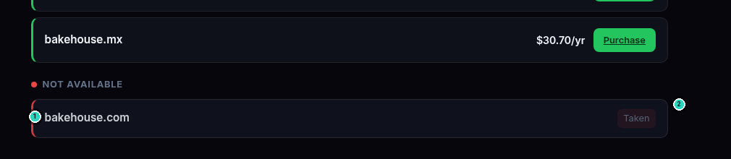
HD
Domain search
CLIENT GUIDE
STEP 3 OF 5 · TAKEN
SLIDE 6 OF 9
bakehouse.com is taken
The search was bakehouse.com. This crop is the bottom of that same results page. The dot com says Taken.
!
Warning
bakehouse.com says Taken. A Taken row is not for sale on this page. Do not click it.
6
NOT AVAILABLE. bakehouse.com — Taken. Still in this crop, just above it: bakehouse.mx $30.70/yr with Purchase. Purchase was not clicked.
Notes:
The exact search was bakehouse dot com. This crop is the bottom of that same results page, not a new search. We've marked the name, and the Taken pill. The label says NOT AVAILABLE. bakehouse dot com is Taken. Just above it, bakehouse dot m x is still in the picture, at 30 dollars and 70 cents a year, with Purchase. We did not click Purchase, and we did not click Taken. A Taken row is not for sale here. The rows above are other endings from the same check. The count for this search sits above this crop, so it is not printed.

Slide 7
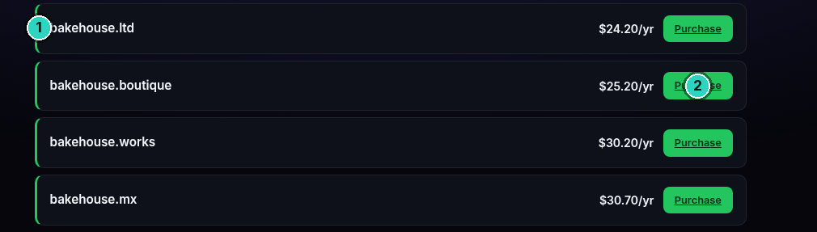
HD
Domain search
CLIENT GUIDE
STEP 4 OF 5 · OTHER TLD
SLIDE 7 OF 9
Other TLDs, same page
These four names sit above the Taken row. Same search. Same page. Each one has a price and Purchase.
Tip
Same search, same page. If the .com is Taken, read the other TLDs already listed above it.
7
Same page: bakehouse.ltd $24.20/yr, bakehouse.boutique $25.20/yr, bakehouse.works $30.20/yr, bakehouse.mx $30.70/yr. Each shows Purchase. No renew price is visible on these rows.
Notes:
These four rows sit on that same bakehouse dot com results page, above the Taken row. This is not a second search. We've marked the first name. bakehouse dot l t d is 24 dollars and 20 cents a year. bakehouse dot boutique is 25 dollars and 20 cents a year. bakehouse dot works is 30 dollars and 20 cents a year. bakehouse dot m x is 30 dollars and 70 cents a year. Each available row shows Purchase. We did not click it. No renew price is on these rows. Names higher up are not in this crop, so they are not listed. If a dot com is taken, this same search already lists other endings.

Slide 8
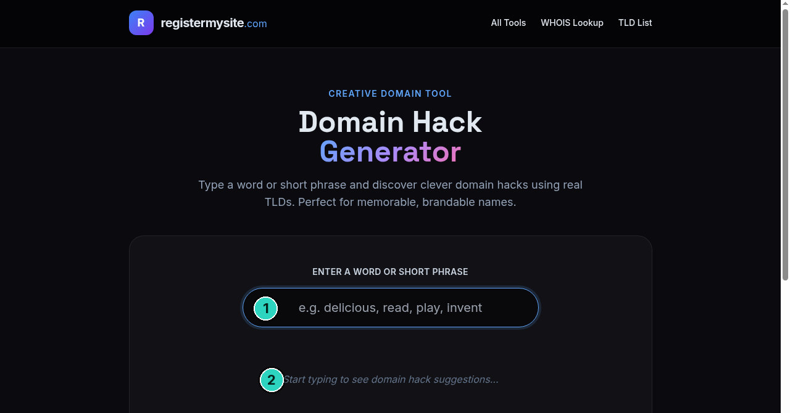
HD
Domain search
CLIENT GUIDE
STEP 5 OF 5 · VERIFY
SLIDE 8 OF 9
Domain Hack generator
A pro tip for ideas only. The field is empty. This tool does not check whether a hack is free.
!
Warning
Domain Hack suggests names only. It does not check availability. Check any hack in advanced domain search before you rely on it.
8
https://registermysite.com/tools/Domain_Hack — field still shows “e.g. delicious, read, play, invent”. Nothing was typed. “Start typing to see domain hack suggestions...”
Notes:
Pro tip, on a different page. registermysite dot com, slash tools, slash Domain underscore Hack. The header shows All Tools, WHOIS Lookup, and T L D List. The title is Domain Hack Generator. It says, type a word or short phrase and discover clever domain hacks using real T L Ds. The label says, enter a word or short phrase. The field still shows the example, delicious, read, play, invent. Under it, start typing to see domain hack suggestions. Nothing was typed. We've marked the field and that line. Warning. This page suggests hacks only. It does not check availability. Check any name back in advanced domain search.

Slide 9
HD
Domain search
CLIENT GUIDE
RegisterMySite client guide
REGISTERMYSITE
Contact
If you want a hand checking a name, or reading a Taken row, start here.
WEB
THE TOOL
registermysite.com
advanced-domain-search.registermysite.com
PHONE
(562) 751-4597
Domain Hack, for ideas only: registermysite.com/tools/Domain_Hack. It does not check availability.
EMAIL
info@registermysite.com
IN PERSON
Los Angeles and Orange County
9
registermysite.com · (562) 751-4597 · info@registermysite.com · in person in Los Angeles and Orange County.
Notes:
If you would like a hand with a search, reach us at registermysite dot com. Call 562, 751, 4597. Or email info at registermysite dot com. We also meet in person in Los Angeles and Orange County. Those are the details on the slide. The tool stays at advanced hyphen domain hyphen search dot registermysite dot com. Domain Hack stays at registermysite dot com, slash tools, slash Domain underscore Hack, and it still does not check availability. This guide stays at registermysite dot com, slash guides, slash advanced hyphen domain hyphen search hyphen guide. Download the PowerPoint or the P D F from More. Thanks for following the walkthrough.

